Slide 1
Innovative Assessment
Professional Development Series
Session 4: Understanding Item Types:
Synthesis
November 2023
Notes:
Time needed for the session:
2 hours
Needed materials for session:
Copies of the Innovative Assessment Assessment Guide document
Copies of the Innovative Assessment Score Report Guidance document
Copies of the Session 4: Understanding Item Types: Synthesis Essay Participant Guide
Chart paper from Session 3: Understanding Item Types: Multiple Choice and Constructed Response
Charged laptops for participants
Notes for facilitators and presenters:
The text referenced in the session has copyright protections that require it be accessed through a password-protected site. It is available in the ADAM system. If you do not have an ADAM account, please ask your school test coordinator for assistance. Participants will get the most out of this session when they’ve had time to read and annotate the text prior to the session. Also, it is highly recommended that participants engage in Session 3 before Session 4.
Facilitator says: Welcome to the Innovative Assessment Professional Learning Series. The Louisiana Department of Education is committed to developing the Innovative Assessment Program in partnership with Louisiana schools and school systems. As part of that commitment, LDOE and partner systems have developed this professional learning series. My name is Emily Howell, and I am the ELA Facilitator for Lincoln Parish Schools. This is Session 4: Understanding Item Types: Synthesis

Slide 2
Professional Learning Series
Understanding the IAP | The IAP Items | Using IAP Data
Introduction to the Innovative Assessment Understanding Grade-Level Standards | Selected-Response and Constructed Response Synthesis Essay | Understanding The Score Reports Using The Classroom Questions Guide Using CSV Files for In Depth Analysis
Please contact Ruth.Caillouet@la.gov
Kathleen.Judy@la.gov
Notes:
Duration: 1 minute
Facilitator says: This session is part of a larger professional learning series designed to help school systems with implementation of the IAP. For any questions about the IAP, please contact Ruth Caillouet, Innovative Assessment Program Coordinator or Kathy Judy, Supervisor of Assessment Content, English Language Arts.

Slide 3
Objectives
Participant Guide
p. 1
Participants will
use pp. 11-12, 20-32 of the IAP Score Report Guidance document to engage in a scoring activity for the synthesis essay.
We will use the Participant Guide as a note catcher along the way.
Notes:
Duration: 30 seconds
Facilitator says: During Session 3, we took a deep dive into the selected-response questions and the constructed response item. Over the course of our session today, we will be working with ideas from the same texts as we dig into the synthesis essay. During this session, we will use three handouts: the Participant Guide, the IAP Assessment Guide, and the IAP Score Report Guidance document, all of which are linked in the speaker’s notes of slide one of this deck. Please be aware that there may be more current documents released since the time of this recording. Keep in mind that it will be essential to read and annotate the passages from The Heretic’s Daughter, which is a passage that was featured on a field test for the Innovative Assessment, prior to these activities. Over the course of our session today, we will be working with ideas from those passages in order to better understand both the selected-response and the constructed response items on the IAP. Take a moment to preview the objectives for this session.
Facilitator does: Provide wait time for participants to preview objectives. Then read the objectives from the slide.
Copies of the Innovative Assessment Assessment Guide document
Copies of the Innovative Assessment Score Report Guidance document
Copies of the Session 4: Understanding Item Types: Synthesis Essay Participant Guide
Chart paper from Session 3: Understanding Item Types: Multiple Choice and Constructed Response
Charged laptops for participants

Slide 4
Agenda
Agenda Items
1. Let’s Set the Context
2. Writing Prompt
3. Scoring Rubric
4. Let’s Set the Context
5. Scoring Activity
Notes:
Duration: 30 seconds
Facilitator says: Let’s take a look at our agenda for this session. First, we will review some Let’s Set the Context information from our previous session.

Slide 5
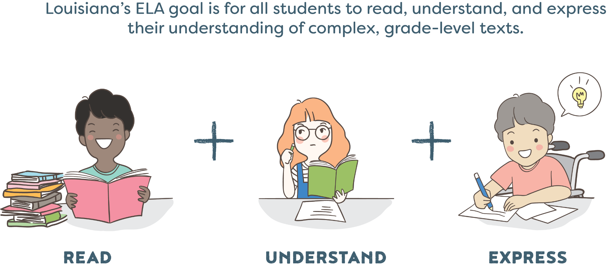
Louisiana’s ELA Goal
Notes:
Duration: 30 seconds
Facilitator says: We always begin with our ELA Goal for all students to read, understand, and express their understanding of complex, grade-level texts.

Slide 6

Let’s Set the Context
Notes:
Duration: 10 minutes
Facilitator says: As a reminder from Session 3, the samples that we are about to examine are based on The Witch of Blackbird Pond Guidebooks unit and were field test items for the Innovative Assessment Program. Because only a small number of students participated in the field-testing of the Grade 6 The Witch of Blackbird Pond unit, we were not able to use this unit assessment operationally. However, this allows us to release some of the writing prompts that were administered during the field test and the sample student responses from that particular test form. When reviewing the materials, please keep in mind that the samples are from grade 6 and were featured on a field test. For our time today, we will be using these items, student responses, and the unit as a whole as an example to guide our participant experientials over the course of the session. At this time, review the information about the sample unit that is provided for you on the screen.
Participant look-fors:
Big Ideas of the Unit
Puritans
America
Person
Identity
Family
Religion
Race
Class
Society
Choices

Slide 7
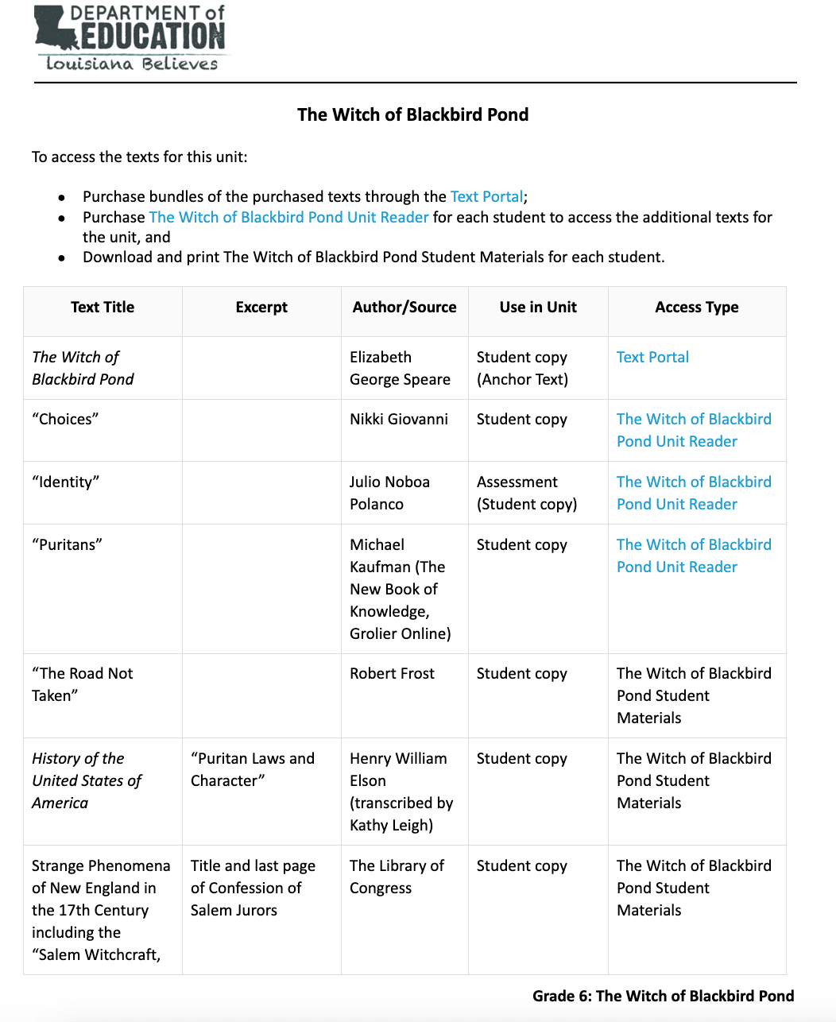
Notes:
Duration: 2 minutes
Facilitator says: As a reminder from Session 3, a key component of the Innovative Assessment is that students are being assessed on a unit that they engaged with in class. Conceptual coherence is a key foundation of Guidebooks design. In all of the Guidebook units, concepts and ideas are explored through a coherent text set of both literary and informational texts. Take 2 minutes to review the sample text set for The Witch of Blackbird Pond.

Slide 8
Agenda
Agenda Items
1. Let’s Set the Context
2. Writing Prompt
3. Scoring Rubric
4. Let’s Set the Context
5. Scoring Activity
Notes:
Duration: 30 seconds
Facilitator says: Now that we’ve reviewed the Let’s Set the Context information from Session 3, we will spend time studying the writing prompt.

Slide 9
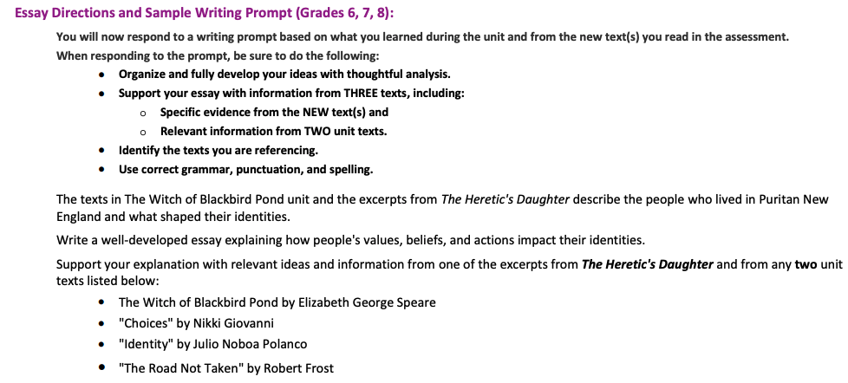
Writing Prompt
Assessment Guide
p. 19
Notes:
Duration: 2 minutes
Facilitator says: Keep in mind that the the second section of the IAP consists of a single essay question that requires students to use the knowledge that they have built form texts in the ELA Guidebooks unit and the new text(s) in Section 1 of the assessment in order to analyze and synthesize concepts across texts. In order to demonstrate synthesis and and expression of knowledge across texts, students are asked to include relevant information from three texts in their written responses, including specific evidence from the new text. Take 2 minutes to read the writing prompt on page 19 of the IAP Assessment Guide. Consider the following question: what connection can you make between the writing prompt and the big ideas in the unit overview?
Facilitator does: Provide a minute of independent review time. Then have participants share their observations (what do they notice and wonder) with a partner. Afterwards, invite participants to share their observations with the group.
Participant look-fors:
The texts in The Witch of Blackbird Pond unit and the excerpts from The Heretic's Daughter describe the people who lived in Puritan New England and what shaped their identities. Write a well-developed essay explaining how people's values, beliefs, and actions impact their identities.
The connection between the IAP writing prompt about how people's identities are impacted by their values, beliefs, and actions and the Culminating Writing Task prompt about Kit's loyalty in The Witch of Blackbird Pond is the theme of identity and its relationship with values and actions.
In the IAP writing prompt, students are asked to explain how individuals' identities are shaped by their values, beliefs, and actions. This requires an analysis of how characters in The Witch of Blackbird Pond and the excerpts from The Heretic's Daughter are influenced by these factors. It is a broader and more general prompt focusing on the thematic exploration of identity in literature.
In the Culminating Writing Task prompt, students are specifically asked to determine to whom Kit is most loyal in The Witch of Blackbird Pond and to support their claim with evidence. Kit's loyalty and her shifts in loyalty are closely tied to her values, beliefs, and actions, which are central to her identity. This prompt delves into Kit's personal journey and transformation within the context of her values and actions, as well as societal values and religious beliefs.
Both prompts, therefore, share the common theme of identity and its connection to values, beliefs, and actions. While the IAP writing prompt invites a broader exploration of this theme across different characters and texts, the CWT prompt focuses on Kit as a specific character and her loyalty, within the same thematic context. Students are expected to analyze identity, values, beliefs, and actions in their responses to both prompts.

Slide 10
Writing Prompt
Assessment Guide
p. 19
Participant Guide
p. 1
Notes:
Duration: 2 minutes
Facilitator says: At this time, read the information about the sample unit that is provided for you on the screen and that can be found on page 19 of the Assessment Guide. With your table partners, circle all of the nouns that you see in the writing prompt. Then, consider the following questions with your group:
What are the ideas present in this prompt?
What are the demands of this prompt?
What do students need to be mindful of?
Facilitator does: Provide wait time for participants to talk with shoulder partners. Circulate throughout the participants to listen to the conversations that are happening. Choose a few participants to share out whole group. As participants share, write the nouns on a sheet of chart paper that is entitled “Abstract Nouns/Thematic Topics.” Have participants take notes on page 1 of the Participant Guide.
Participant look-fors:
What are the ideas present in this prompt?
People
New England
Identities
Values
Beliefs
Actions
What are the demands of this prompt?
RL.6.1: Cite textual evidence to support analysis of what the text says explicitly as well as inferences drawn from the text.
RL.6.2: Determine a theme or central idea of a text and how it is conveyed through particular details; provide a summary of the text distinct from personal opinions or judgments.
RL.6.3: Describe how a particular story's or drama's plot unfolds in a series of episodes, as well as how the characters respond or change as the plot moves toward a resolution.
W.6.1: Write arguments to support claims with clear reasons and relevant evidence.
W.6.4: Produce clear and coherent writing in which the development, organization, and style are appropriate to task, purpose, and audience.
W.6.9: Draw evidence from literary or informational texts to support analysis, reflection, and research.
These standards emphasize the need for students to analyze texts, determine themes, cite evidence, and write clear and coherent arguments based on textual support. The prompt aligns with these standards by requiring students to analyze the impact of values, beliefs, and actions on identity, using evidence from the provided texts to construct a well-developed essay.
What do students need to be mindful of?
Students will need to be sure to use the new text provided by the prompt AND two unit texts.

Slide 11
Agenda
Agenda Items
1. Let’s Set the Context
2. Writing Prompt
3. Scoring Rubric
4. Let’s Set the Context
5. Scoring Activity
Please contact name@la.gov
¹Author's Last name, First Initial. (Year). Book title [format of book]. Publisher. URL
Notes:
Duration: 30 seconds
Facilitator says: Now that we’ve explored the writing prompt, we will take a deep dive into the scoring rubric for the synthesis essay.

Slide 12
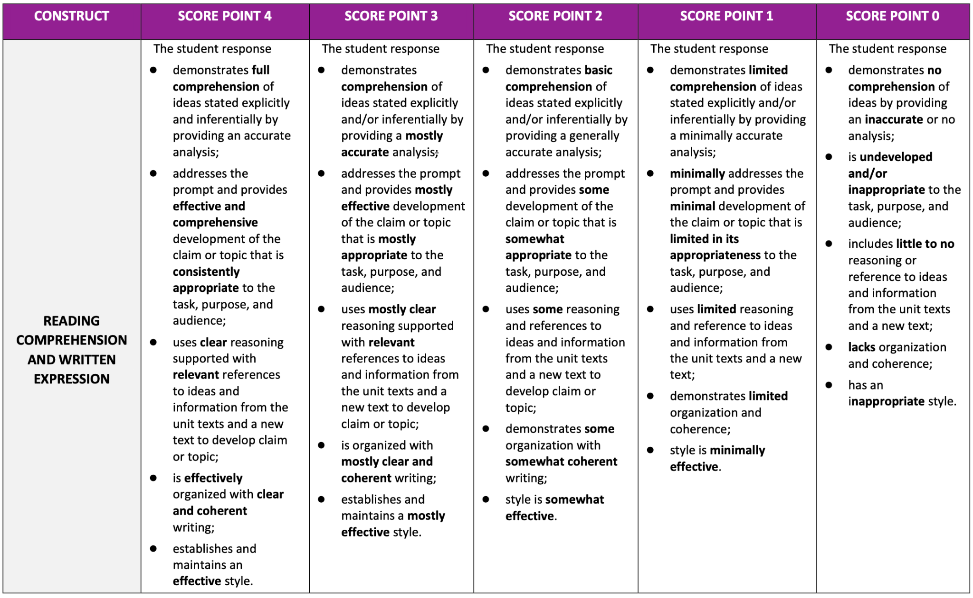
Scoring Rubric
IAP Score
Report Guidance
pp. 21-22
Notes:
Duration: 10 minutes
Facilitator says: The responses to the writing prompt are scored for two dimensions: Reading Comprehension and Written Expression (RCWE) and Knowledge and Use of Language Conventions (LC). The RCWE scores range from 0 to 4 points, and the holistic score is doubled for a total of up to 8 points for that dimension. The LC scores range from 0 to 3 points for a total of up to three points. The rubric that follows includes both dimensions, but the student samples provided for the writing prompt show scores for RCWE only since this is the area of most concern and requires the most intensive instruction. As the LDOE continues to build out the student work samples, they will add annotations for the LC dimension. Take 5 minutes to read the writing prompt rubric found on pages 21-22 of the IAP Report Guidance document.
Facilitator does:
Give participants time to read the rubric.
Facilitator says: Now that you’ve read the rubric, pay close attention to the words that are bolded. What do you notice about progression of language from score to score?
Facilitator does: Provide wait time for participants to talk with shoulder partners. Circulate throughout the participants to listen to the conversations that are happening. Choose a few participants to share out whole group.
Participant look-fors:
Think about the progression of the elements in the rubric. It starts with understanding of the text and the task, then it moves to development, evidence, analysis, followed by organization and finally to style. If students can’t understand what they read, they can’t write about it. If they don’t understand the task, they can’t show their understanding. Therefore, focusing on the later elements, like organization and style, can wait until these more critical elements are addressed.)
Stronger responses are rooted in deeper analysis and selection of evidence. Think about where students have shown insights and included analysis beyond the text evidence (extensions, connections, the right evidence). Notice the use of the term “effective” over and over at the highest score point and mostly effective at the 3 (a little less insight, but still has analysis and reasoning supported by relevant evidence).
As we move across the rubric, notice the words that dominate each of the lower score points. The language of the 2 score point: basic understanding and some, some, somewhat. The student is on the right track, but the evidence is often thin and the reasoning not sharp. However, these students get it, so moving them to a higher score point is usually about taking advantage of missed opportunities in their writing, which usually has to do with development; they need better or more evidence, more analysis that goes beyond the evidence.
The repeated language of the 1s: limited, minimal, even when addressing the task. Many of the strategies in the guidance are aimed at supporting these students: starting small, with opportunities to help them address the task and show understanding.
The language of the zero is often negative: no comprehension, undeveloped or inappropriate, little to no. Often the issue comes from the first part of the prompt: inaccurate or no analysis and not on task.

Slide 13
Agenda
Agenda Items
1. Let’s Set the Context
2. Writing Prompt
3. Scoring Rubric
4. Let’s Set the Context
5. Scoring Activity
Notes:
Duration: 30 seconds
Facilitator says: Before engaging in the scoring activity, we will build some quick context in order to more deeply understand the texts students wrote in response to.

Slide 14
Participant Guide
p. 2
Text Title | Author/Source
The Witch of Blackbird Pond | Elizabeth George Speare
“Choices” | Nikki Giovanni
“Identity” | Julio Noboa Polanco
“Puritans” | Michael Kaufman (The New Book of Knowledge, Grolier Online)
“The Road Not Taken” | Robert Frost
History of the United States of America from “Puritan Laws and Character” | Henry William Elson (transcribed by Kathy Leigh)
Strange Phenomena of New England in the 17th Century including the “Salem Witchcraft, 1692,” from the writing of Cotton Mather, New York, 1846 from Title and last page of Confession of Salem Jurors | The Library of Congress
Salem Witch Trials from “The Story of the Witch Hunt” (Video) | Discovery Education
Notes:
Duration: 2 minutes
Facilitator says: You’ve already reviewed the text set for The Witch of Blackbird Pond in session 3. With this knowledge in mind, review the writing prompt on page 19 of the Assessment Guide document once again. Consider the following questions with your group:
What do you notice about the texts chosen for the writing prompt?
What connections do these texts have to the big ideas of the unit and prompt?
Facilitator does: Provide wait time for participants to talk with shoulder partners. Circulate throughout the participants to listen to the conversations that are happening. Choose a few participants to share out whole group. Have participants write their reflections on page 2 of the Participant Guide.
Participant look-fors:
What do you notice about the texts chosen for the writing prompt?
Common Theme of Identity: All the texts, including the excerpts from "The Heretic's Daughter" and the unit texts, revolve around the theme of identity. They explore how individuals in Puritan New England define themselves based on their values, beliefs, and actions.
Historical Setting: The texts are set in Puritan New England, a historical context that greatly influences the characters' values and beliefs. The Puritan society and its rigid norms play a significant role in shaping the characters' identities.
Diverse Text Types: The texts encompass various types, including a historical novel (The Witch of Blackbird Pond), poems ("Choices" and "Identity"), and a poem ("The Road Not Taken"). This diversity allows for a multidimensional exploration of identity through different literary forms.
Relevant Ideas and Information: The texts chosen provide relevant ideas and information about how the characters' values, beliefs, and actions impact their identities. This information serves as the basis for students to craft a well-developed essay that delves into these themes.
Interdisciplinary Approach: The inclusion of poems and a historical novel demonstrates an interdisciplinary approach, which enriches the exploration of identity by combining literature and history.
Overall, the texts are thoughtfully selected to provide a comprehensive examination of identity and its relationship with values, beliefs, and actions in the context of Puritan New England. Students are encouraged to draw connections and insights from these various texts to construct a well-developed essay that explores this central theme.
What connections do these texts have to the big ideas of the unit and prompt?
The selected texts for the unit and the essay prompt are closely tied to the core themes of people, New England, identities, values, beliefs, and actions. These texts illuminate the lives of individuals in Puritan New England, revealing how their values and beliefs drive their actions and influence their identities. The characters' responses to societal norms and personal dilemmas are central to these narratives, showcasing the interconnectedness of these key themes.

Slide 15
Let’s Set the Context
Participant Guide
p. 2
IAP Score
Report Guidance
pp. 22-25
At this time,
use your device to find digital access to the texts listed in the writing prompt, and read each text;
take notes on your page 2 Participant Guide as you look for the big ideas that we identified in the beginning of the session.
Notes:
Duration: 20 minutes
Facilitator says: Turn to page 2 of your Participant Guide. Take 10 minutes to read the poems. Be sure to annotate for the big ideas that we identified at the beginning of the session. Then, share your thoughts with your group.
Facilitator does: Provide wait time for participants to talk with shoulder partners. Circulate throughout the participants to listen to the conversations that are happening. Choose a few participants to share out whole group.
Note for facilitators:
See pp. 22-25 of the IAP Score Report Guidance document for notes on these texts.

Slide 16
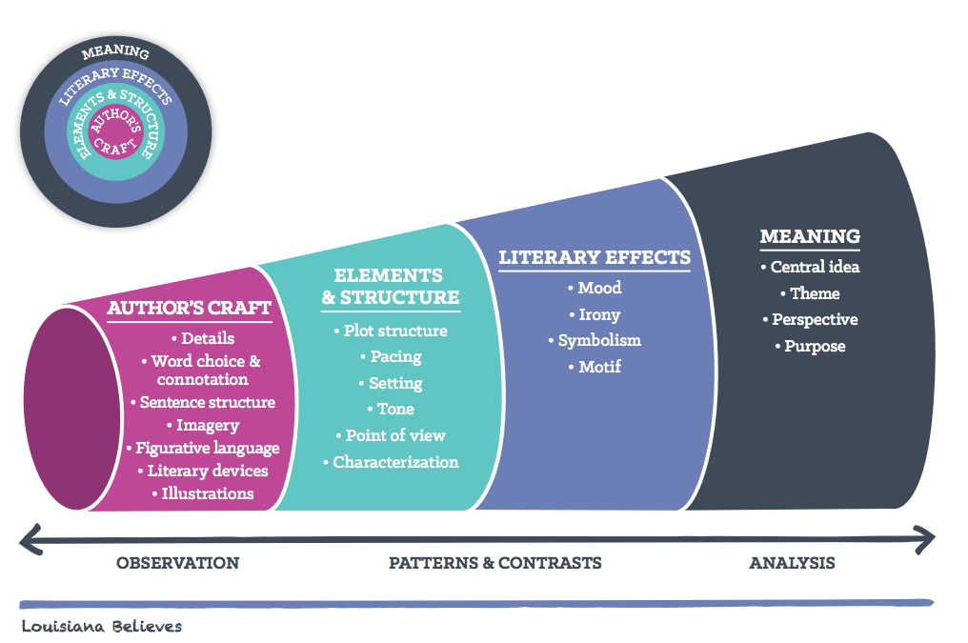
Reader’s Circles for Literary Texts
Participant Guide
p. 3
Notes:
Duration: 4 minutes
Facilitator says: Before we dig into the sample essay, we will briefly go over the Reader’s Circle for Literary Texts. The simplest explanation of Reader’s Circles is that each layer informs the next. We can compare them to a telescope – they help the reader focus their lens as they read a text to ultimately see and uncover the true meaning of the text. Take a moment and review the graphic in your Participant Guide on page 3, and circle what you think are the major elements of the writing prompt that we just studied.
Facilitator does: Direct participants to their participant guide and provide a minute of independent review time. Then have participants share their observations (what do they notice and wonder) with a partner. Afterwards, invite participants to share their observations with the group. Advance the slide.
Note: Important context for facilitators about the Reader’s Circles:
How: Author’s Craft: As a reader, the first layer we observe is the actual words on the page—these are what the author provides. This is what the author has the most control over, thus it is a study of Author’s Craft. As we read, our brains look for patterns and notice contrasts in the details and language of a text.
How: Elements and Structure: Each of these things come together and we begin, as readers, to draw some conclusions about those details and those words, which brings us to the next layer—Elements and Structure, where we focus our attention on the characters, plot and setting, as well as the author’s point of view. Just like with Author’s Craft, our brain is looking for patterns and contrasts, such as changes in character actions from the beginning of a text to the end—what do those changes mean?
How: Literary Effects: That leads us to the next layer—Literary Effects. This layer is where we, as readers, start making interpretations and making the story our own. This is where we apply our experiences, our background knowledge, and our feelings to find humor through irony or start making meaning through identifying symbols that have a meaning separate from the words on the page. Again, we determine what is important based on what patterns and contrasts we see—where do situations end up differently than we would expect? What could that possibly mean?
What: Meaning: As we work through those thoughts, we start to make meaning from the text, which also informs the outermost layer of the circles, Meaning. In this layer, we, as readers, have the most control over the text. We determine theme (or meaning) and author’s purpose or perspective (to teach us the theme or to reveal some kind of point) based on the patterns and contrasts we’ve seen throughout the text in each layer of the text.
Participant look-fors:
Knowledge:
Background on the Salem Witch Trials
Puritan beliefs and background
Effect of setting on characters
Skills:
Explaining how the main events of each season cause a change within Kit
Explaining how a character’s response to conflict develops an overall theme in the novel
Source: TL Summit presentation (shared by Louisiana Advisors)
Image Source: ELA Guidebooks

Slide 17
Agenda
Agenda Items
1. Let’s Set the Context
2. Writing Prompt
3. Scoring Rubric
4. Let’s Set the Context
5. Scoring Activity
Notes:
Duration: 30 seconds
Facilitator says: Now we will dig into the scoring activity for the Synthesis Essay.

Slide 18
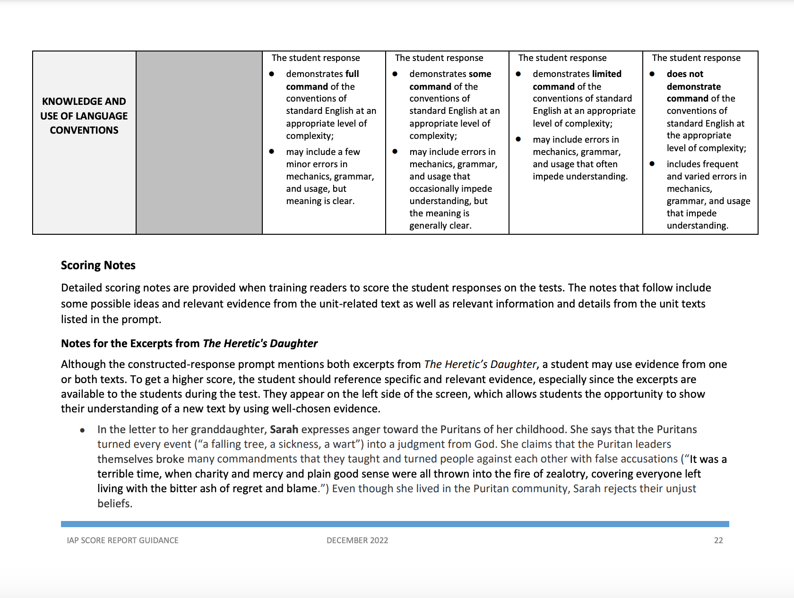
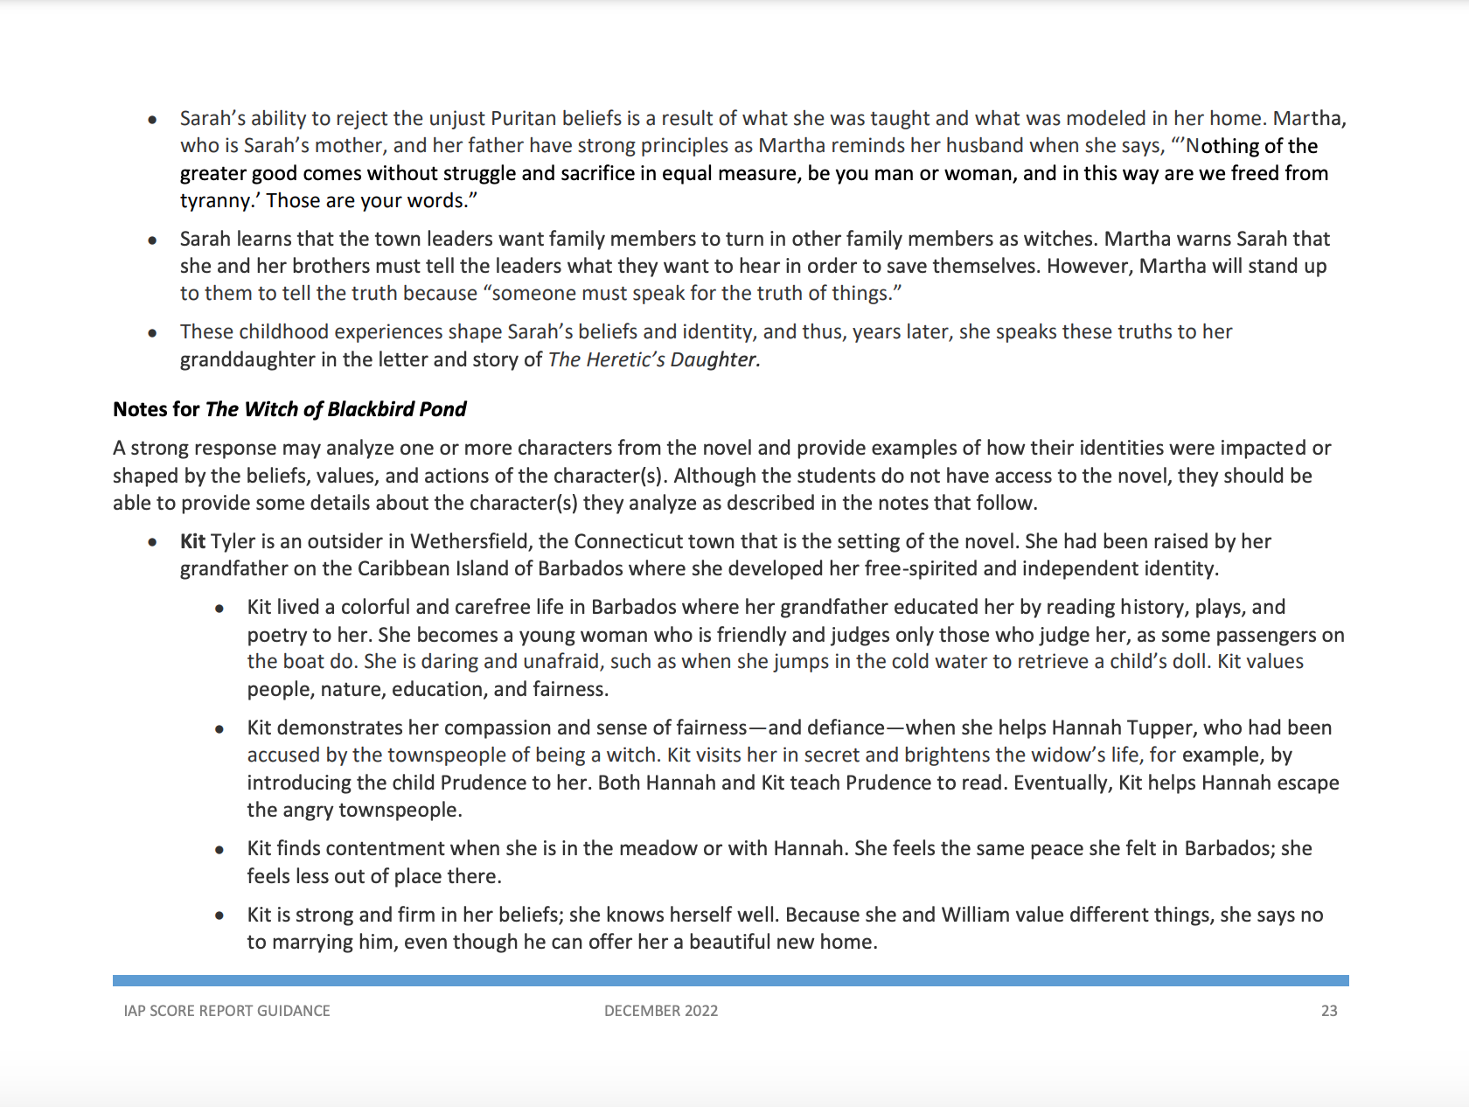
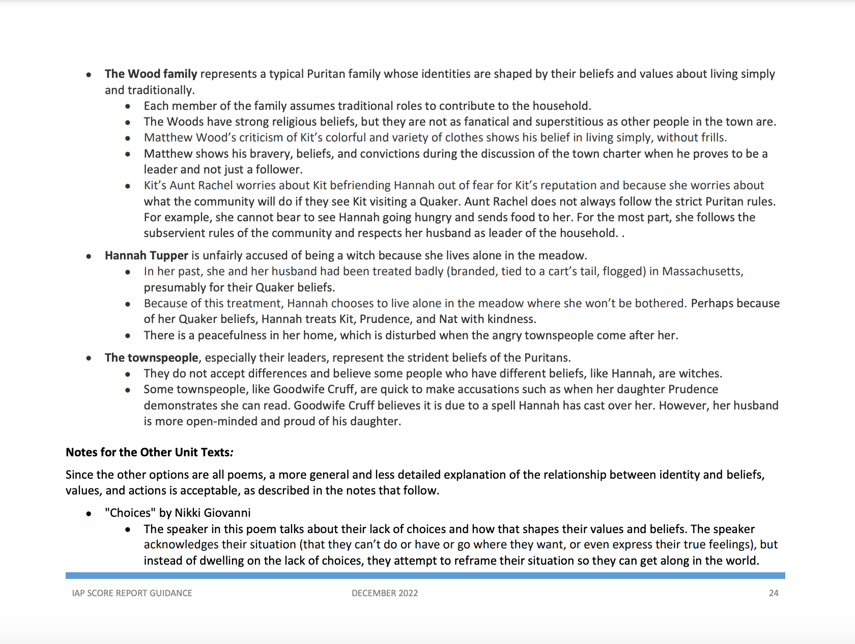
Scoring Notes
IAP Score
Report Guidance
pp. 22-25
Notes:
Duration: 7 minutes
Facilitator says: Detailed scoring notes are provided when training readers to score the student responses on the tests. The notes that follow include some possible ideas and relevant evidence from the unit-related text as well as relevant information and details from the unit texts listed in the prompt. Take 7 minutes to read the scoring notes found on pages 22-25 of the IAP Report Guidance document.
Facilitator does: Give participants time to read the scoring notes.

Slide 19
Scoring Rubric
IAP Score
Report Guidance
pp. 11-12
Notes:
Duration: 30 minutes
Facilitator does: Predetermine a process for dividing the group into five smaller groups. See the scoring activity protocol below.
Facilitator says: These sample student work materials are provided to help teachers better understand the writing expectations for the prompts on the IAP tests and are meant to be used in conjunction with the collaborative scoring activity described in the guidance. Because only a small number of students participated in the field-testing of the Grade 6 Witch of Blackbird Pond unit, we were not able to use this unit assessment operationally. However, this allows us to release some of the writing prompts that were administered during the field test and the sample student responses from that particular test form. When reviewing the materials, please keep in mind that the samples are from grade 6 and are in response to timed writing prompts on a field test. You will now engage in a scoring activity for essay. Choose a high, medium, and low scoring essay to study. With each essay, one person from the group should read the response out loud. Then, group members should read the scoring notes and rubric for each response. Annotate the essays with your reflections.
Facilitator does: Direct participants to the protocol on pp. 11-12 of the IAP Score Report Guidance document. Provide time for participants to read the responses with shoulder groups. Circulate throughout the participants to listen to the conversations that are happening as they engage in the scoring activity. Choose a few participants to share out whole group.
Note: Important information for facilitators about the scoring activity:
Be sure to read pp. 11-12 of the IAP Score Report Guidance document prior to beginning the activity. Keep in mind that this protocol is a general protocol for studying and scoring student work. Tailor the instructions to suit the purposes of examining a set of pre-scored anchor papers.
This activity, when done with a group of teachers who teach the same grade level, can be invaluable. By analyzing the rubrics, choosing papers at each score point, and discussing the scoring of student papers collaboratively, teachers not only gain a better understanding of grade-level writing expectations, but they discover students’ strengths and weaknesses and how they might be addressed within their own classroom or within their schools or school systems. We encourage school and school system leaders to incorporate the scoring activity into their professional development or to at least set aside time for teachers to engage in the kind of discussion about student work that is at the heart of the scoring activity.
This same activity can be used with students as well. By having students work through the scoring process, they learn so much about what is expected, and they see the rubric in action as they score and discuss other students’ papers. Often the discussion turns out to be the most valuable part of the activity and takes hold in a way that looking at sample responses from another source could never achieve.
Purpose:
● To establish common expectations for student writing
Outcomes:
● Learn to use a writing rubric and identify qualities of writing that meet standards
● Reveal grade-specific expectations in a school
● Learn about and discuss different approaches that can improve instruction
Process:
After students respond to a task from ELA Guidebooks (e.g., Culminating Writing Task, Extension Task , Cold-Read Task):
Collect students’ written responses to the common prompt.
Work collaboratively to understand the rubric.
Review the scoring criteria on the chosen rubric. Read through each row. Highlight the keywords on the rubric that show the differences between each score point.
Create anchor papers for each score point. These are papers that all participants agree represent a solid score (e.g., a 4 in Reading Comprehension/Written Expression, a 2 in Conventions, etc.). Annotate the papers to identify which qualities match the rubric. They will serve as models of each score point on the rubric. Refer to the Sample Student Work from a released Grade 6 IAP unit test for examples of anchor papers for the Reading Comprehension and Written Expression dimension.
Score the responses collaboratively.
Individually score the responses using the rubric and anchor set.
Then come together as a group. Read each response aloud and, as a group, discuss the individual scores using the rubric and the anchor papers.
Try to reach consensus on the scores for each response. Discuss any scores that are not consistent.
After the responses are scored, discuss the responses in general—strengths, weaknesses, different approaches to the task, etc. Determine any patterns that exist in the responses as a whole (e.g., difficulty with a particular construct, such as relevance of the evidence or the organization of the ideas). Individual teachers should also consider their own students’ responses to determine any patterns.
Finally, discuss the instructional implications: “How will we address the general learning opportunities? How will I address my own students’ learning opportunities, etc.?” Develop a plan.

Slide 20
Reflection and Closing
Participant Guide
p. 3
What did you learn from the scoring activity?
Notes:
Duration: 2 minutes
Facilitator says: Let’s reflect on what we’ve learned in this session. What did you learn from the scoring activity?
Facilitator does: Provide time for participants share with the whole group. Participants should write reflections on page 3 of the Participant Guide.
Facilitator says: Our next session will be Session 5: Understanding the Score Reports for Window 1.

Slide 21
For questions about the IAP, please contact
Ruth Caillouet, the Innovative Assessment Coordinator
Ruth.caillouet@la.gov
Send general assessment questions to
assessment@la.gov

