Slide 1
Innovative Assessment
Professional Learning Series
Session 3: Understanding Item Types:
Selected-Response and Constructed Response
November 2023
Notes:
Time needed for the session:
2 hours
Needed materials for session:
Copies of the Innovative Assessment Assessment Guide document
Copies of the Innovative Assessment Score Report Guidance document
Copies of the Session 3: Understanding Item Types: Selected Response and Constructed Response Participant Guide
Highlighters (green, orange, yellow)
Chart paper
Copies of the Innovative Assessment constructed response scoring activity cards
Notes for facilitators and presenters:
The text referenced in the session has copyright protections that require it be accessed through a password-protected site. It is available in the ADAM system. If you do not have an ADAM account, please ask your school test coordinator for assistance. Participants will get the most out of this session when they’ve had time to read and annotate the text prior to the session.
Facilitator says: Welcome to the Innovative Assessment Professional Learning Series. The Louisiana Department of Education is committed to developing the Innovative Assessment Program in partnership with Louisiana schools and school systems. As part of that commitment, LDOE and partner systems have developed this professional learning series. My name is Emily Howell, and I am the ELA Facilitator for Lincoln Parish Schools. This is Session 3: Understanding Item Types: Selected-Response and Constructed Response Items.

Slide 2
Professional Learning Series
Understanding the IAP | The IAP Items | Using IAP Data
Introduction to the Innovative Assessment Understanding Grade-Level Standards | Selected-Response and Constructed Response Synthesis Essay | Understanding The Score Reports Using The Classroom Questions Guide Using CSV Files for In Depth Analysis
Please contact Ruth.Caillouet@la.gov
Kathleen.Judy@la.gov
Notes:
Duration: 1 minute
Facilitator says: This session is part of a larger professional learning series designed to help school systems with implementation of the IAP. For any questions about the IAP, please contact Ruth Caillouet, Innovative Assessment Program Coordinator or Kathy Judy, Supervisor of Assessment Content, English Language Arts.

Slide 3
Objectives
Participant Guide
p. 1
Participants will
use pp. 16-17 of the IAP Assessment Guide for Grades 5-8 Guidebooks Operational Tests to increase their knowledge of sample selected response and constructed response test items; and
use pp. 11-19 of the IAP Score Report Guidance document to engage in a scoring activity for the constructed response sample item.
We will use the Participant Guide as a note catcher along the way.
Notes:
Duration: 30 seconds
Facilitator says: During this session, we will use three handouts: the Participant Guide, the IAP Assessment Guide, and the IAP Score Report Guidance document, all of which are linked in the speaker’s notes of slide one of this deck. Please be aware that there may be more current documents released since the time of this recording. Take a moment to preview the objectives for this session. Keep in mind that it will be essential to read and annotate the passages from The Heretic’s Daughter, which is a passage that was featured on a field test for the Innovative Assessment, prior to these activities. Over the course of our session today, we will be working with ideas from those passages in order to better understand both the selected-response and the constructed response items on the IAP.
Facilitator does: Provide wait time for participants to preview objectives. Then read the objectives from the slide.

Slide 4
Agenda
Agenda Items
1. Let’s Set the Context
2. Sample Selected-Response Items
3. Constructed Response Items
Notes:
Duration: 30 seconds
Facilitator says: Let’s take a look at our agenda for this session. First, we will spend time setting the context for our time today.

Slide 5
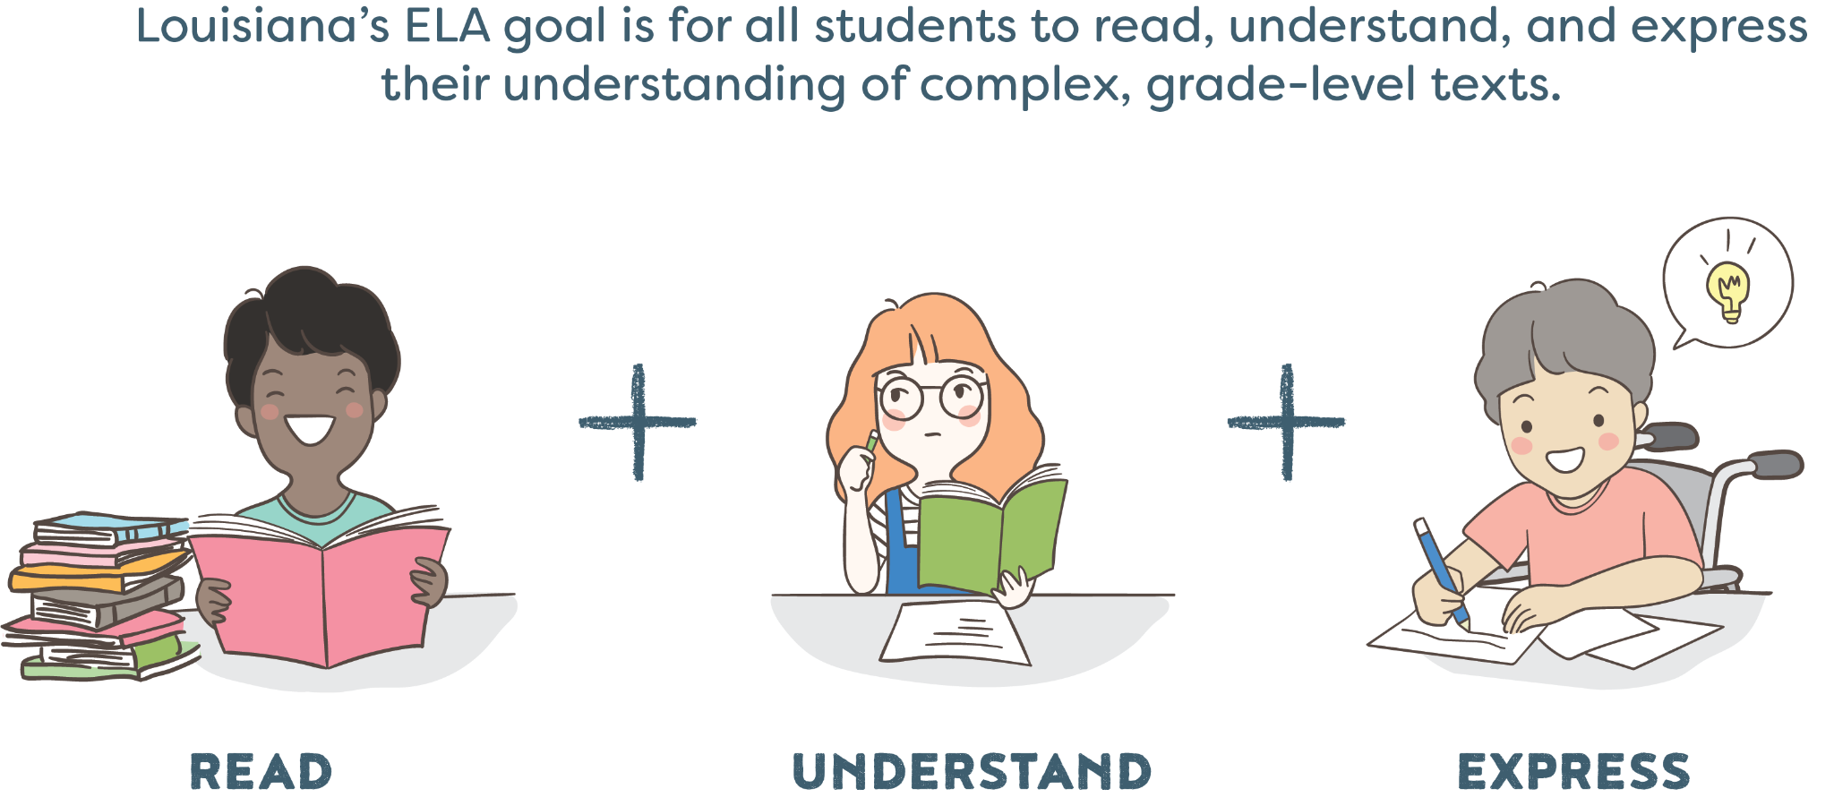
Louisiana’s ELA Goal
Notes:
Duration: 30 seconds
Facilitator says: We always begin with our ELA Goal for all students to read, understand, and express their understanding of complex, grade-level texts.

Slide 6

Let’s Set the Context
Participant Guide
p. 1
Notes:
Duration: 10 minutes
Facilitator says: First, we are going to spend some time building the context around the sample items that we will study today. The items that we are about to examine are based on The Witch of Blackbird Pond ELA Guidebooks unit and were field test items for the Innovative Assessment Program. Because only a small number of students participated in the field-testing of the Grade 6 The Witch of Blackbird Pond unit, we were not able to use this unit assessment operationally. However, this allows us to release some of the writing prompts that were administered during the field test and the sample student responses from that particular test form. When reviewing the materials, please keep in mind that the samples are from grade 6 and were featured on a field test. For our time today, we will be using these items, student responses, and the unit as a whole as an example to guide our participant experientials over the course of the session. At this time, read the information about the sample unit that is provided for you on the screen. With your table partners, identify all of the nouns that you see in the statement, and write these in the box on page 1 of your Participant Guide.
Facilitator does:
Provide wait time for participants to talk with shoulder partners. Circulate throughout the participants to listen to the conversations that are happening. Choose a few participants to share out whole group. As participants share, write the nouns on a sheet of chart paper that is entitled “Abstract Nouns/Thematic Topics.”
Participant look-fors:
Puritans
America
Person
Identity
Family
Religion
Race
Class
Society
Choices
Participant Guide
p. 1

Slide 7
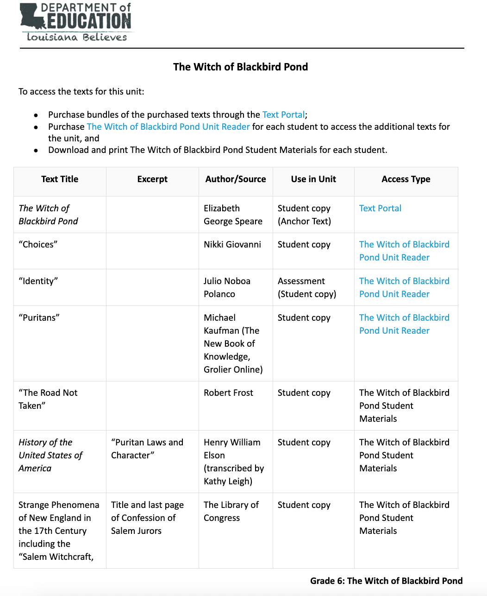
Participant Guide
pp. 2-3
Notes:
Duration: 2 minutes
Facilitator says: One key component of the Innovative Assessment is that students are being assessed on a unit that they engaged with in class. Conceptual coherence is a key foundation of the ELA Guidebooks design. In all of the units, concepts and ideas are explored through a coherent text set of both literary and informational texts. Take 2 minutes to study the text access document for the unit The Witch of Blackbird Pond, which can be found on pp. 2-3 of your Participant Guide. After reading through the text set, consider the following questions with your group, and write your thoughts on page 3 of the Participant Guide:
What do you notice about the balance between literary and informational texts?
How does this text set look similar to some of the ELA Guidebooks units?
What are the connections between the nouns that were identified in the previous activity and the texts in this set?
Facilitator does:
Provide wait time for participants to talk with shoulder partners. Circulate throughout the participants to listen to the conversations that are happening. Choose a few participants to share out whole group.
Participant look-fors:
What do you notice about the balance between literary and informational texts?
The anchor text is literary. The balance between literary and informational texts in the text set for the supplemental texts leans more towards informational texts, particularly related to historical and factual content. There are some literary elements in the form of poems and novels, but the majority of the supplementary texts are informational, historical, or educational in nature.
How does this text set look similar to some of the ELA Guidebooks units?
The hallmark features of the ELA Guidebooks are a wide text variety, inclusion of rich informational texts that build background knowledge (such as historical documents and videos), an emphasis on historical, cultural, or topical context, and finally, a diversity of perspectives.
What are the connections between the nouns that were identified in the previous activity and the texts in this set?
Puritans are explored in texts like "Puritans" and "Puritan Laws and Character," shedding light on their beliefs and history in America during the 17th century.
Identity is a central theme, particularly in Nikki Giovanni's poem "Identity," as well as in the character exploration in "The Witch of Blackbird Pond."
Family dynamics and relationships are examined in literary works like "The Witch of Blackbird Pond."
Religion plays a significant role, notably in texts related to the Puritans and their religious beliefs.
Race and racial dynamics are hinted at in the historical context, especially in relation to the Puritans.
Class distinctions and societal hierarchies are depicted in texts discussing the norms of the 17th-century society.
Society of the 17th century is explored, showcasing its customs, norms, and structures.
Choices and decision-making are central themes in texts like "Choices" and "The Road Not Taken," highlighting the consequences of individual decisions and actions.

Slide 8
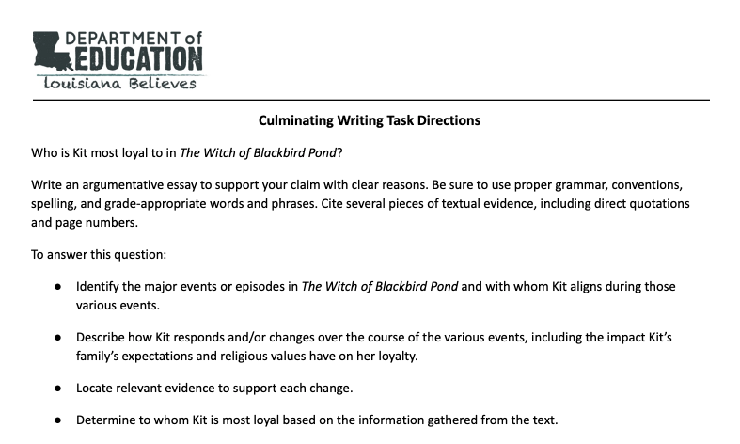
Let’s Set the Context
Participant Guide
p. 4
Notes:
Duration: 2 minutes
Facilitator says: Now, let’s consider the unit goals in terms of assessment. Read over the Culminating Writing Task for The Witch of Blackbird Pond unit. What are the major knowledge and skills that are required to be successful in writing this essay? In other words, what do students need to know and be able to do at the end of the unit in order to be successful on the Culminating Writing Task? Knowledge includes concepts and content knowledge required to perform grade-level skills. Skills (often activity-based or standards-based) define what a student should be able to do with content knowledge in order to progress toward mastery of the grade-level standards.
Facilitator does:
Provide wait time for participants to talk with shoulder partners. Circulate throughout the participants to listen to the conversations that are happening. Choose a few participants to share out whole group. Write answers on a T chart drawn on chart paper, and have participants take notes on page 4 of the Participant Guide.
Participant look-fors:
Knowledge:
Background on the Salem Witch Trials
Puritan beliefs and background
Effect of setting on characters
Skills:
Explaining how the main events of each season cause a change within Kit
Explaining how a character’s response to conflict develops an overall theme in the novel

Slide 9
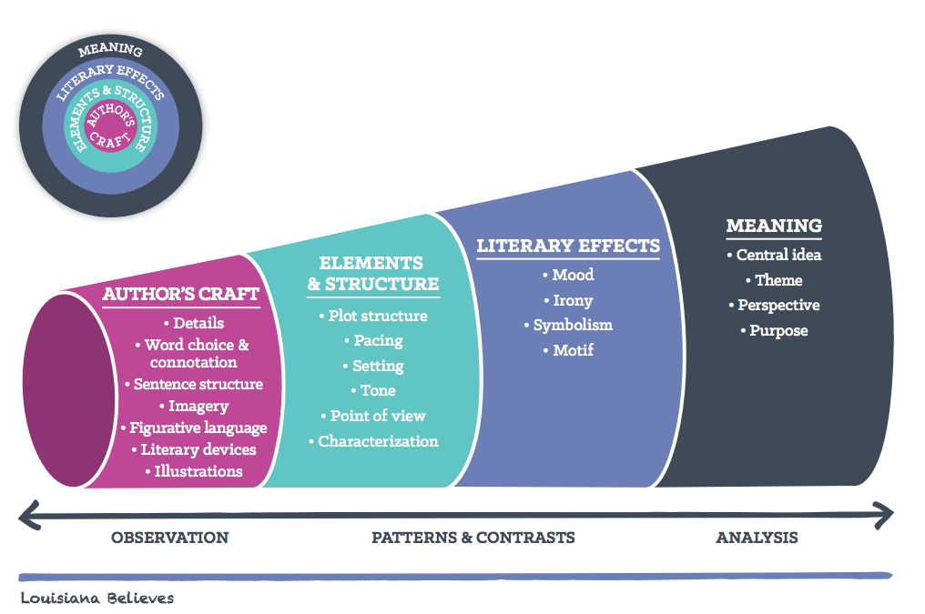
Reader’s Circles for Literary Texts
Participant Guide
p. 4
Notes:
Duration: 4 minutes
Facilitator says: Before we dig into the sample items, we will briefly go over the Reader’s Circle for Literary Texts. The simplest explanation of Reader’s Circles is that each layer informs the next. We can compare them to a telescope – they help the reader focus their lens as they read a text to ultimately see and uncover the true meaning of the text. Take a moment and review the graphic in your Participant Guide on page 4, and circle what you think are the major elements of the Culminating Writing Task that we just studied.
Facilitator does: Direct participants to their participant guide and provide a minute of independent review time. Then have participants share their observations (what do they notice and wonder) with a partner. Afterwards, invite participants to share their observations with the group.
Note: Important context for facilitators about the Reader’s Circles:
How: Author’s Craft: As a reader, the first layer we observe is the actual words on the page—these are what the author provides. This is what the author has the most control over, thus it is a study of Author’s Craft. As we read, our brains look for patterns and notice contrasts in the details and language of a text.
How: Elements and Structure: Each of these things come together and we begin, as readers, to draw some conclusions about those details and those words, which brings us to the next layer—Elements and Structure, where we focus our attention on the characters, plot and setting, as well as the author’s point of view. Just like with Author’s Craft, our brain is looking for patterns and contrasts, such as changes in character actions from the beginning of a text to the end—what do those changes mean?
How: Literary Effects: That leads us to the next layer—Literary Effects. This layer is where we, as readers, start making interpretations and making the story our own. This is where we apply our experiences, our background knowledge, and our feelings to find humor through irony or start making meaning through identifying symbols that have a meaning separate from the words on the page. Again, we determine what is important based on what patterns and contrasts we see—where do situations end up differently than we would expect? What could that possibly mean?
What: Meaning: As we work through those thoughts, we start to make meaning from the text, which also informs the outermost layer of the circles, Meaning. In this layer, we, as readers, have the most control over the text. We determine theme (or meaning) and author’s purpose or perspective (to teach us the theme or to reveal some kind of point) based on the patterns and contrasts we’ve seen throughout the text in each layer of the text.
Participant look-fors:
Knowledge:
Background on the Salem Witch Trials
Puritan beliefs and background
Effect of setting on characters
Skills:
Explaining how the main events of each season cause a change within Kit
Explaining how a character’s response to conflict develops an overall theme in the novel
Source: TL Summit presentation (shared by Louisiana Advisors)
Image Source: ELA Guidebooks

Slide 10
Reader’s Circles for Literary Texts
Participant Guide
p. 4
WHAT
HOW
Notes:
Duration: 4 minutes
Facilitator says: Before we dig into the sample items, we will briefly go over the Reader’s Circle for Literary Texts. The simplest explanation of Reader’s Circles is that each layer informs the next. We can compare them to a telescope – they help the reader focus their lens as they read a text to ultimately see and uncover the true meaning of the text. Take a moment and review the graphic in your Participant Guide on page 4, and circle what you think are the major elements of the Culminating Writing Task that we just studied.
Facilitator does: Direct participants to their participant guide and provide a minute of independent review time. Then have participants share their observations (what do they notice and wonder) with a partner. Afterwards, invite participants to share their observations with the group.
Note: Important context for facilitators about the Reader’s Circles:
How: Author’s Craft: As a reader, the first layer we observe is the actual words on the page—these are what the author provides. This is what the author has the most control over, thus it is a study of Author’s Craft. As we read, our brains look for patterns and notice contrasts in the details and language of a text.
How: Elements and Structure: Each of these things come together and we begin, as readers, to draw some conclusions about those details and those words, which brings us to the next layer—Elements and Structure, where we focus our attention on the characters, plot and setting, as well as the author’s point of view. Just like with Author’s Craft, our brain is looking for patterns and contrasts, such as changes in character actions from the beginning of a text to the end—what do those changes mean?
How: Literary Effects: That leads us to the next layer—Literary Effects. This layer is where we, as readers, start making interpretations and making the story our own. This is where we apply our experiences, our background knowledge, and our feelings to find humor through irony or start making meaning through identifying symbols that have a meaning separate from the words on the page. Again, we determine what is important based on what patterns and contrasts we see—where do situations end up differently than we would expect? What could that possibly mean?
What: Meaning: As we work through those thoughts, we start to make meaning from the text, which also informs the outermost layer of the circles, Meaning. In this layer, we, as readers, have the most control over the text. We determine theme (or meaning) and author’s purpose or perspective (to teach us the theme or to reveal some kind of point) based on the patterns and contrasts we’ve seen throughout the text in each layer of the text.
Participant look-fors:
Knowledge:
Background on the Salem Witch Trials
Puritan beliefs and background
Effect of setting on characters
Skills:
Explaining how the main events of each season cause a change within Kit
Explaining how a character’s response to conflict develops an overall theme in the novel
Source: TL Summit presentation (shared by Louisiana Advisors)
Image Source: ELA Guidebooks

Slide 11
Agenda
Agenda Items
1. Let’s Set the Context
2. Sample Selected-Response Items
3. Constructed Response Items
Notes:
Duration: 30 seconds
Facilitator says: Now that we’ve set the context of the unit ideas, goals, and skills, we will look over sample items.

Slide 12
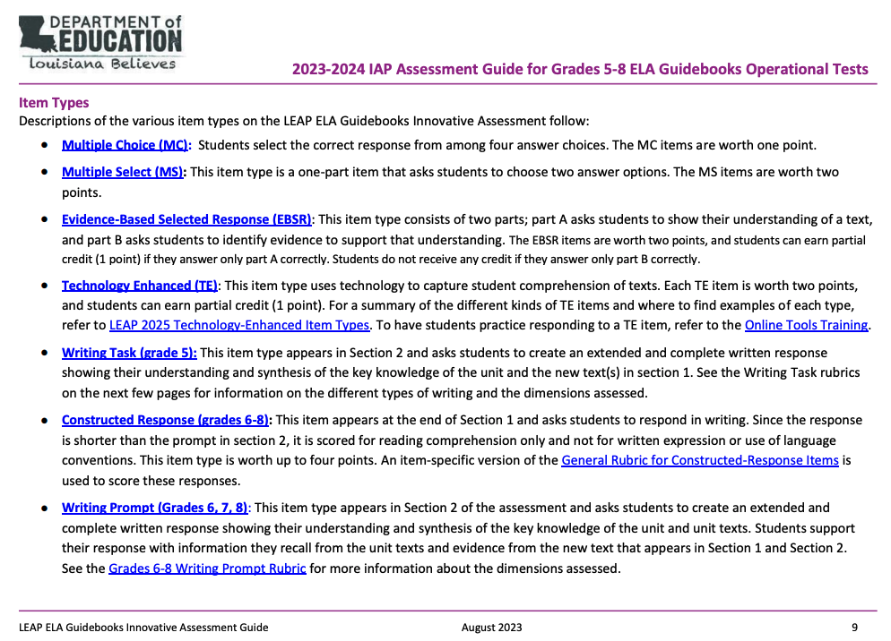
Item Types
Assessment Guide
p. 9
Notes:
Duration: 5 minutes
Facilitator says: Please turn to page 9 of the Assessment Guide to look over the item types on the Innovative Assessment. Read the information on page 9 independently. Then, examine the screenshot pictured on this slide. As you read, consider the following questions, and discuss with a shoulder partner:
How are the item types similar to the LEAP assessment?
What differences do you notice?
Facilitator does: Provide wait time for participants to engage in the activity. Circulate throughout the participants to monitor the notes that they are taking. Then take questions from the whole group.
Participant look-fors:
How are the item types similar to the LEAP assessment?
The items look the same as what we expect to see on the LEAP: the multiple choice, multiple select, evidence-based selected response, technology enhanced items are all identical to the description in the LEAP 2025 Assessment Guides.
What differences do you notice?
There are differences in the writing items: writing task for grade 5, constructed response for grades 5-8, and the writing prompt for grades 6-8.

Slide 13
Sample Items
Assessment Guide
pp. 16-17
At this time,
re-read the passages from The Heretic’s Daughter,
take notes about the following elements of the text: setting, characters, and conflict, and
answer the questions on pp. 16 and 17 of the IAP Assessment Guide.
Notes:
Duration: 20 minutes
Facilitator does: Predetermine a process for dividing the group into three smaller groups. Assign each group one of the following story elements: characters, setting, and conflict. Each group will be responsible for annotating for one of these elements during the reading of the passage of The Heretic’s Daughter. See slide one for notes on how to access this text.
Facilitator says: Go back through the passage, and highlight the text for your assigned story element: setting, characters, or conflict.
Facilitator does: Give participants time to read and highlight the text. Provide participants with the appropriate colored highlighters for the literary elements (green for setting, orange for characters, and yellow for conflict)..
Facilitator says: You will now have an opportunity to answer the sample items that are based on The Witch of Blackbird Pond unit. At this time, independently answer the sample items found on pages 16-17 of the IAP Assessment Guide.
Facilitator does: Give participants time to read the questions and mark answers. Provide participants with the appropriate colored highlighters for the literary elements (green for setting, orange for characters, and yellow for conflict). After 15 minutes, go over the correct answers. See the next two slides for the correct answers.

Slide 14
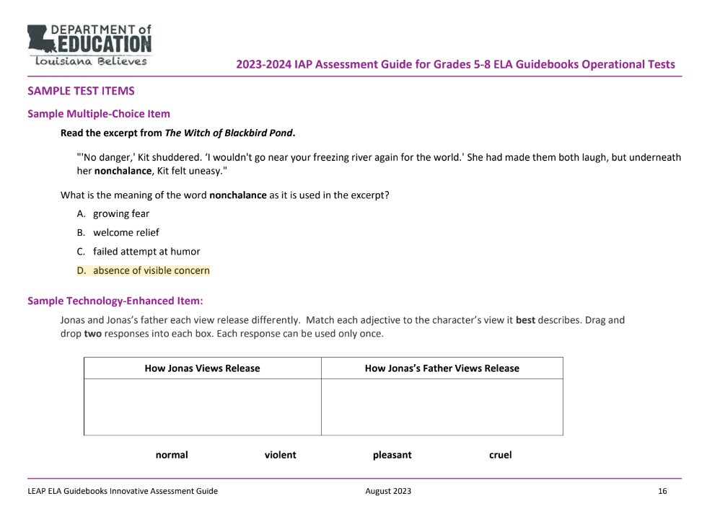
Sample Items

Slide 15
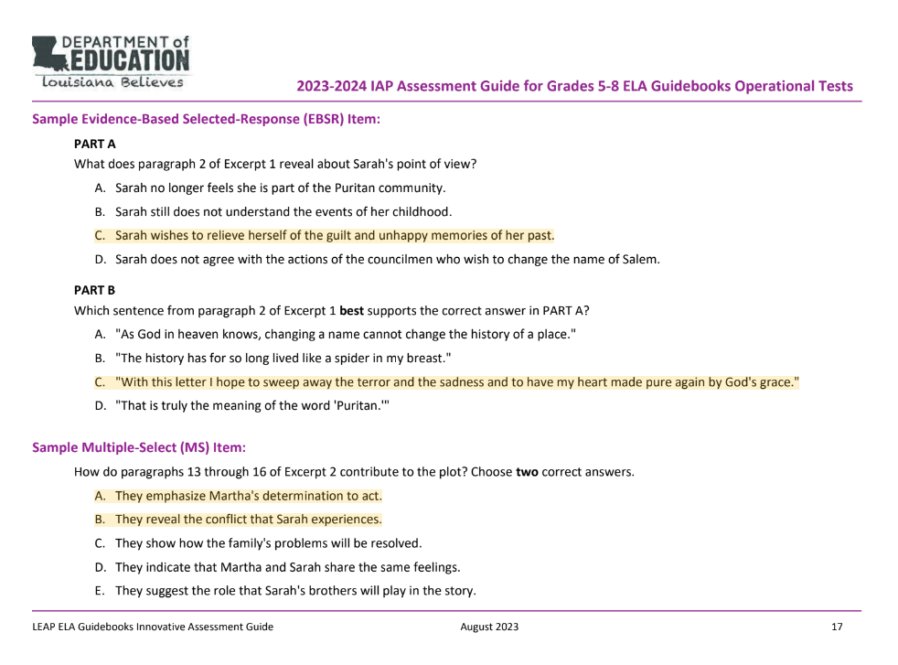
Sample Items

Slide 16
Sample Items
Assessment Guide
pp. 16-17
At this time,
make a poster with your group based on your assignment: focusing on setting, characters, and conflict. Share your observations about your assigned literary element.
consider how students’ background knowledge would have aided them as they approached the text and items.
Notes:
Duration: 7 minutes
Facilitator says: Now, with your group, create a poster with notes about your assigned element to present to the larger group. As we move into examining student responses for the Constructed Response items, it will be important for us to deeply understand these elements of the text.
Facilitator does: Give participants time to make their posters. Then, allow participants to present to the larger group.
Participant look-fors:
Setting:
Letter written in 1752
Salem Village
1692
Puritan community
Characters:
Sarah Carrier Chapman (narrator)
Lydia (narrator’s granddaughter)
Martha (Sarah’s mother)
Martha is independent, strong, and a fighter.
Sarah’s ability to reject the unjust Puritan beliefs is a result of what she was taught and what was modeled in her home.
Martha, who is Sarah’s mother, and her father have strong principles as Martha reminds her husband when she says, “’Nothing of the greater good comes without struggle and sacrifice in equal measure, be you man or woman, and in this way are we freed from tyranny.’ Those are your words.”
Sarah’s speaks these truths to her granddaughter in the letter and story of The Heretic’s Daughter.
Conflict:
In the letter to her granddaughter, Sarah expresses anger toward the Puritans of her childhood.
She says that the Puritans turned every event (“a falling tree, a sickness, a wart”) into a judgment from God.
She claims that the Puritan leaders themselves broke many commandments that they taught and turned people against each other with false accusations.
Sarah learns that the town leaders want family members to turn in other family members as witches.
Martha warns Sarah that she and her brothers must tell the leaders what they want to hear in order to save themselves. However, Martha will stand up to them to tell the truth because “someone must speak for the truth of things.”
These childhood experiences shape Sarah’s beliefs and identity, and thus, years later, she speaks these truths to her granddaughter in the letter and story of The Heretic’s Daughter.

Slide 17
Agenda
Agenda Items
1. Let’s Set the Context
2. Sample Selected-Response Items
3. Constructed Response Items
Notes:
Duration: 30 seconds
Facilitator says: Now that we’ve spent time deeply understanding the text on the assessment, we will now dig into the constructed response items.

Slide 18
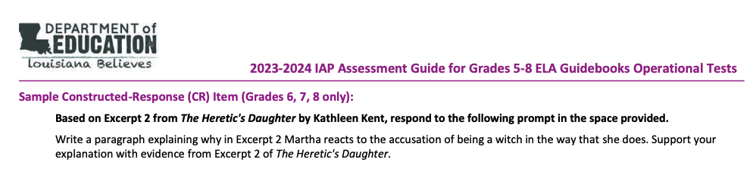
Constructed Response
Assessment Guide
p. 19
Sample CR for Grades 6, 7, 8 Only
Notes:
Duration: 2 minutes
Facilitator says: Take 2 minutes to read the constructed response question on page 19 of the Assessment Guide. Consider the following question: what connection can you make between the constructed response item and the Culminating Writing Task prompt?
Facilitator does: Provide a minute of independent review time. Then have participants share their observations (what they notice and wonder) with a partner. Afterwards, invite participants to share their observations with the group.
Participant look-fors:
The connection between the constructed response prompt for The Heretic's Daughter and the culminating writing task prompt for The Witch of Blackbird Pond is that both prompts require students to analyze a character's response or loyalty based on textual evidence.
In the The Heretic's Daughter prompt, students are asked to examine Martha's reaction to the accusation of being a witch in Excerpt 2 and support their explanation with evidence from the text. This prompt focuses on understanding a character's response to a specific situation.
In the The Witch of Blackbird Pond prompt, students are required to write an argumentative essay about Kit's loyalty. They need to identify major events or episodes in the novel, describe how Kit responds and changes over the course of these events, and determine to whom Kit is most loyal based on evidence from the text. This prompt involves a broader analysis of a character's loyalty over the course of the story.
The common thread between these prompts is the need for students to provide evidence-based explanations about characters' reactions or loyalty.
In both cases, students must draw on textual evidence to support their claims and analyze the characters' actions and motivations. While one focuses on a specific excerpt, the other explores a character's loyalty across the entire novel.

Slide 19
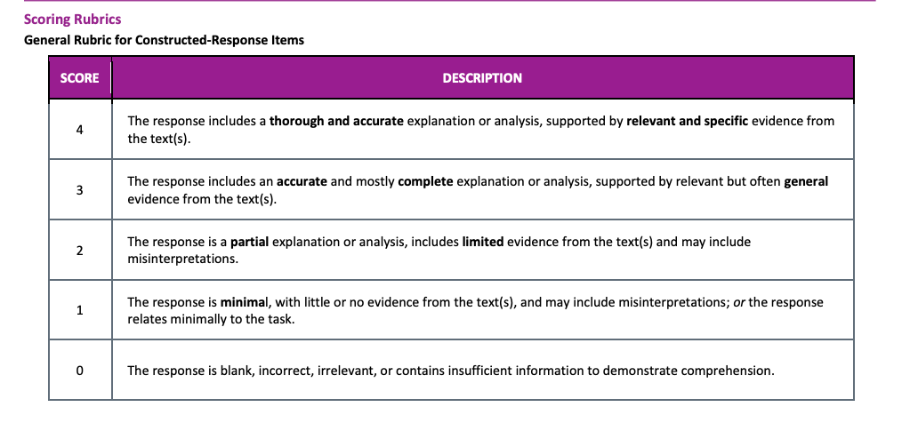
Constructed Response Rubric
IAP Score
Report Guidance
p. 14
For Grades 6, 7, 8 only
Notes:
Duration: 10 minutes
Facilitator says: Take 5 minutes to read the constructed response item rubric found on page 14 of the IAP Report Guidance document. Keep in mind that the constructed response question allows student to show their understanding of the new text and how the text connects to the knowledge of the unit. This is a shorter written response that is not scored for language conventions; instead, it is scored for reading comprehension only.
Facilitator does:
Give participants time to read the rubric.
Facilitator says: Now that you’ve read the rubric, pay close attention to the words that are bolded. What do you notice about progression of language from score to score? (Advance slide.)

Slide 20
Constructed Response Rubric
IAP Score
Report Guidance
p. 14
For Grades 6, 7, 8 only
 | ANALYSIS | EVIDENCE
4 | THOROUGH ACCURATE | RELEVANT SPECIFIC
3 | ACCURATE MOSTLY COMPLETE | GENERAL
2 | PARTIAL | LIMITED
1 | MINIMAL | –
0 | – | –
Notes:
Duration: 10 minutes
Facilitator says: Now that you’ve read the rubric, pay close attention to the words that are bolded. What do you notice about progression of language from score to score?
Participant look-fors:
Stronger responses are rooted in deeper analysis and selection of evidence.

Slide 21
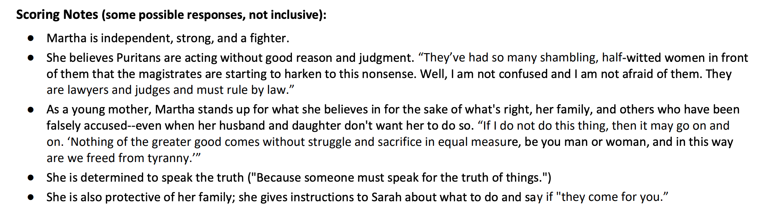
Constructed Response
IAP Score
Report Guidance
p. 14
Notes:
Duration: 2 minutes
Facilitator says: Take 2 minutes to read the scoring notes provided by the LDOE found on page 14 of the IAP Report Guidance document. Please note that these notes include some possible responses but are not inclusive.
Facilitator does: Instruct participants to then put all documents away in order to engage in the scoring activity. Provide them with the Innovative Assessment constructed response scoring activity cards, which can be found linked in slide one of this presentation.

Slide 22
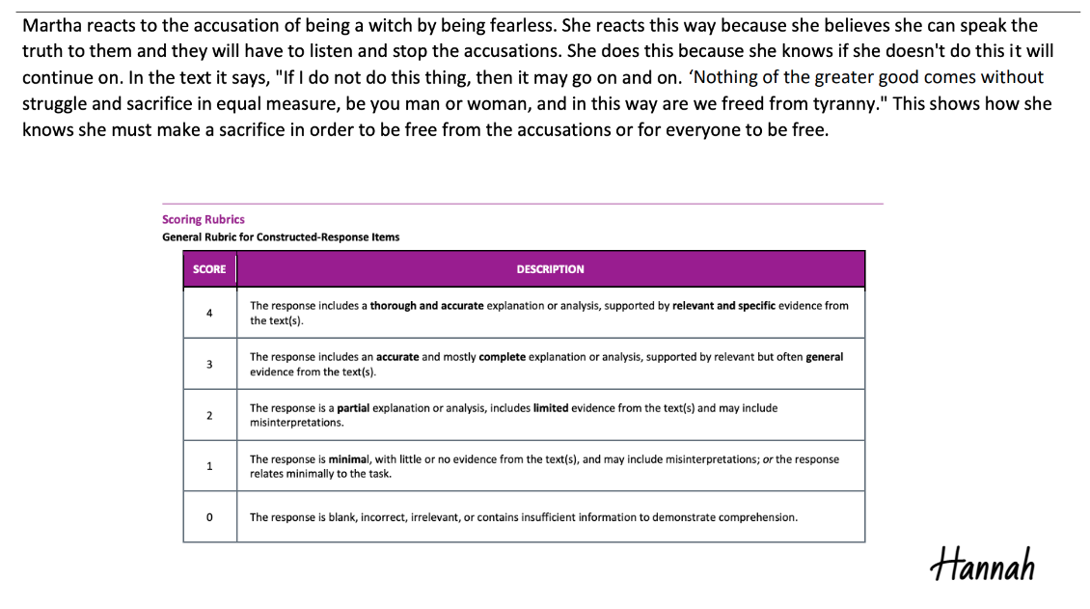
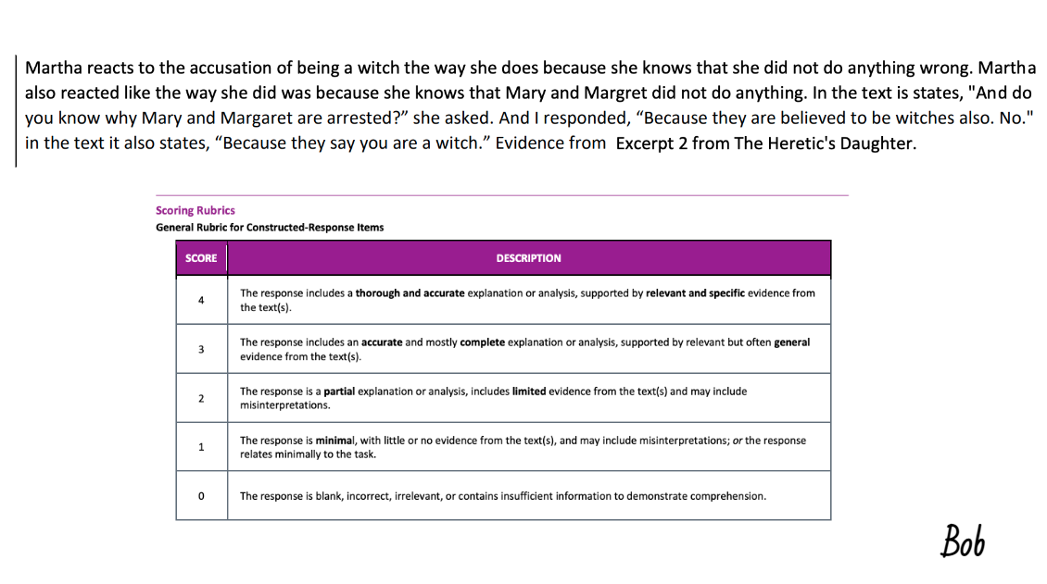
Constructed Response
Notes:
Duration: 15 minutes
Facilitator does: Predetermine a process for dividing the group into three smaller groups. Assign each group one or two responses to score, depending on how much time you have. See slide one for a copy of the scoring activity cards.
Facilitator says: Your group will be given some sample constructed responses to score. Please read the student response with your group and assign each constructed response a score using the rubric printed on the scoring activity card. Be ready to justify your score as a group. Be sure to put your IAP Guidance for Score Reports document away.
Facilitator does: Provide time for participants to read the responses with shoulder partners. Circulate throughout the participants to listen to the conversations that are happening as they score the sample items. Choose a few participants to share out whole group.
Facilitator says: Now that we’ve scored the items and discussed our thoughts, turn to pp. 15-19 of the IAP Score Report Guidance document to see if your score matches the notes. Be sure to thoroughly read the scoring notes for your responses.
Note: Important information for facilitators about the scoring activity:
Be sure to read pp. 11-12 of the IAP Score Report Guidance document prior to beginning the activity. Additionally, as a facilitator, keep the IAP Score Report Guidance in hand as the activity unfolds, but be sure that participants have put their documents away.
Key for the IAP Constructed Response Scoring Activity
Response #1: Juan
Response #2: Hannah
Response #3: Jordan
Response #4: Hank
Response #5: Zoe
Response #6: Malia
Response #7: Ahmad
Response #8: Bob
Response #9: Ricky
Response #10: Tyla

Slide 23
Reflection and Closing
Participant Guide
p. 5
What did you learn from the scoring activity?
Notes:
Duration: 2 minutes
Facilitator says: Let’s reflect on what we’ve learned in this session. Did your scoring match up with the IAP Score Report Guidance document? If not, what can you learn from this process?
Facilitator does: Provide time for participants share with the whole group. Participants should write reflections on page 5 of the Participant Guide.
Facilitator says: Be sure to be looking for another session, Understanding Items Types on the IAP (Synthesis Essay).

Slide 24
For questions about the IAP, please contact
Ruth Caillouet, the Innovative Assessment Program Coordinator
Ruth.caillouet@la.gov
Send general assessment questions to
assessment@la.gov

