Slide 1

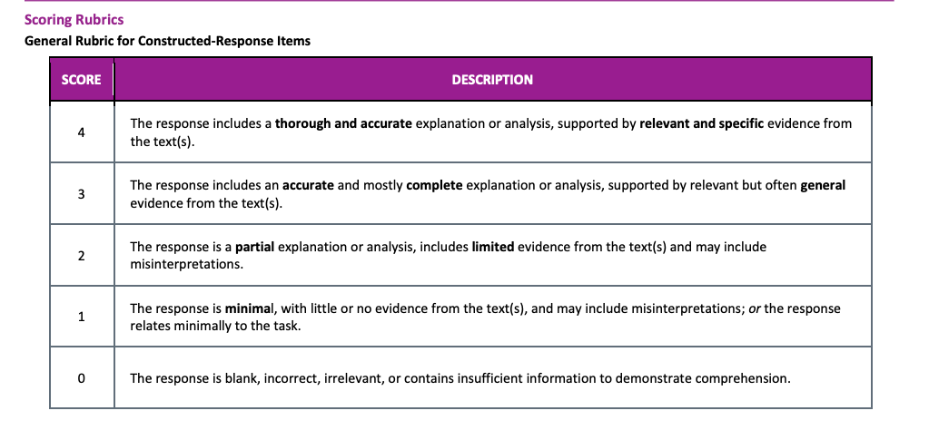
Juan

Slide 2

Hannah

Slide 3

Jordan

Slide 4

Hank

Slide 5

Zoe

Slide 6

Malia

Slide 7
Ahmad

Slide 8

Bob

Slide 9

Ricky

Slide 10
Tyla

