Slide 1
Innovative Assessment Program
Professional Learning Series
Session 6: Using The Score Report Reflections Guide
December 2023
Notes:
Time needed for the session: 2 hours to work through student work, otherwise 15-20 minutes for an introduction and overview of the Score Report Reflections Guide
Duration: 30 seconds
Needed materials for session:
Score Report Reflections Guide
Score Report
Student work from recent curriculum-embedded assessments from the current ELA Guidebooks unit
Facilitator says: Welcome to the Innovative Assessment Program’s Professional Learning Series. The Louisiana Department of Education is committed to developing the Innovative Assessment Program in partnership with Louisiana schools and school systems. As part of that commitment, LDOE and partner systems have developed this professional learning series. My name is XXX and I am partnering with the Louisiana Department of Education to present this information. This is Session 6: Using the Score Report Reflections Guide.

Slide 2
Professional Learning Series
Understanding the IAP | The IAP Items | Using IAP Data
Introduction to the Innovative Assessment Understanding Grade-Level Standards | Selected-Response and Constructed Response Synthesis Essay | Understanding The Score Reports Using the Score Report Reflections Guide Using CSV Files for In Depth Analysis
Please contact Ruth.Caillouet@la.gov
Kathleen.Judy@la.gov
Notes:
Duration: 30 seconds
Facilitator says: This session is part of a larger professional learning series designed to help schools and school systems with implementation of the Innovative Assessment Program, or the IAP for short. For any questions about the IAP, please contact Ruth Caillouet, Innovative Assessment Program Coordinator or Kathy Judy, Supervisor of Assessment Content, English Language Arts.

Slide 3
Objectives
Participants will
Use the Score Report Reflections Guide in conjunction with the Classroom Score Report to analyze results together with student work from a recent ELA Guidebooks unit to support students in their current instructional unit.
Notes:
Duration: 30 seconds
Facilitator says: During Session 5, we took a look at the four sections of the score report - the Overall Results, the Grouped Roster, the Classroom Profiles, and the Comparisons report. During this session, we will use the Score Report Reflections Guide in conjunction with your classroom score report. The Score Report Reflections Guide is meant to help connect the results of the IAP to potential insturctional next steps.
Facilitator does: Provide wait time for participants to preview objectives. Then read the objectives from the slide.

Slide 4


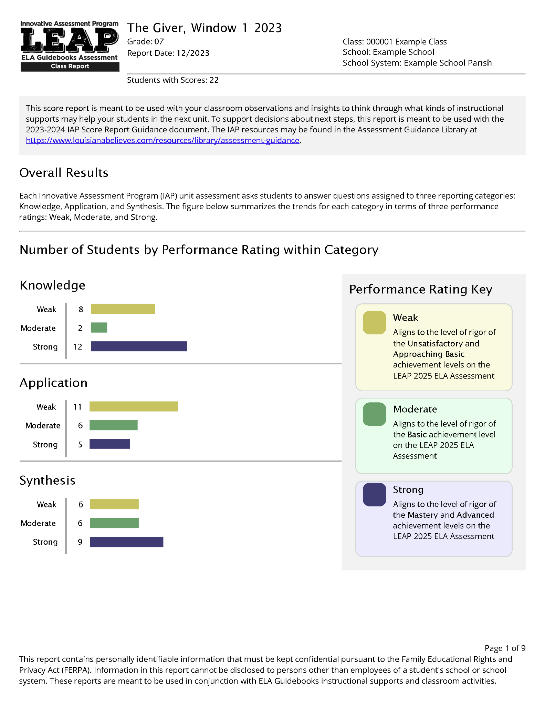
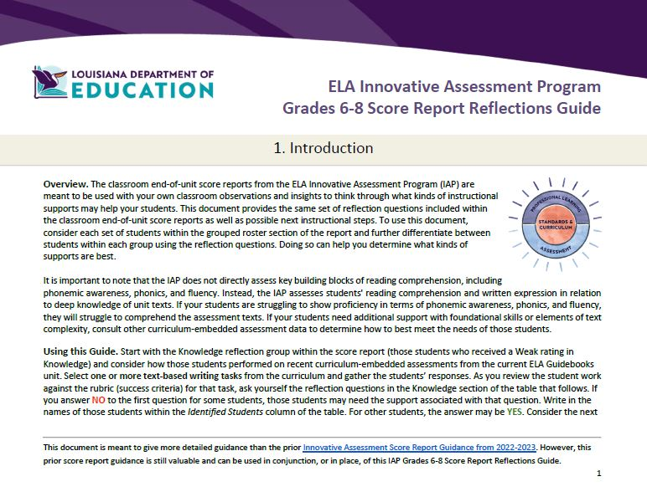
Materials For Today’s Session
Materials for today’s session, including this slide deck, an example score report, and Score Report Reflections Guide are available online at: https://ldoe.zendesk.com/hc/en-us/sections/19671802015127-Professional-Learning
Notes:
Duration: 10 seconds
Facilitator says: Materials for today, including an example classroom score report and the Score Report Reflections Guide , are available online on the ZenDesk Website. You might want to pause the video and make sure that you have downloaded the example classroom score report, or your own classroom score report, since a lot of this session walks through that report.

Slide 5
Agenda
Agenda Items
1. Let’s Set the Context
2. Overview of the Score Report Reflections Guide
3. Additional Materials You Will Need
4. Score Report Reflections Guide: Reflection Questions
5. Score Report Reflections Guide: Support Guidance
6. Reflection
Notes:
Duration: 30 seconds.
NOTE: THERE IS AN ANIMATION ON THIS SLIDE.
Facilitator says: Let’s take a look at our agenda for this session. First, we will set the context by providing some framing information for the IAP, which was also shared in prior sessions. Then we will spend a few minutes orienting you to the Score Report Reflections Guide. We will also talk about some additional materials you should have at hand. We will then walk through using the two main sections of the Score Report Reflections Guide. Finally we will end with a brief reflection opportunity.
Note that periodically a “Pause” image [ADVANCE SLIDE SO THE IMAGE IS VISIBLE] will appear on a slide as an indication that you might want to stop the video and review some materials in more depth. When you are done, hit play again.

Slide 6
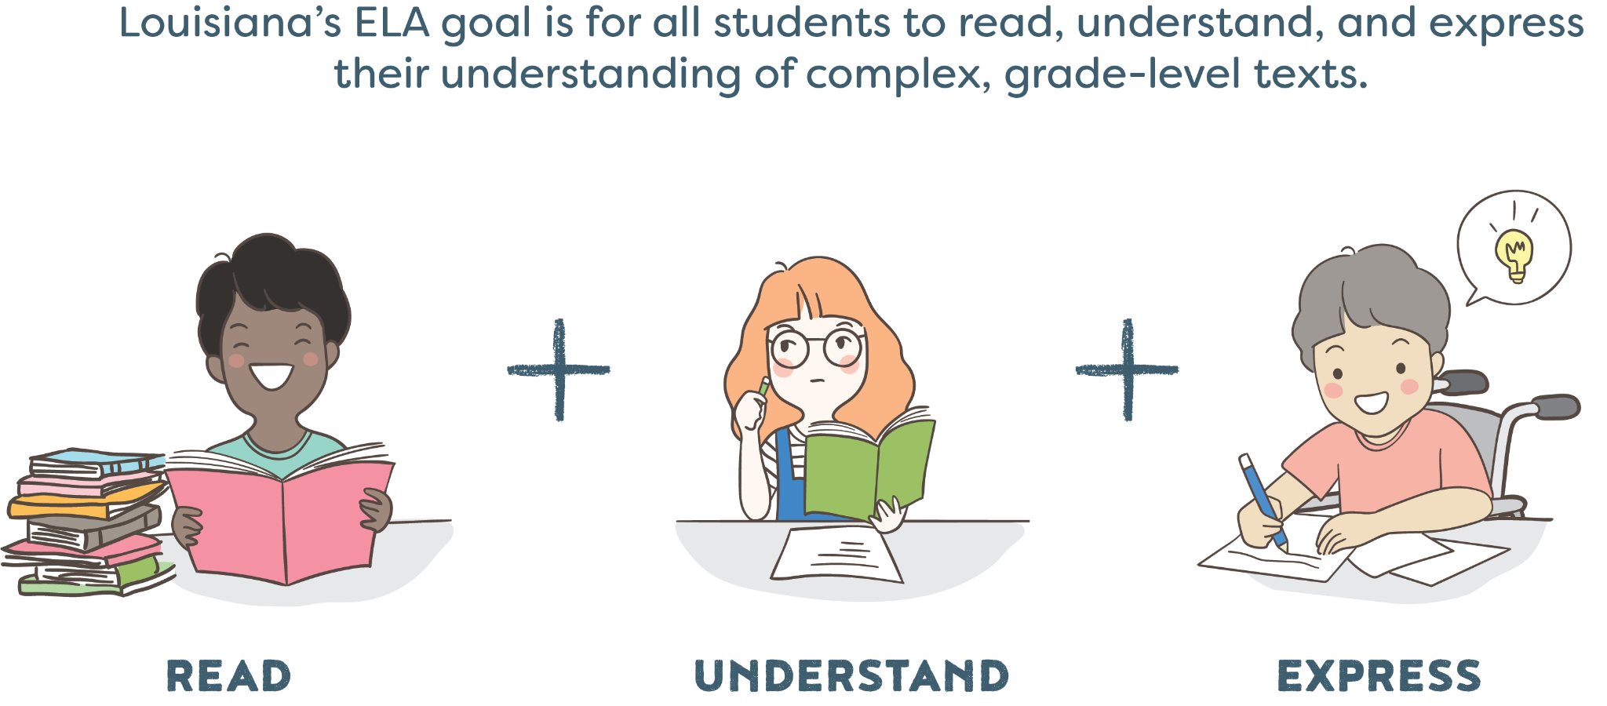
Overarching ELA IAP Goal
Notes:
Duration: 30 seconds
Facilitator says: We always begin these sessions with a review of our overall goal for English Language Arts, which is for all students to read, understand, and express their understanding of complex, grade-level texts. That goal informs the structure of the Innovative Assessment Program, which is intended to (1) provide students with opportunities to demonstrate what they know and can do grounded in texts that they have already studied in class and (2) provide teachers with common assessment information at the end of each unit which allows them to use the information to adjust how they support students in the next unit.

Slide 7

Updated Score Reporting for Grades 6-8 in 2023-24
Curriculum
Classroom Score Report
Score Report Reflections Guide
Notes:
Duration: 30 seconds.
NOTE: THERE IS AN ANIMATION ON THIS SLIDE.
Facilitator says: The Innovative Assessment Program, or the IAP, connects the state summative assessment to the ELA Guidebooks curriculum. This connection means that IAP reports can be used to inform instruction in your upcoming or current ELA guidebooks unit.
(click) For the 2023-24 school year, the student and classroom score reports have been updated, for grades 6, 7 and 8. In addition, (click) there is a new supporting document, the Score Report Reflections Guide for grades 6-8. This document is meant to help support decision making on instructional next steps, based on their performance on each section of the IAP and your own classroom assessment observations.

Slide 8
Agenda Items
1. Let’s Set the Context
2. Overview of the Score Report Reflections Guide
3. Additional Materials You Will Need
4. Score Report Reflections Guide: Reflection Questions
5. Score Report Reflections Guide: Support Guidance
6. Reflection
Notes:
Duration: 30 seconds
Facilitator says: In this section we are going to move through a brief overview of the Score Report Reflections Guide before we begin to use it.

Slide 9
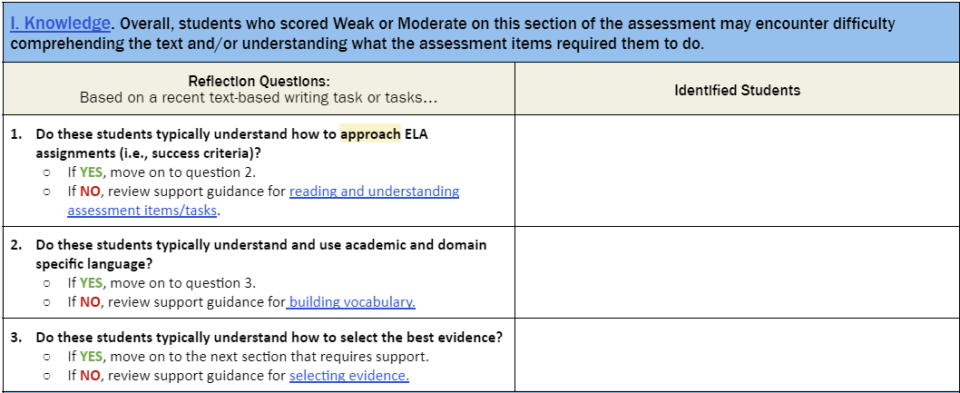
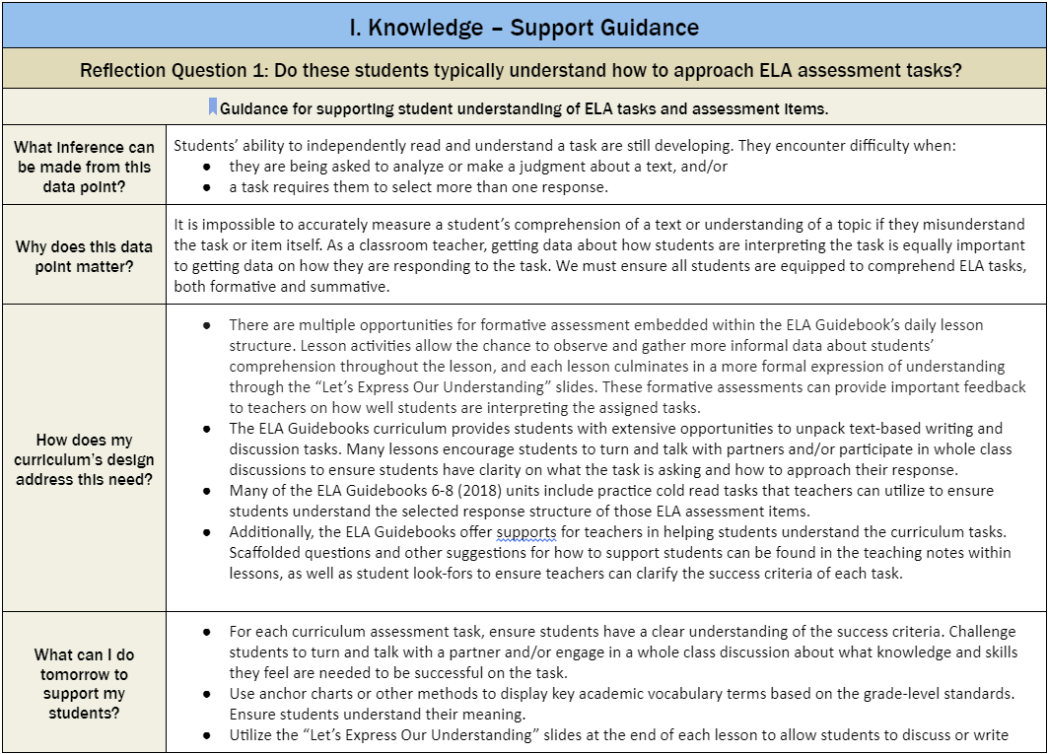
Overview of the Score Report Reflections Guide
Introduction
Reflection Questions with Question Tables
Support Guidance
Pause the video: Take a moment to familiarize yourself with the contents of the Guide.
Notes:
Duration: 60 seconds.. NOTE THERE ARE FOUR ANIMATIONS ON THIS SLIDE.
Facilitator says: After the initial introductory text [ADVANCE SLIDE SO FIRST IMAGE IS VISIBLE] the Score Report Reflections Guide has two main sections.
The first major section is the series of Question Tables [ADVANCE SLIDE SO SECOND IMAGE IS VISIBLE] that you will use in conjunction with your Classroom Score report.
The second major section is the series of Support Guidance Tables [ADVANCE SLIDE SO THIRD IMAGE IS VISIBLE] that you will use after you have grouped students by learning needs based on the questions in the prior section.
Please pause the video [ADVANCE SLIDE SO LAST IMAGE IS VISIBLE] and take a few moments to read the introductory section and orient yourself to the two main sections of the Score Report Reflections Guide. When you are done, hit play again.

Slide 10
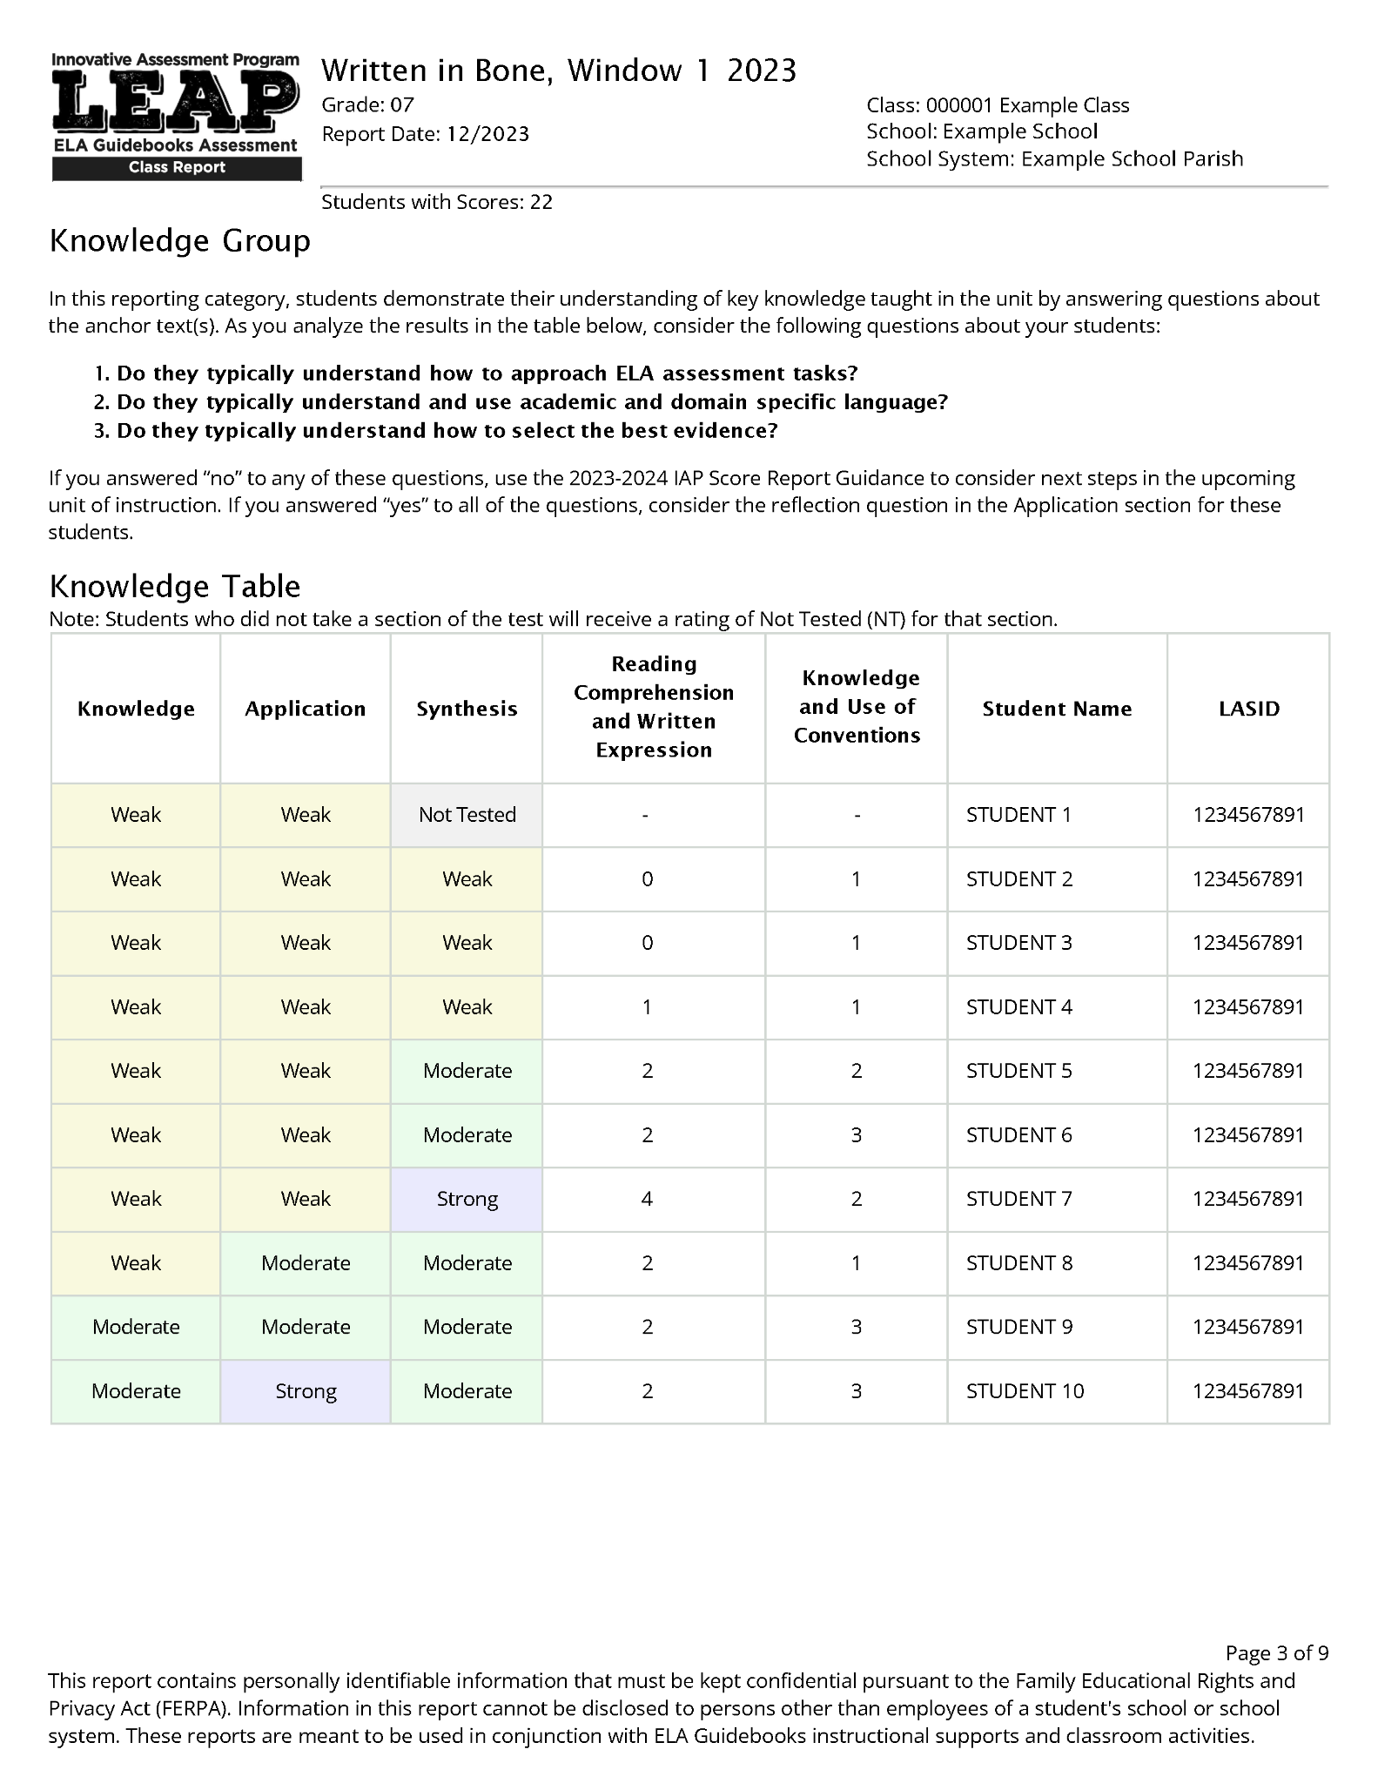
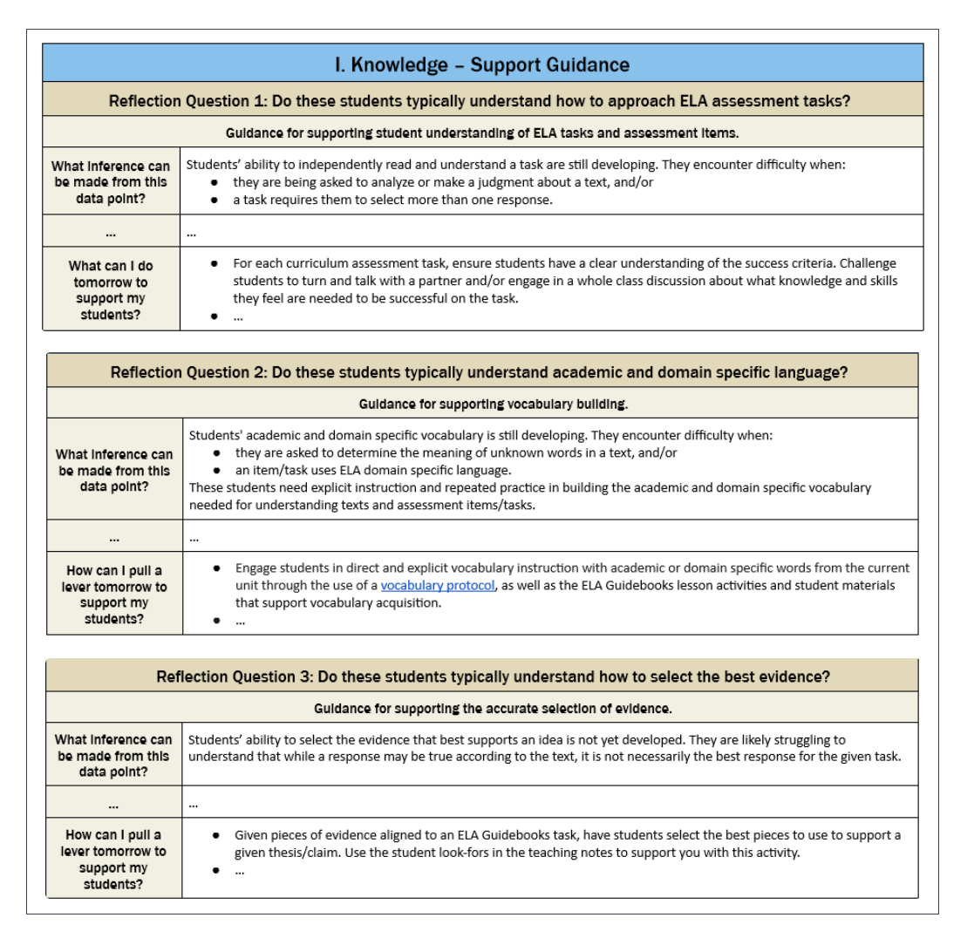
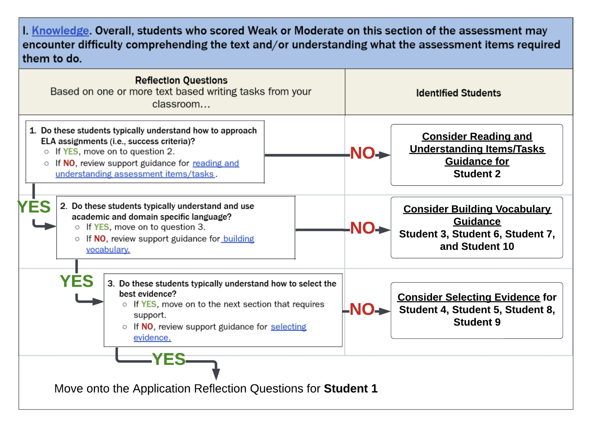
Using the Score Report Reflections Guide
1. Start with the Knowledge, Application and Synthesis Tables in the Classroom Report.
2. Think through the reflection questions in the Reflections Guide.
3. Identify “levers” that are most useful and then implement.
Notes:
Duration: 60 seconds
NOTE THERE ARE ANIMATIONS ON THIS SLIDE.
Facilitator says: This flow chart illustrates the process of using the Score Report Reflections Guide for the Knowledge group. For each group within the Grouped Roster section, (click) the reflection guide there has a number of corresponding questions. Looking at the students in the score report, the reflection guide asks to you draw on a recent classroom writing task and think through a set of reflection questions. Doing so lets you, potently, (click) better match students to the instructional next steps or ‘levers” provided in the second half of the reflections guide. We will walk through the process later in this video.

Slide 11
Agenda Items
1. Let’s Set the Context
2. Overview of the Score Report Reflections Guide
3. Additional Materials You Will Need
4. Score Report Reflections Guide: Reflection Questions
5. Score Report Reflections Guide: Support Guidance
6. Reflection
Notes:
Duration: 30 seconds
Facilitator says: In this section we are going to talk about the other materials you will need to have access to while you use the Score Report Reflections Guide. Specifically, there are two sets of materials you’ll need: (1) the IAP Classroom Score Report and (2) student work samples.

Slide 12
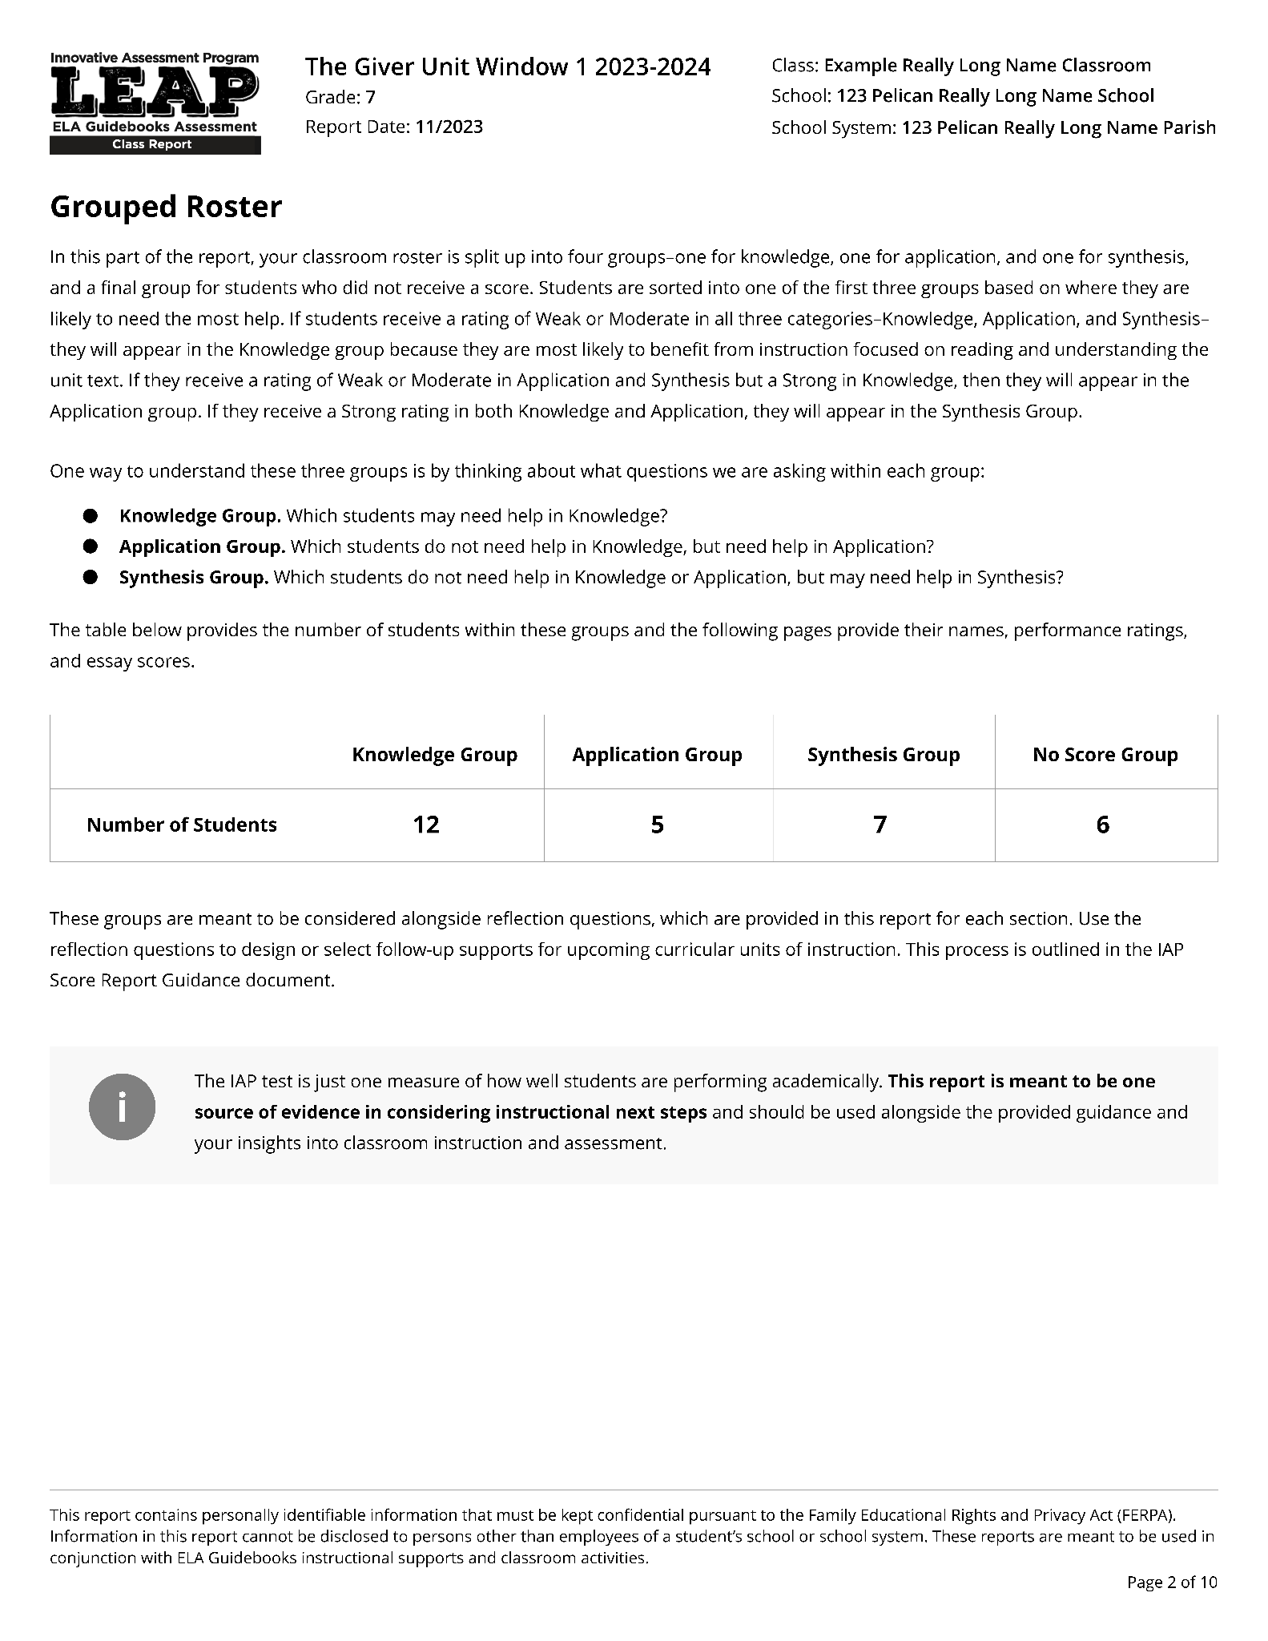
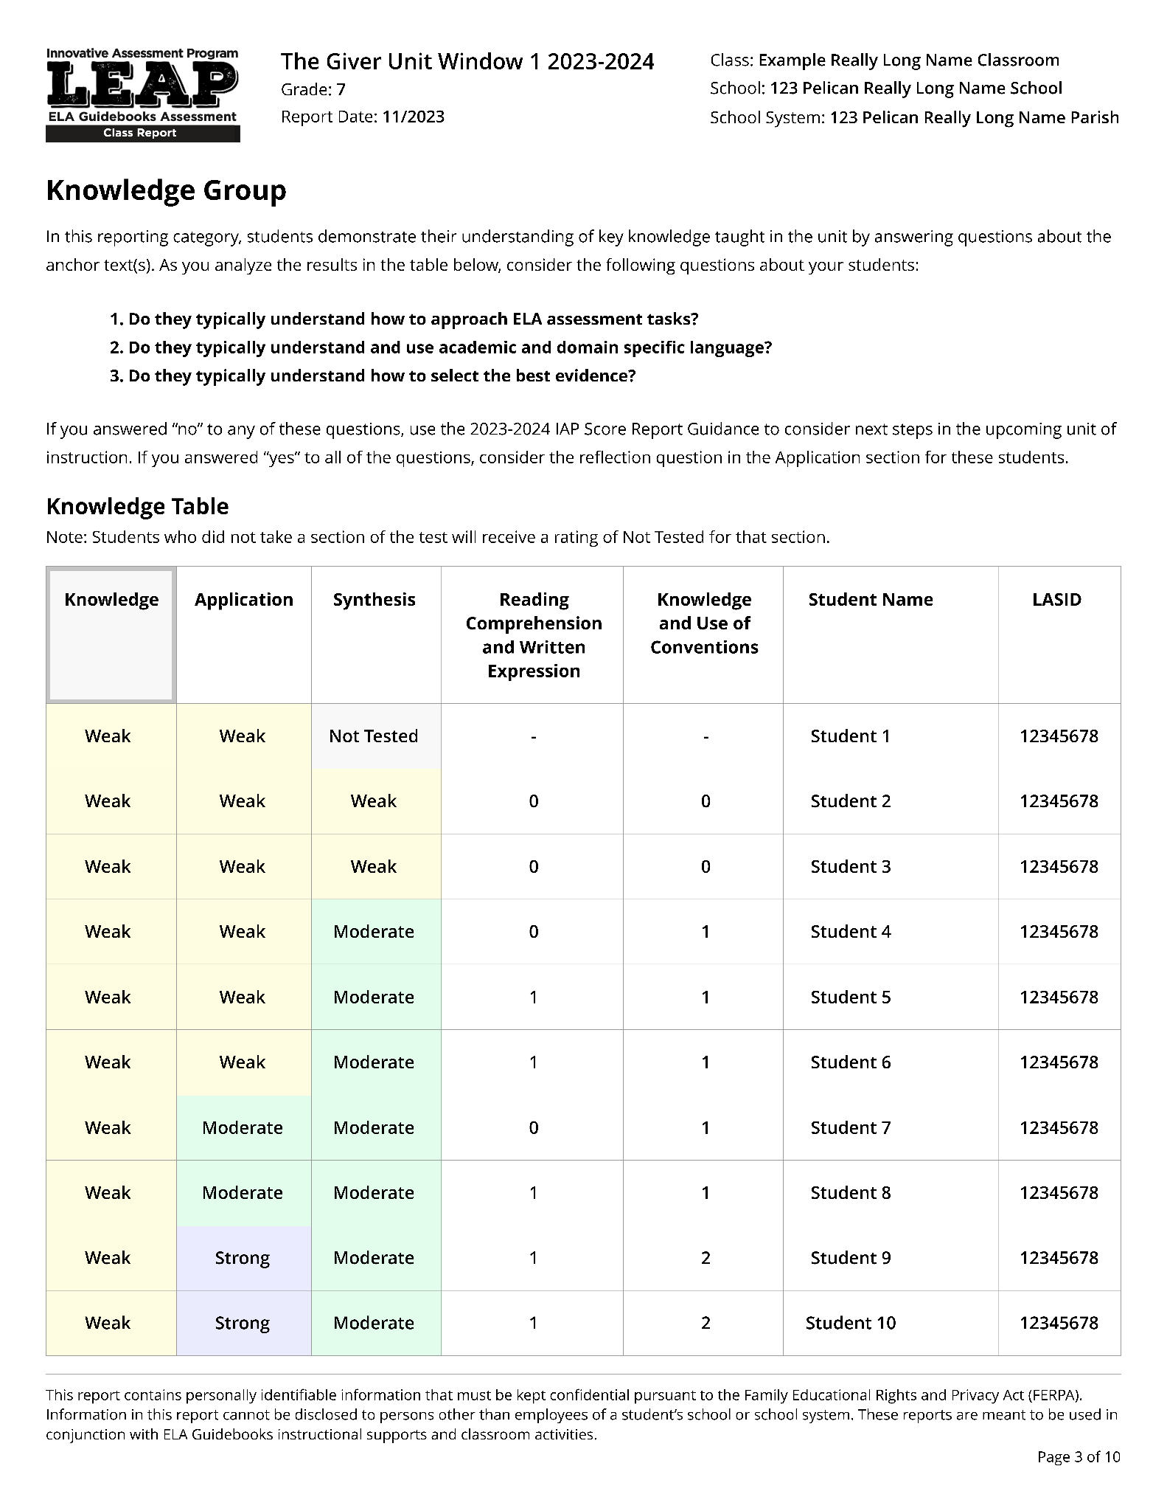
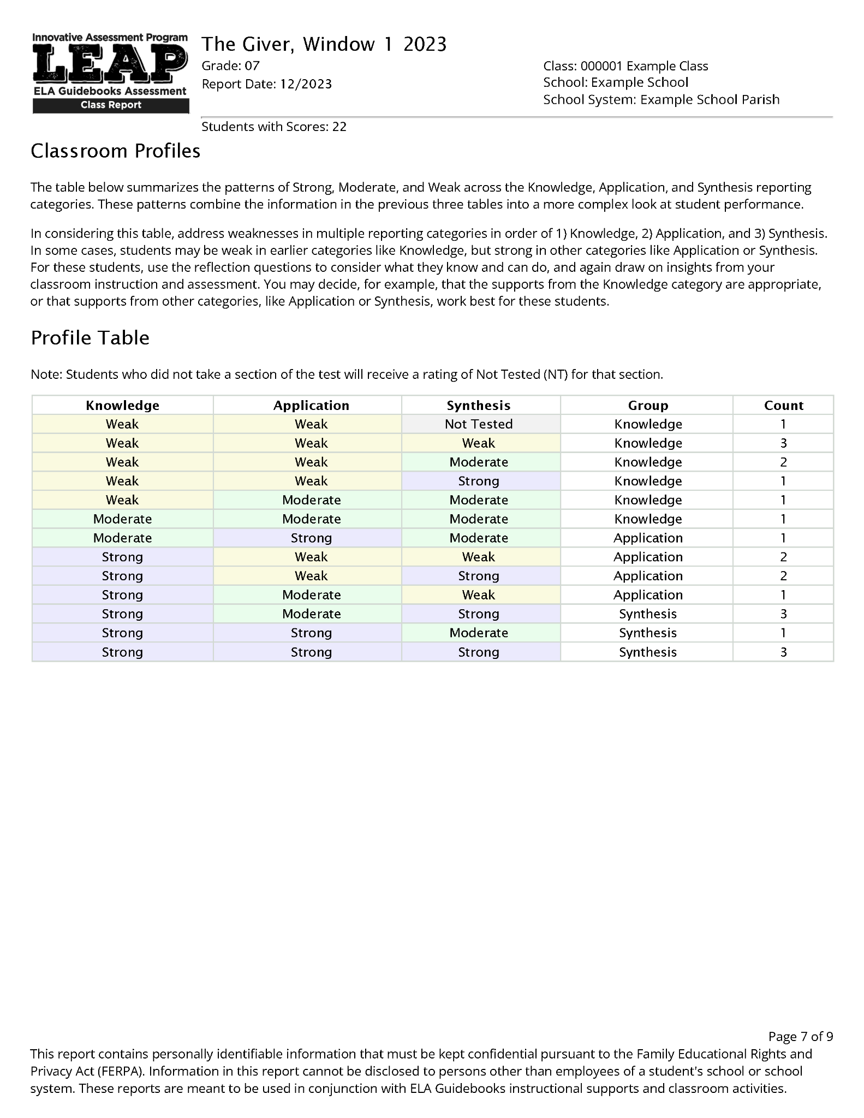
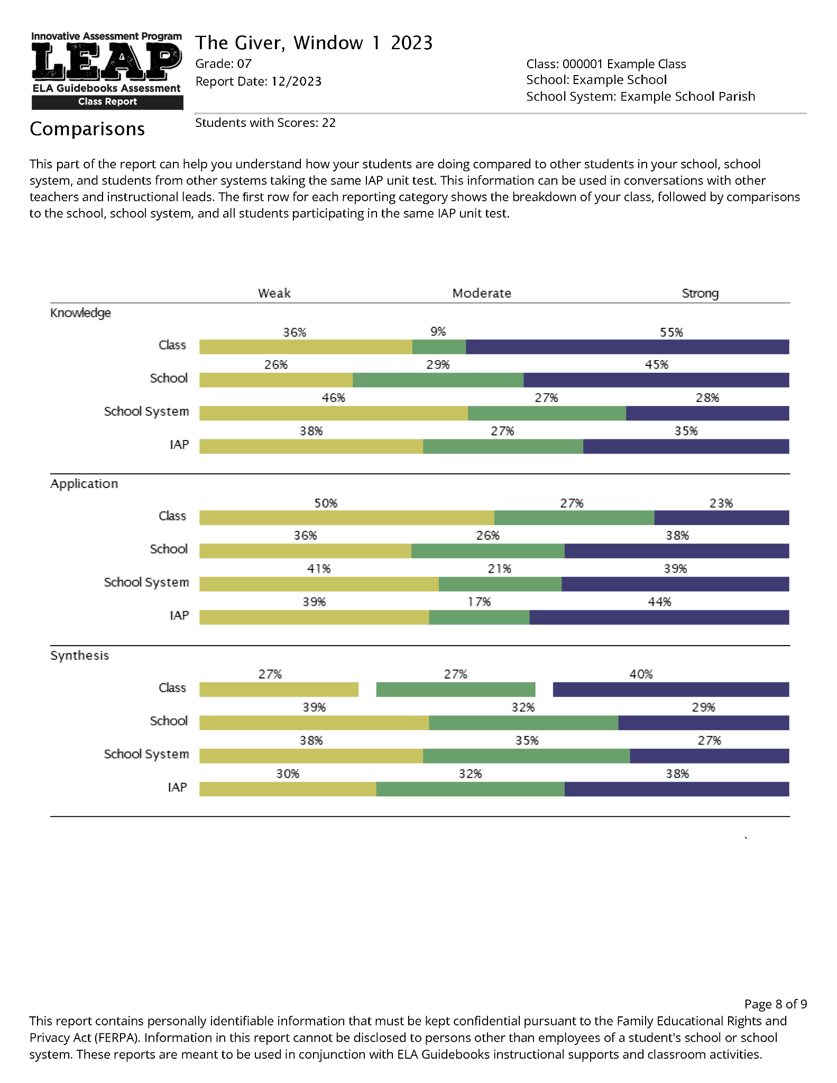
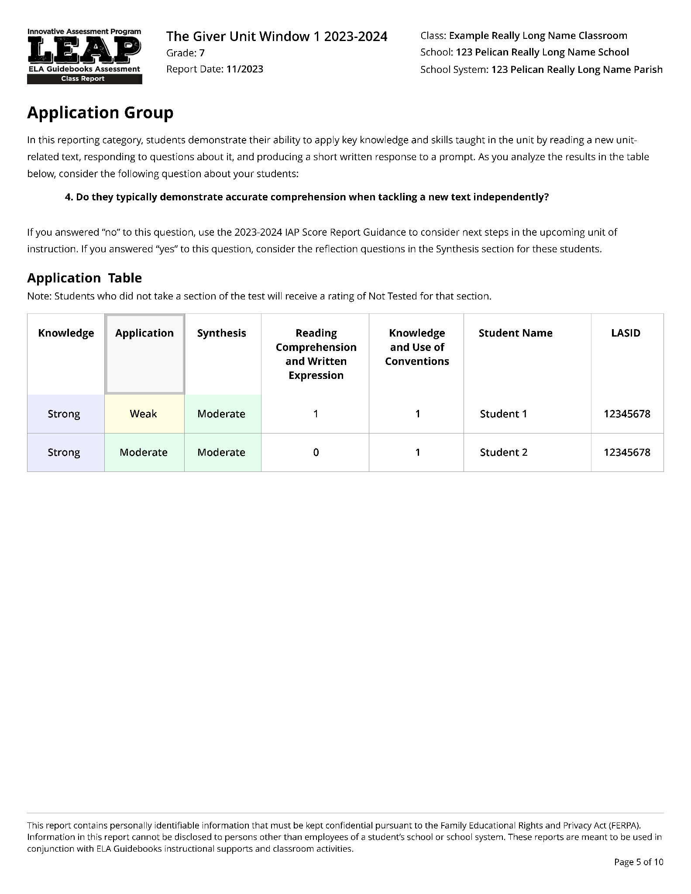
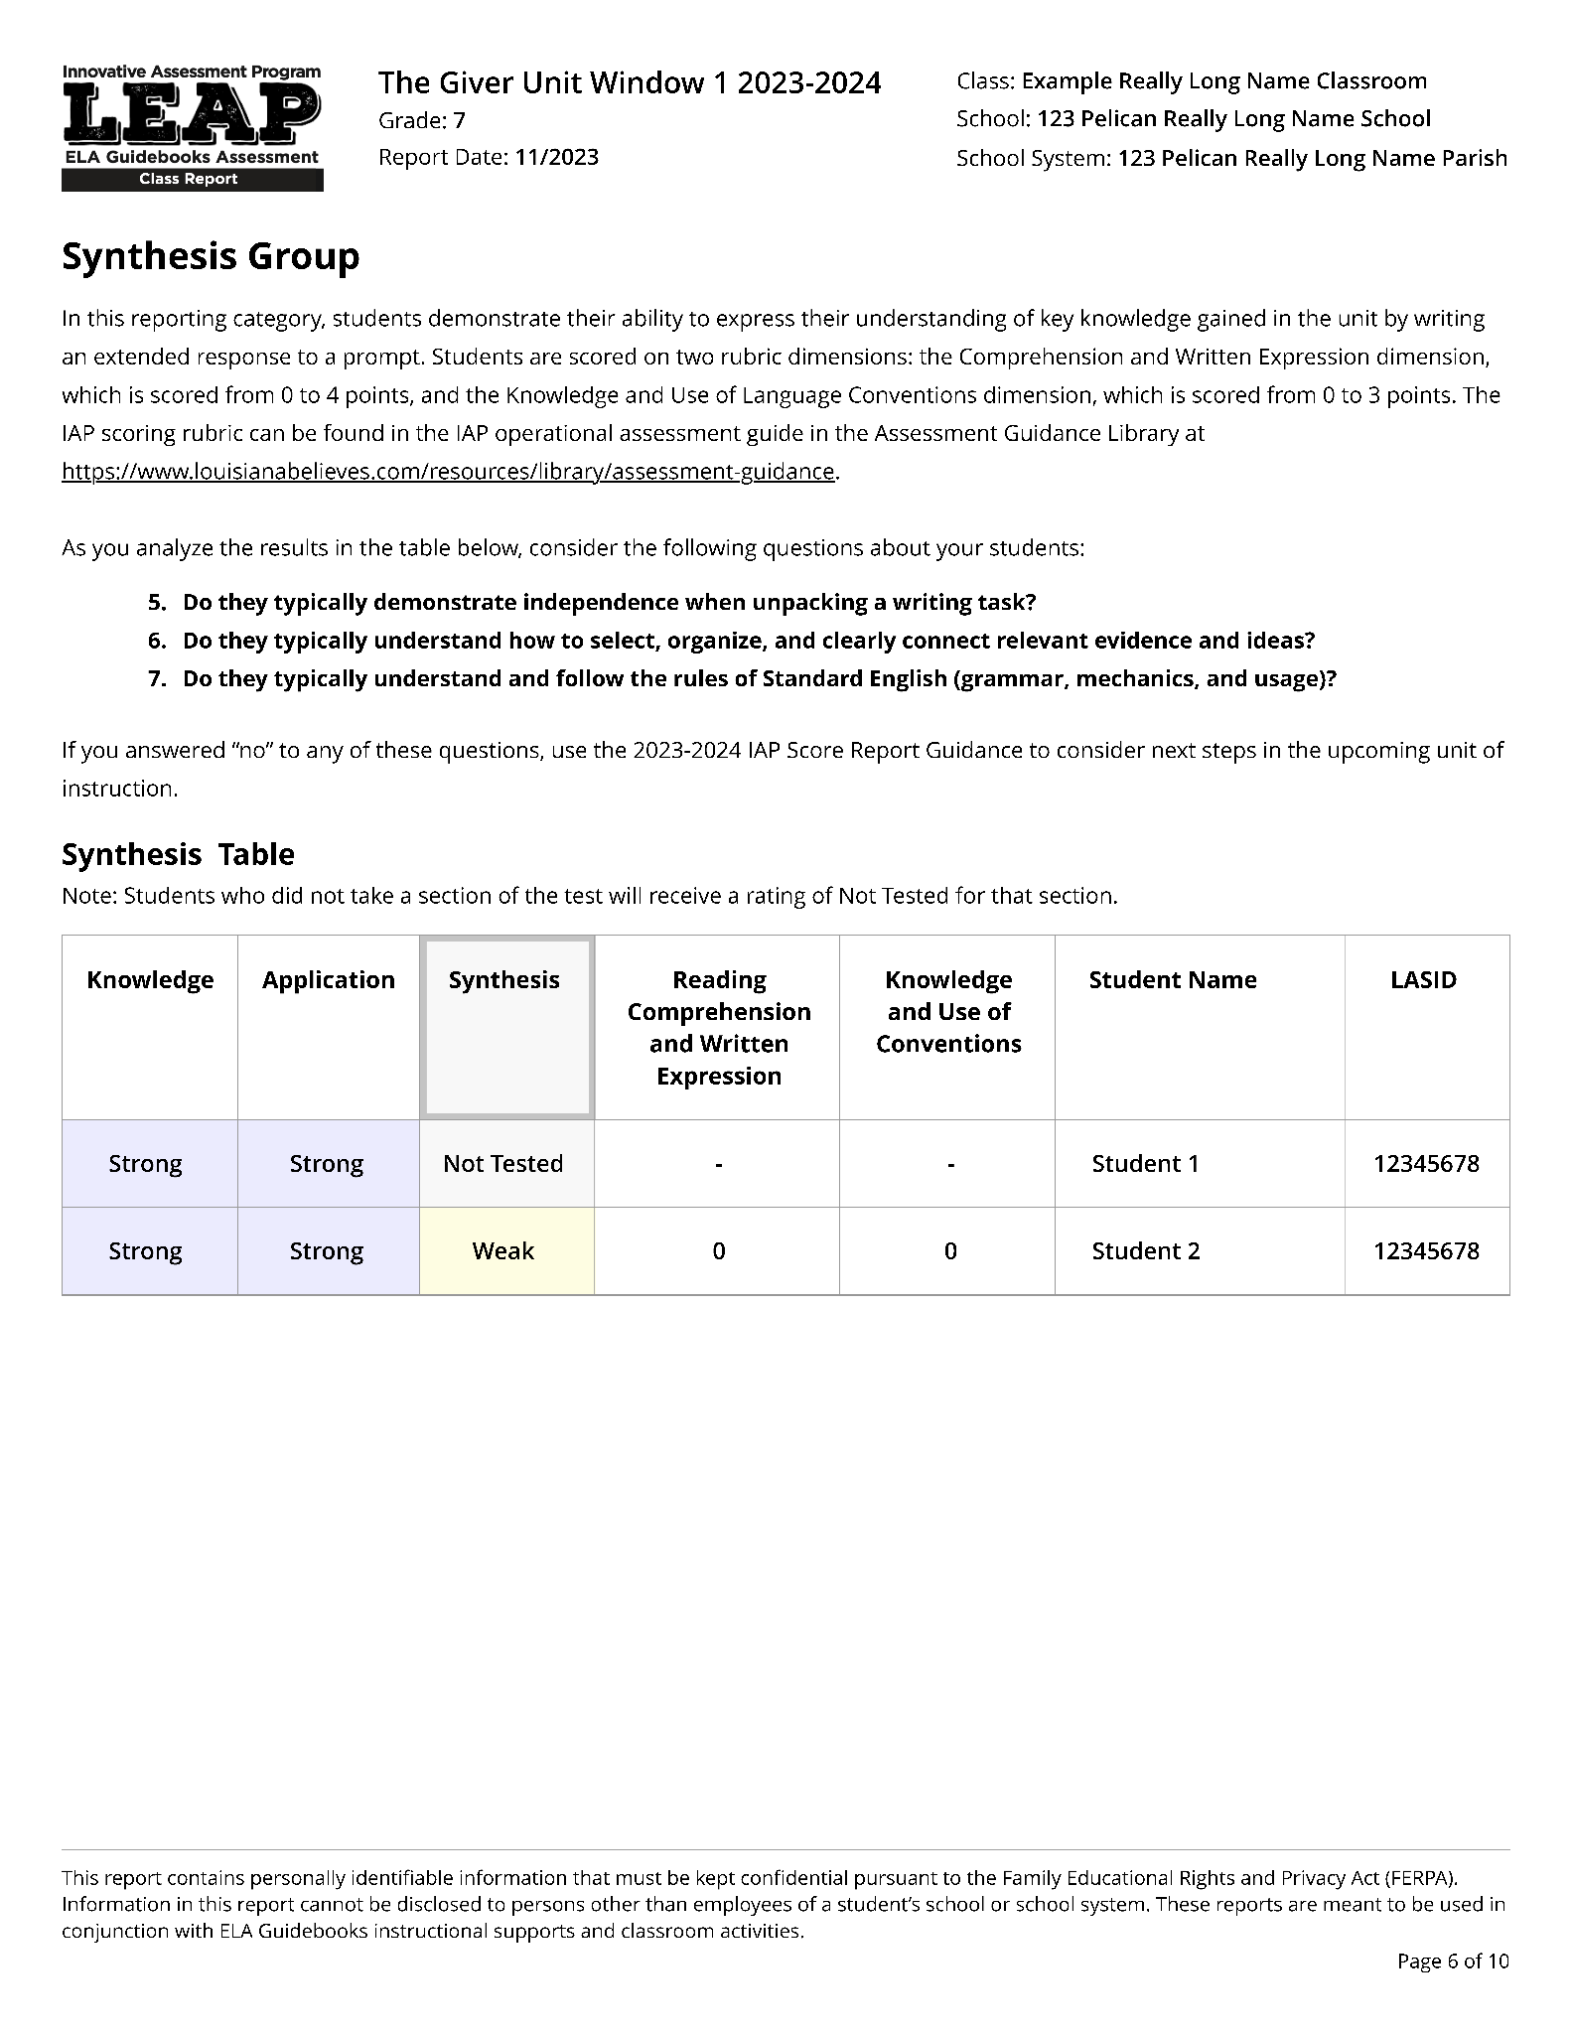
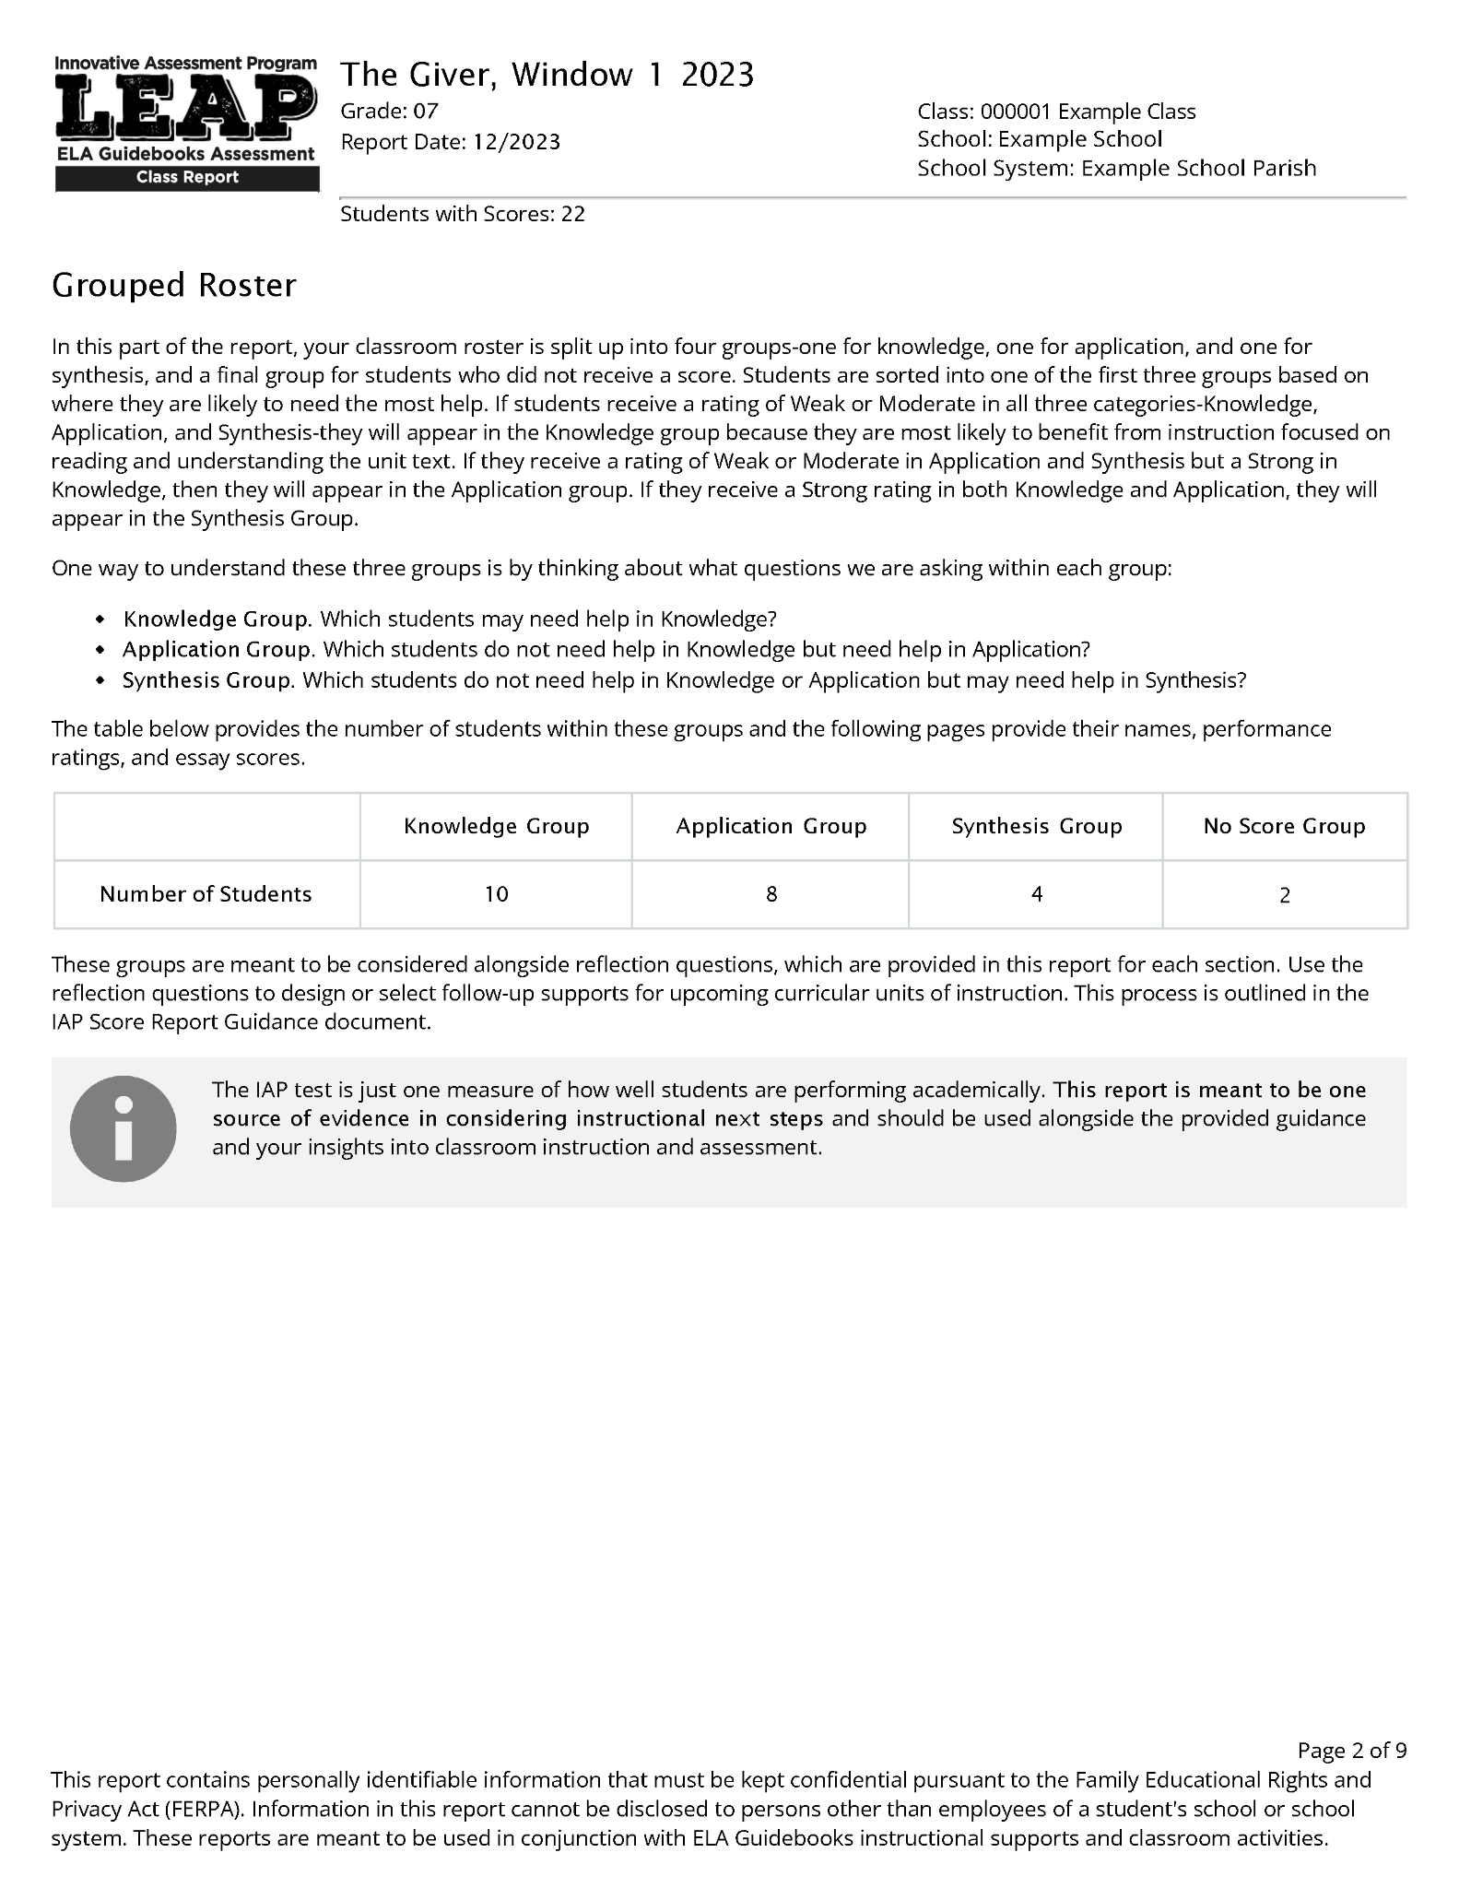
The Classroom Score Report
The new 2023-24 classroom score report is made up of four sections.
Overall Results
Grouped Roster
Classroom Profiles
Comparisons
Notes:
Duration: 60 seconds. NOTE THERE IS AN ANIMATION ON THIS SLIDE.
Facilitator says: In addition to the Score Report Reflections Guide you will need your most recent IAP Classroom Score Report. As you might remember from the previous module, the Classroom Score Reports have four sections. When working through the Score Report Reflections Guide, the most relevant section is the Grouped Roster Section [ADVANCE SLIDE SO THE IMAGE IS VISIBLE]. The Grouped Roster Section organizes students into three groups – those who scored weak or moderate on each of the three sections – Knowledge, Application and Synthesis. The Reflections Guide is organized around these groups.
In addition, the Profiles section of the Classroom Report shows all the score profiles and how many students are in each group for a more fine-grained breakdown of your class.
Make sure you have a classroom score report report near you before proceeding to the rest of this video.

Slide 13


Student Work Samples
Recent curriculum-embedded writing task
Why look at additional student work samples?
Looking at both IAP results and a classroom writing task provides a richer picture of student performance, and therefore learning.
Notes:
Duration: 2 minutes.
NOTE THERE ARE THREE ANIMATIONS ON THIS SLIDE.
Facilitator says: You might have noticed in the introduction to the Score Report Reflections Guide that we recommend that you gather some student responses to one or more recent curriculum-embedded writing task to review in conjunction with the score report.We suggest you pick a recent piece of writing that your students did that will give you insight into their current strengths and areas for growth.
And perhaps you are asking yourself [ADVANCE SLIDE SO THE IMAGE IS VISIBLE] why. First, [ADVANCE SLIDE SO THE IMAGE IS VISIBLE] no assessment is 100% reliable. If we could go back in time and retest your students, most would get similar scores, but some would get scores that differ.
In addition, the IAP results provides one valuable “snapshot” of student performance, and considering the IAP results the with results from classroom assessments, and in particular classroom writing tasks, provides a much richer picture of student performance and learning.
And that is why we ask you to also consider the most recent information you have access to. For example, if you are surprised by a student who scored lower than you expected on the IAP, you might dismiss the IAP results. However, if you go back to a recent curriculum-embedded writing task and you might realize that the student has been struggling and you hadn’t quite noticed because in earlier writing tasks they had done well.
Conversely, you might notice another student who usually performs well in class score in the Moderate performance level on the Knowledge reporting category. However, looking back at recent assessments you do not have any concerns about this student’s ability to identify key ideas from texts. You could decide that the student does not need any additional support at this time.
Pause now to look at both the IAP data and your own classroom data you can see some patterns and can identify areas for support.

Slide 14
Agenda Items
1. Let’s Set the Context
2. Overview of the Score Report Reflections Guide
3. Additional Materials You Will Need
4. Score Report Reflections Guide: Reflection Questions
5. Score Report Reflections Guide: Support Guidance
6. Reflection
Notes:
Duration: 30 seconds.
Facilitator says: Now pause the video here if you need to gather either student work or the class score reports before we begin to use Score Report Reflections Guide.

Slide 15
Using Reflection Questions: Knowledge
Do these students typically understand how to approach ELA assignments (i.e., success criteria)?
Do these students typically understand and use academic and domain-specific language?
Do these students typically understand how to select the best evidence?
Notes:
Duration: 2 minutes. NOTE THERE IS AN ANIMATION ON THIS SLIDE.
Facilitator says: Now we are going to begin the process. The first set of questions in the Reflection Tables ask you to consider the information in the score report for the group of students who scored Weak or Moderate on the Knowledge section. These students are listed in the Grouped Roster section of your score report, and specifically, the Knowledge Table.
The Reflection questions [ADVANCE SLIDE SO THE IMAGE IS VISIBLE] are intended to help you identify what each student is struggling with that relates to this assessment category. The questions are ordered with the most pressing issues first. In other words, you might not yet know if a student struggles to select the best evidence to support their argument or ideas (question 3) if they are struggling to independently read the task itself (question 1).
Note each question uses the word “typically” – in other words, although these students have been flagged in this category as needing additional support, this is where you can triangulate the IAP report with your own classroom observations and curriculum-embedded assessments. This allows you to think about multiple sources of data - which will let you build a more reliable picture of student strengths and weaknesses than any single source.
First think about this group of students and identify which ones don’t typically (based on the IAP data AND other assessment data you have access to) understand how to approach the assignment. Write their names in the box opposite the question in the Reflection Guide. In the next section you will get information about strategies you can employ for this sub-group. Assuming not all students fall into this category, for the remaining students you will shift to question 2 and consider whether some typically do not understand and use academic and domain-specific language. Write their names in Box 2 - again there will be guidance for those students later. For the students who remain you will look at question 3 to consider whether any are struggling to select the best evidence. Again, put their names in box 3. You may have 1 or 2 students who were flagged but who do not fall into any of the current categories. Keep their names in mind as you continue to interrogate the later questions.

Slide 16
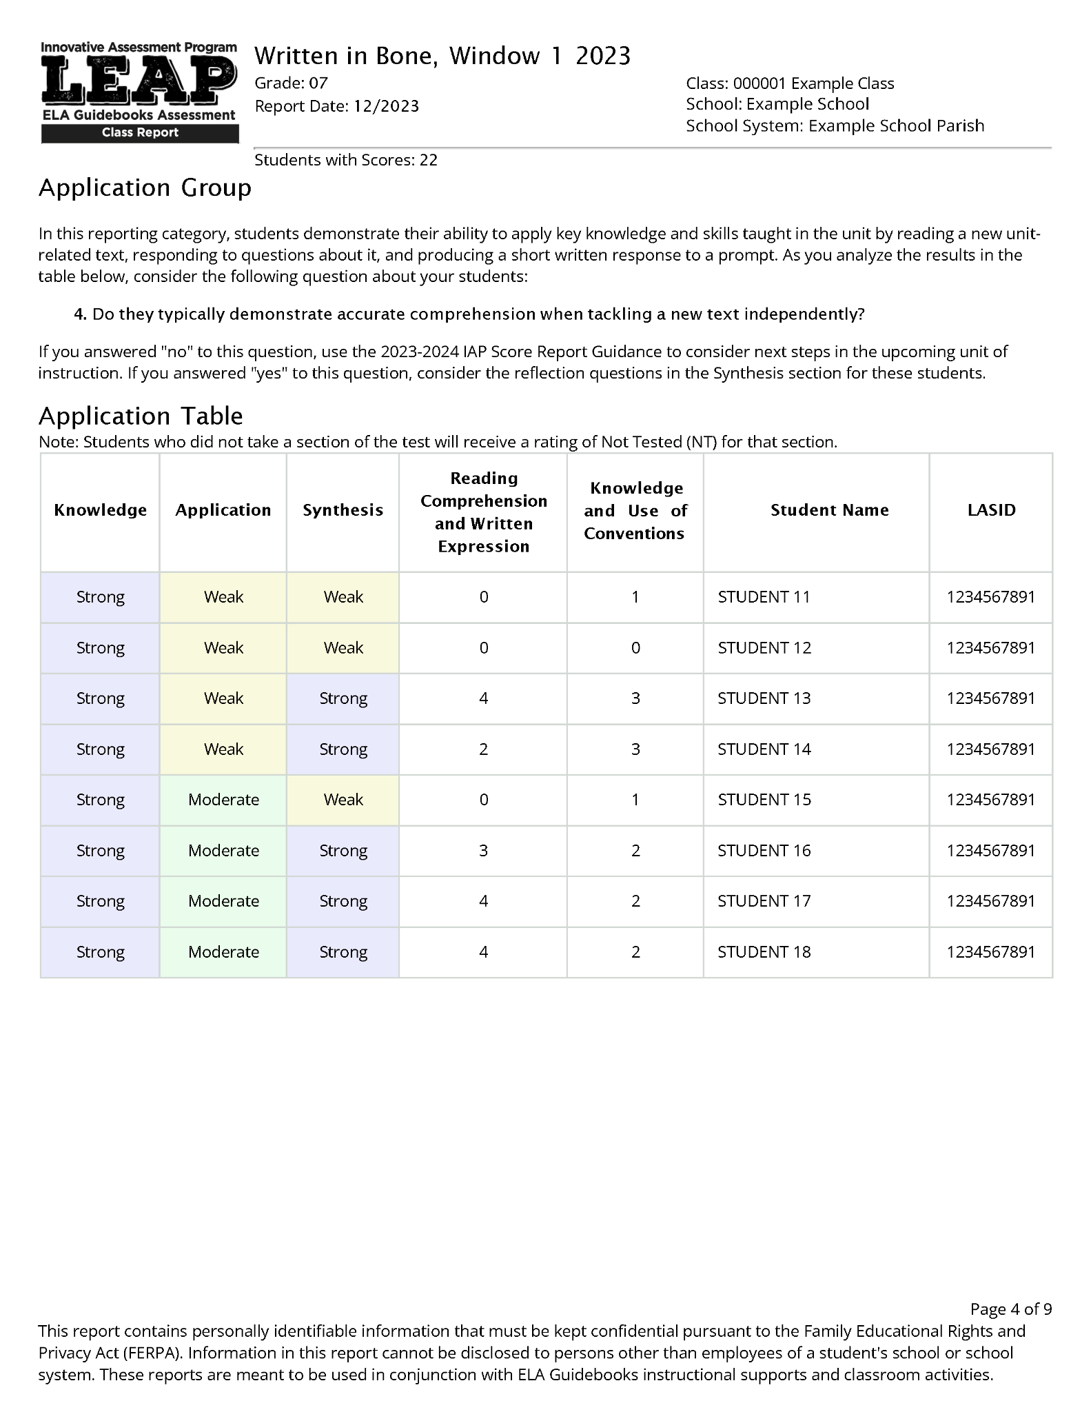
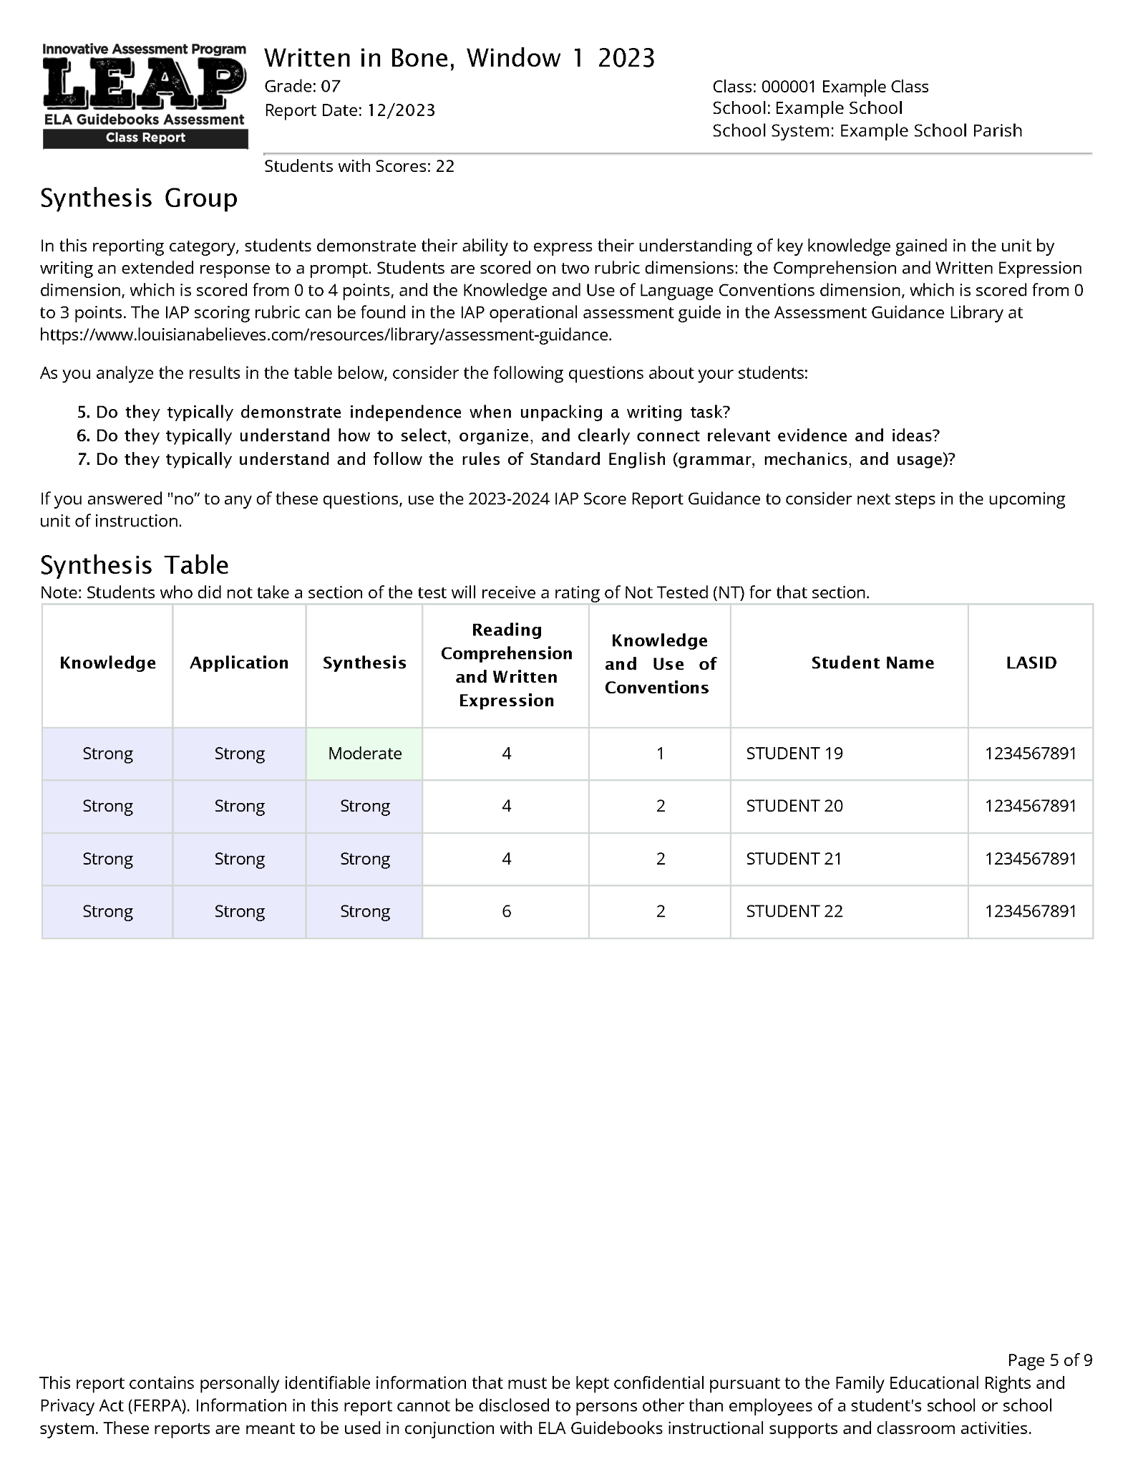
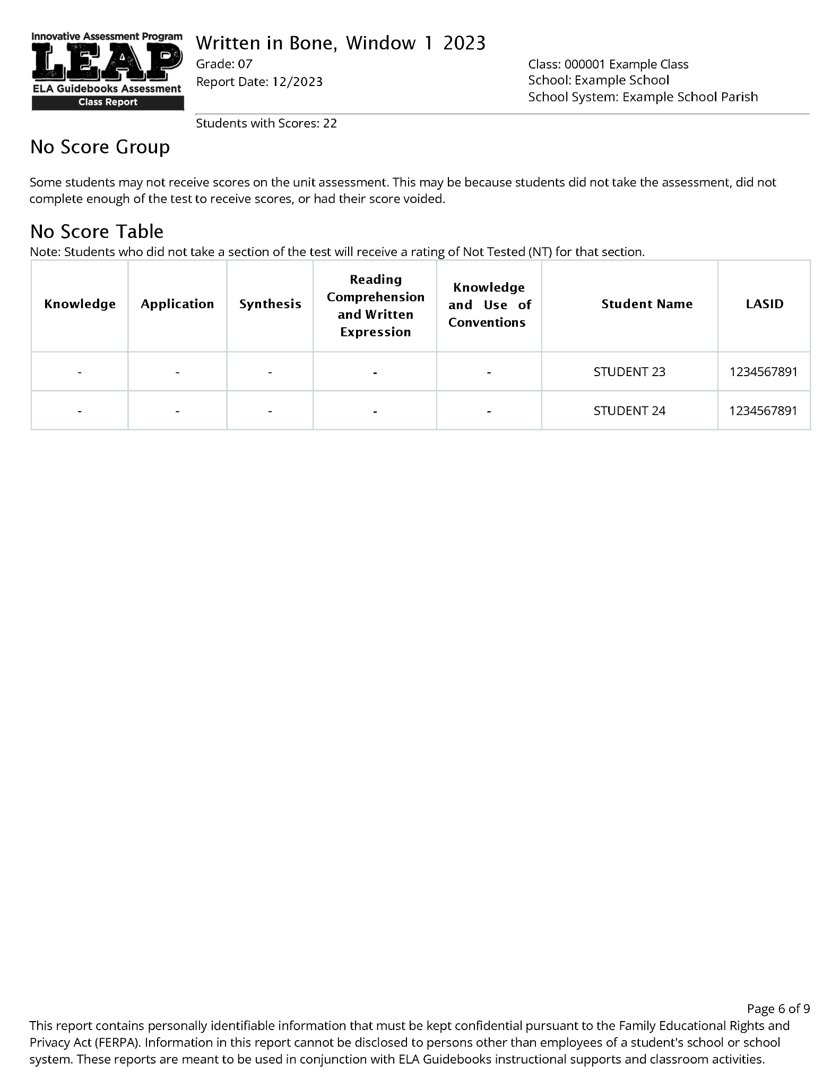
Modeling the Process
The Knowledge Group
The Application Group
The Synthesis Group
The No Score Group
Notes:
Duration: 1 minute.
Facilitator says: This is an example showing how a class of 22 students were grouped into the Knowledge, Application and Synthesis groups depending on their performance ratings. The first set of questions that we just reviewed apply, in this example, to the 10 students in the Knowledge group who scored Weak or Moderate on the Knowledge section. Let’s see what happens as a teacher considers the first set of Reflection questions for this group.

Slide 17
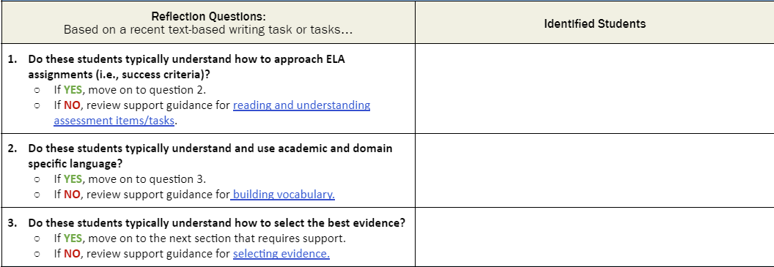
Modeling the Process
The Knowledge Group
1
2
3
4
5
6
7
8
9
10
Student 2
Notes:
Duration: 15 seconds. NOTE THERE IS AN ANIMATION ON THIS SLIDE.
Facilitator says: After reviewing a recent classroom writing task for this group of 10 students, the teacher identifies just one student who is struggling significantly understanding what the IAP questions are asking. [ADVANCE SLIDE] She notes that student’s name down for question 1.

Slide 18
Modeling the Process
The Knowledge Group
1
3
4
5
6
7
8
9
10
Student 2
Student 3, Student 6, Student 7 Student 10
Notes:
Duration: 15 seconds. NOTE THERE IS AN ANIMATION ON THIS SLIDE.
Facilitator says: She then noted another four students who struggled within a writing task, as well as other assignments, to understand and use academic and domain specific vocabulary [ADVANCE SLIDE] - so she noted them down in the second box.

Slide 19
Modeling the Process
The Knowledge Group
1
4
5
8
9
Student 2
Student 3, Student 6, Student 7 Student 10
Student 4, Student 5, Student 8 Student 9
Notes:
Duration: 15 seconds. NOTE THERE IS AN ANIMATION ON THIS SLIDE.
Facilitator says: Finally she reviewed students’ responses to several recent writing prompts and noted that almost all of the remaining students struggled to select the best evidence to support their answers [ADVANCE SLIDE] – so she noted them in the third and final box.

Slide 20
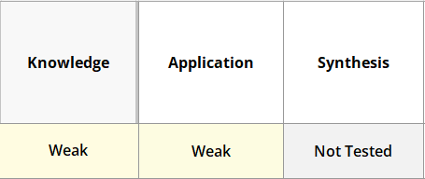
Modeling the Process
The Knowledge Group
1
Student 2
Student 3, Student 6, Student 7 Student 10
Student 4, Student 5, Student 8 Student 9
Notes:
Duration: 1 minute. NOTE THERE ARE 2 ANIMATIONS ON THIS SLIDE.
Facilitator says: Student 1 was the only student for whom none of the three Reflection questions seemed to apply. This student was not always a strong writer, but was a good reader and someone who was able to understand what assignments asked of him and responded well. The teacher looked at this student’s complete profile [ADVANCE SLIDE SO THE IMAGE IS VISIBLE] and saw that he was rated as Weak on both the Knowledge and Application sections and did not complete the final writing prompt. This seemed unusual for this student and the teacher wondered if something had happened on the testing days or if he had not been feeling well. The teacher decided to keep this student in mind when she got to the Synthesis section and reflect some more on his essay writing, even though she did not have any IAP data for Student 1 on that section.
[ADVANCE SLIDE SO THE IMAGE IS VISIBLE] Pause the video here and work through the first set of Reflection Questions for the students in your class who are in the Knowledge group. When you are done, hit play again.

Slide 21
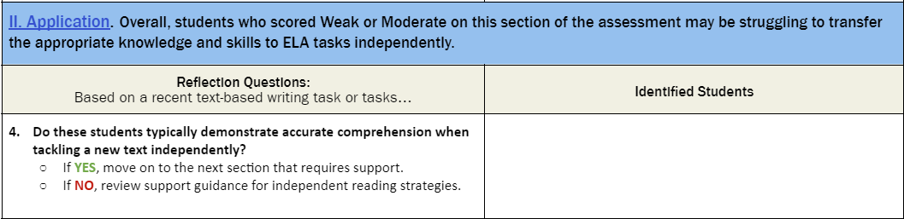
Using the Reflection Questions: Application
Notes:
Duration: 2 minutes. NOTE THERE IS AN ANIMATION ON THIS SLIDE.
Facilitator says: You are now going to repeat the process for the students who were placed in the Application group – that is those students who were Strong in the Knowledge section but Weak or Moderate in the Application section, which suggests they may be struggling to transfer the appropriate knowledge and skills to ELA tasks independently. In this instance there is only one reflection question to consider. As you look at some recent assignments and assessments for this group of students note which of them seem to struggle with comprehension when looking at a new text on their own. Note their names in the table. If there are students in this group on the IAP report who do not typically have comprehension struggles, consider the questions in the final table.
[ADVANCE SLIDE SO THE IMAGE IS VISIBLE] Pause the video here and step through this process for the students in your class who are in the Analysis group. When you are done, hit play again.

Slide 22
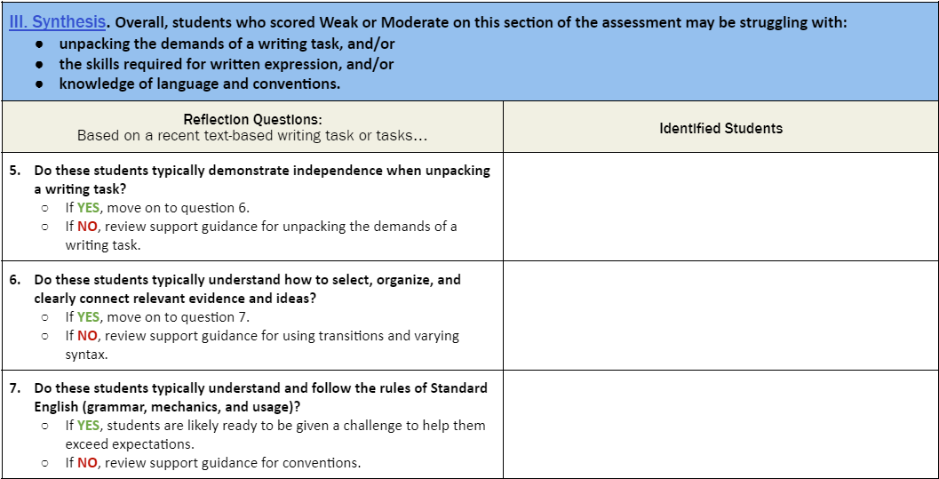
Using the Reflection Questions: Synthesis
Notes:
Duration: 2 minutes. NOTE THERE IS AN ANIMATION ON THIS SLIDE.
Facilitator says: You are now going to repeat the process for the students who were placed in the Synthesis group – that is those students who were Strong in the first two sections, but Weak or Moderate in the Synthesis section, which suggests they may be struggling with some aspects of writing. Here there are three reflection questions to consider. As you look at some recent assignments and assessments for this group of students note whether the first question describes a typical struggle they have. If not, move to the second and third questions. Where the questions describe something you see in other writing that they have done, note their names in the table.
[ADVANCE SLIDE SO THE IMAGE IS VISIBLE] Pause the video here and step through this process for the students in your class who are in the Synthesis group. When you are done, hit play again.

Slide 23
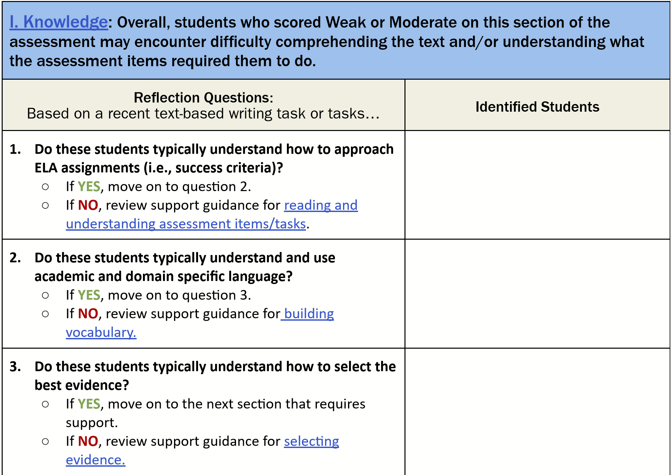
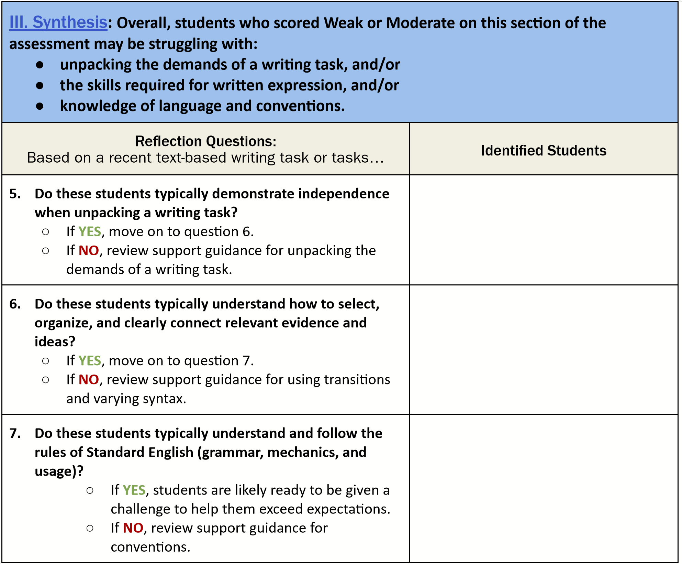
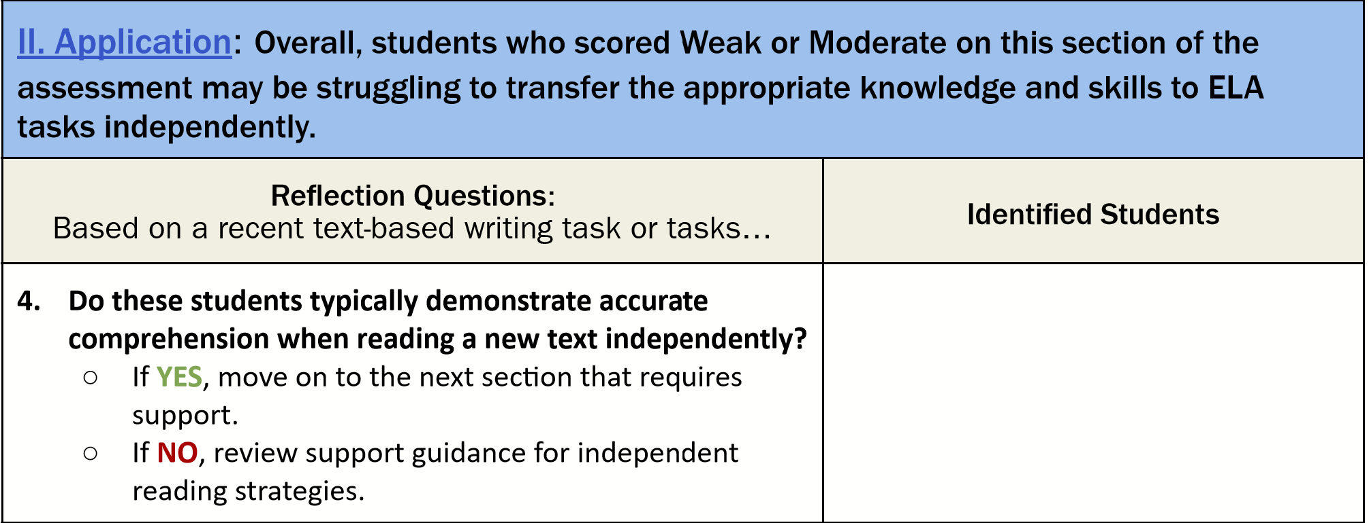
Student 2
Student 1, Student 14, Student 15, Student 18
Student 3, Student 6, Student 7 Student 10
Student 19, Student 20,
Student 22
Student 4, Student 5, Student 8 Student 9
Student 22
Student 11, Student 12, Student 13, Student 16, Student 17
Notes:
Duration: 30 seconds
Facilitator says: You now should have a complete worksheet with the reflection questions that looks something like this. You might not have identified students for every section. The next section will walk you through using the Support Guidance resource.

Slide 24
Agenda Items
1. Let’s Set the Context
2. Overview of the Score Report Reflections Guide
3. Additional Materials You Will Need
4. Score Report Reflections Guide: Reflection Questions
5. Score Report Reflections Guide: Support Guidance
6. Reflection
Notes:
Duration: 30 seconds. NOTE THERE IS AN ANIMATION ON THIS SLIDE.
Facilitator says: The final section of the support documentation is in many ways the most important because it moves you from analysis of your students’ data to action, providing you with suggestions for how you might want to support the various groups of students that you just identified.
Remember you don’t have to review and enact all of the suggestions at once but can quickly skim to see what might be relevant and what you might want to come back to later. For this section, we suggestion you print out the Support Guidance, grab a highlighter and some sticky notes.
[ADVANCE SLIDE SO THE IMAGE IS VISIBLE] Pause the video here if you need to grab supplies. When you are ready, hit play again.

Slide 25

Support Guidance
Student Q, Student B
Notes:
Duration: 2 minutes. NOTE THERE ARE ANIMATIONS ON THIS SLIDE.
Facilitator says: There are seven sections in the Support Guidance. Each one follows the same structure, with answers to the same four questions.
[ADVANCE SLIDE SO THE FIRST OVAL IS VISIBLE] At the top of each table is a reflection question that you already answered and identified students for whom the answer was “NO”
[ADVANCE SLIDE SO THE FIRST OVAL DISAPPEARS, AND AGAIN SO THAT THE SECOND OVAL IS VISIBLE] The answer to the first question “what inferences can be made from this data point?” is essentially describing what you have already noted about the cluster of students whom you identified in responding to question 1.
[ADVANCE SLIDE SO THE SECOND OVAL DISAPPEARS, AND AGAIN SO THAT THE THIRD OVAL IS VISIBLE] The answer to the second question is in many ways the motivation for why it is important to help students succeed in this area - what are they being held back from being able to do?
[ADVANCE SLIDE SO THE THIRD OVAL DISAPPEARS, AND AGAIN SO THAT THE FOURTH OVAL IS VISIBLE] The answer to the third question draws your attention to specific aspects of the ELA Guidebooks Lessons that will support students engage with this need.
[ADVANCE SLIDE SO THE FOURTH OVAL DISAPPEARS, AND AGAIN SO THAT THE FIFTH OVAL IS VISIBLE] The final section provides some very practical suggestions for what you can do next.
[ADVANCE SLIDE SO THE IMAGE IS VISIBLE] Pause the video here and skim through this document to get a sense for its structure. Note if you have students in each section of the Reflection Question worksheet. If not, there may be some sections of the Support Guidance that you skip for now. When you are done reading, hit play again.

Slide 26

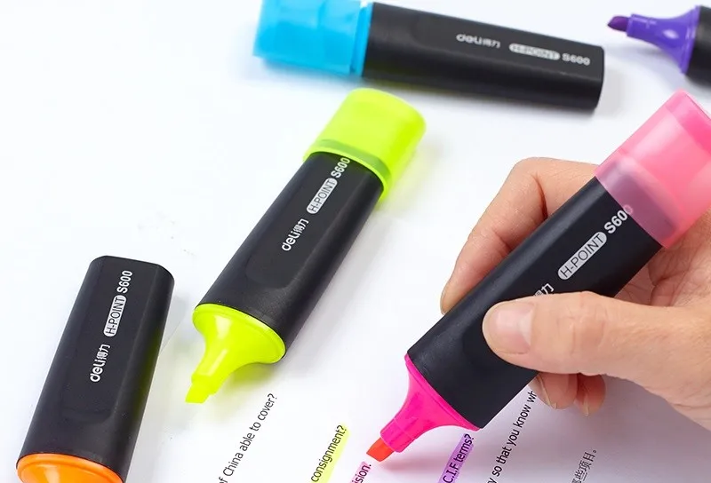

Connect the Guidance with the Current Unit
Start with the students who need the most help.
OR
Start with the largest group of students.
Connect guidance that you want to implement with your curriculum materials.
Repeat for each student group.
Notes:
Duration: 2 minutes.
Facilitator says: There are lots of suggestions for ways in which you can help your students, particularly as within the last section of each table - the How can I pull a lever tomorrow to support my students? section. The number of student groups, and possible levers to pull, might seem daunting at first. You don’t have to try to do all of the levers at once, but instead strategically think through what levers you can introduce and when. You may not get to all of the levers or groups, and that’s okay. What is important is to think about how you can best help your students and integrate these levers as opportunities present themselves. You may also find it useful to have these discussions with your grade-level teaching team.
We are not suggesting that every lesson is differentiated for every group of students identified in your most recent classroom IAP report, and some of the suggestions may be things that you already are doing. The guidance provided here is meant to be used flexibly based on your professional judgment.
Making the connection to your curriculum and lesson planning takes some time. We suggest you take this in stages. [ADVANCE SLIDE SO THE TEXT BOX IS VISIBLE] You can either start with the Support Guidance that corresponds to the first Reflection Question where you categorized students or the largest group of students. Maybe you did not identify any students for Reflection Questions 1 and 2 but had several for Question 3. So you might start with the Support Guidance for Question 3. Alternatively you might have the largest group of students identified for, say, Question 4. So you might start with the Support Guidance for Question 4.
Wherever you choose to start, read the various actions that you could take to help this group of students tomorrow using your ELA Guidebooks Curriculum. Identify what seems most useful and that you can implement. Use sticky notes, highlighting etc. to mark up your curriculum materials, like lessons plans, so that you remember what you are planning to do. Some of the actions might be tomorrow, but some could be next week, or part of a weekly routine. Some of the guidance might only apply to a particular kind of curriculum task. It is important to connect the Guidance provided in this document to your curriculum resources and make it easy for you to remember. For example, you might want to write students names on sticky notes and add them to specific sections of the unit to help you remember which students these actions are particularly important for. [ADVANCE SLIDE SO THE STICKY NOTES IMAGE IS VISIBLE]
If you are not able to work through all the relevant Support Guidance sections at one time, the last thing you should do it make a plan for when you will be able to find the time. [ADVANCE SLIDE SO THE PLANNER IMAGE IS VISIBLE] You might want to plan time for yourself or with your grade level team to work together.

Slide 27
Agenda Items
1. Let’s Set the Context
2. Overview of the Score Report Reflections Guide
3. Additional Materials You Will Need
4. Using the Reflection Questions
5. Using the Support Guidance
6. Reflection
What did you learn from examining your score reports along with the Reflections Guide?
Notes:
Duration: 2 minutes
Facilitator says: Let’s close out this session by taking a few moments to reflect on what we’ve learned in this session. [ADVANCE SLIDE SO THE QUESTION IS VISIBLE]
What did you learn from examining student score reports in conjunction with the Reflections Guide?
Facilitator does: Provide time for participants share with the whole group.
Facilitator says: Our next session will be Session 7: Using CSV Files for In Depth Analysis

Slide 28
For questions about the IAP, please contact
Ruth Caillouet, the Innovative Assessment Coordinator
Ruth.caillouet@la.gov
Send general assessment questions to
assessment@la.gov

