Slide 1
Innovative Assessment Program
Professional Learning Series
Short Videos
For Teachers: Understanding the Grades 6-8, 2023-24 Classroom
Score Report and Score Report Reflections Guide
December 2023
Notes:
Facilitator says: In this short video, we will review the new, Innovative Assessment Program classroom score report for grades 6-8. These reports are new for the 2023-34 school year. In addition, we will also review am important a supporting document known as the score report reflections guide.

Slide 2
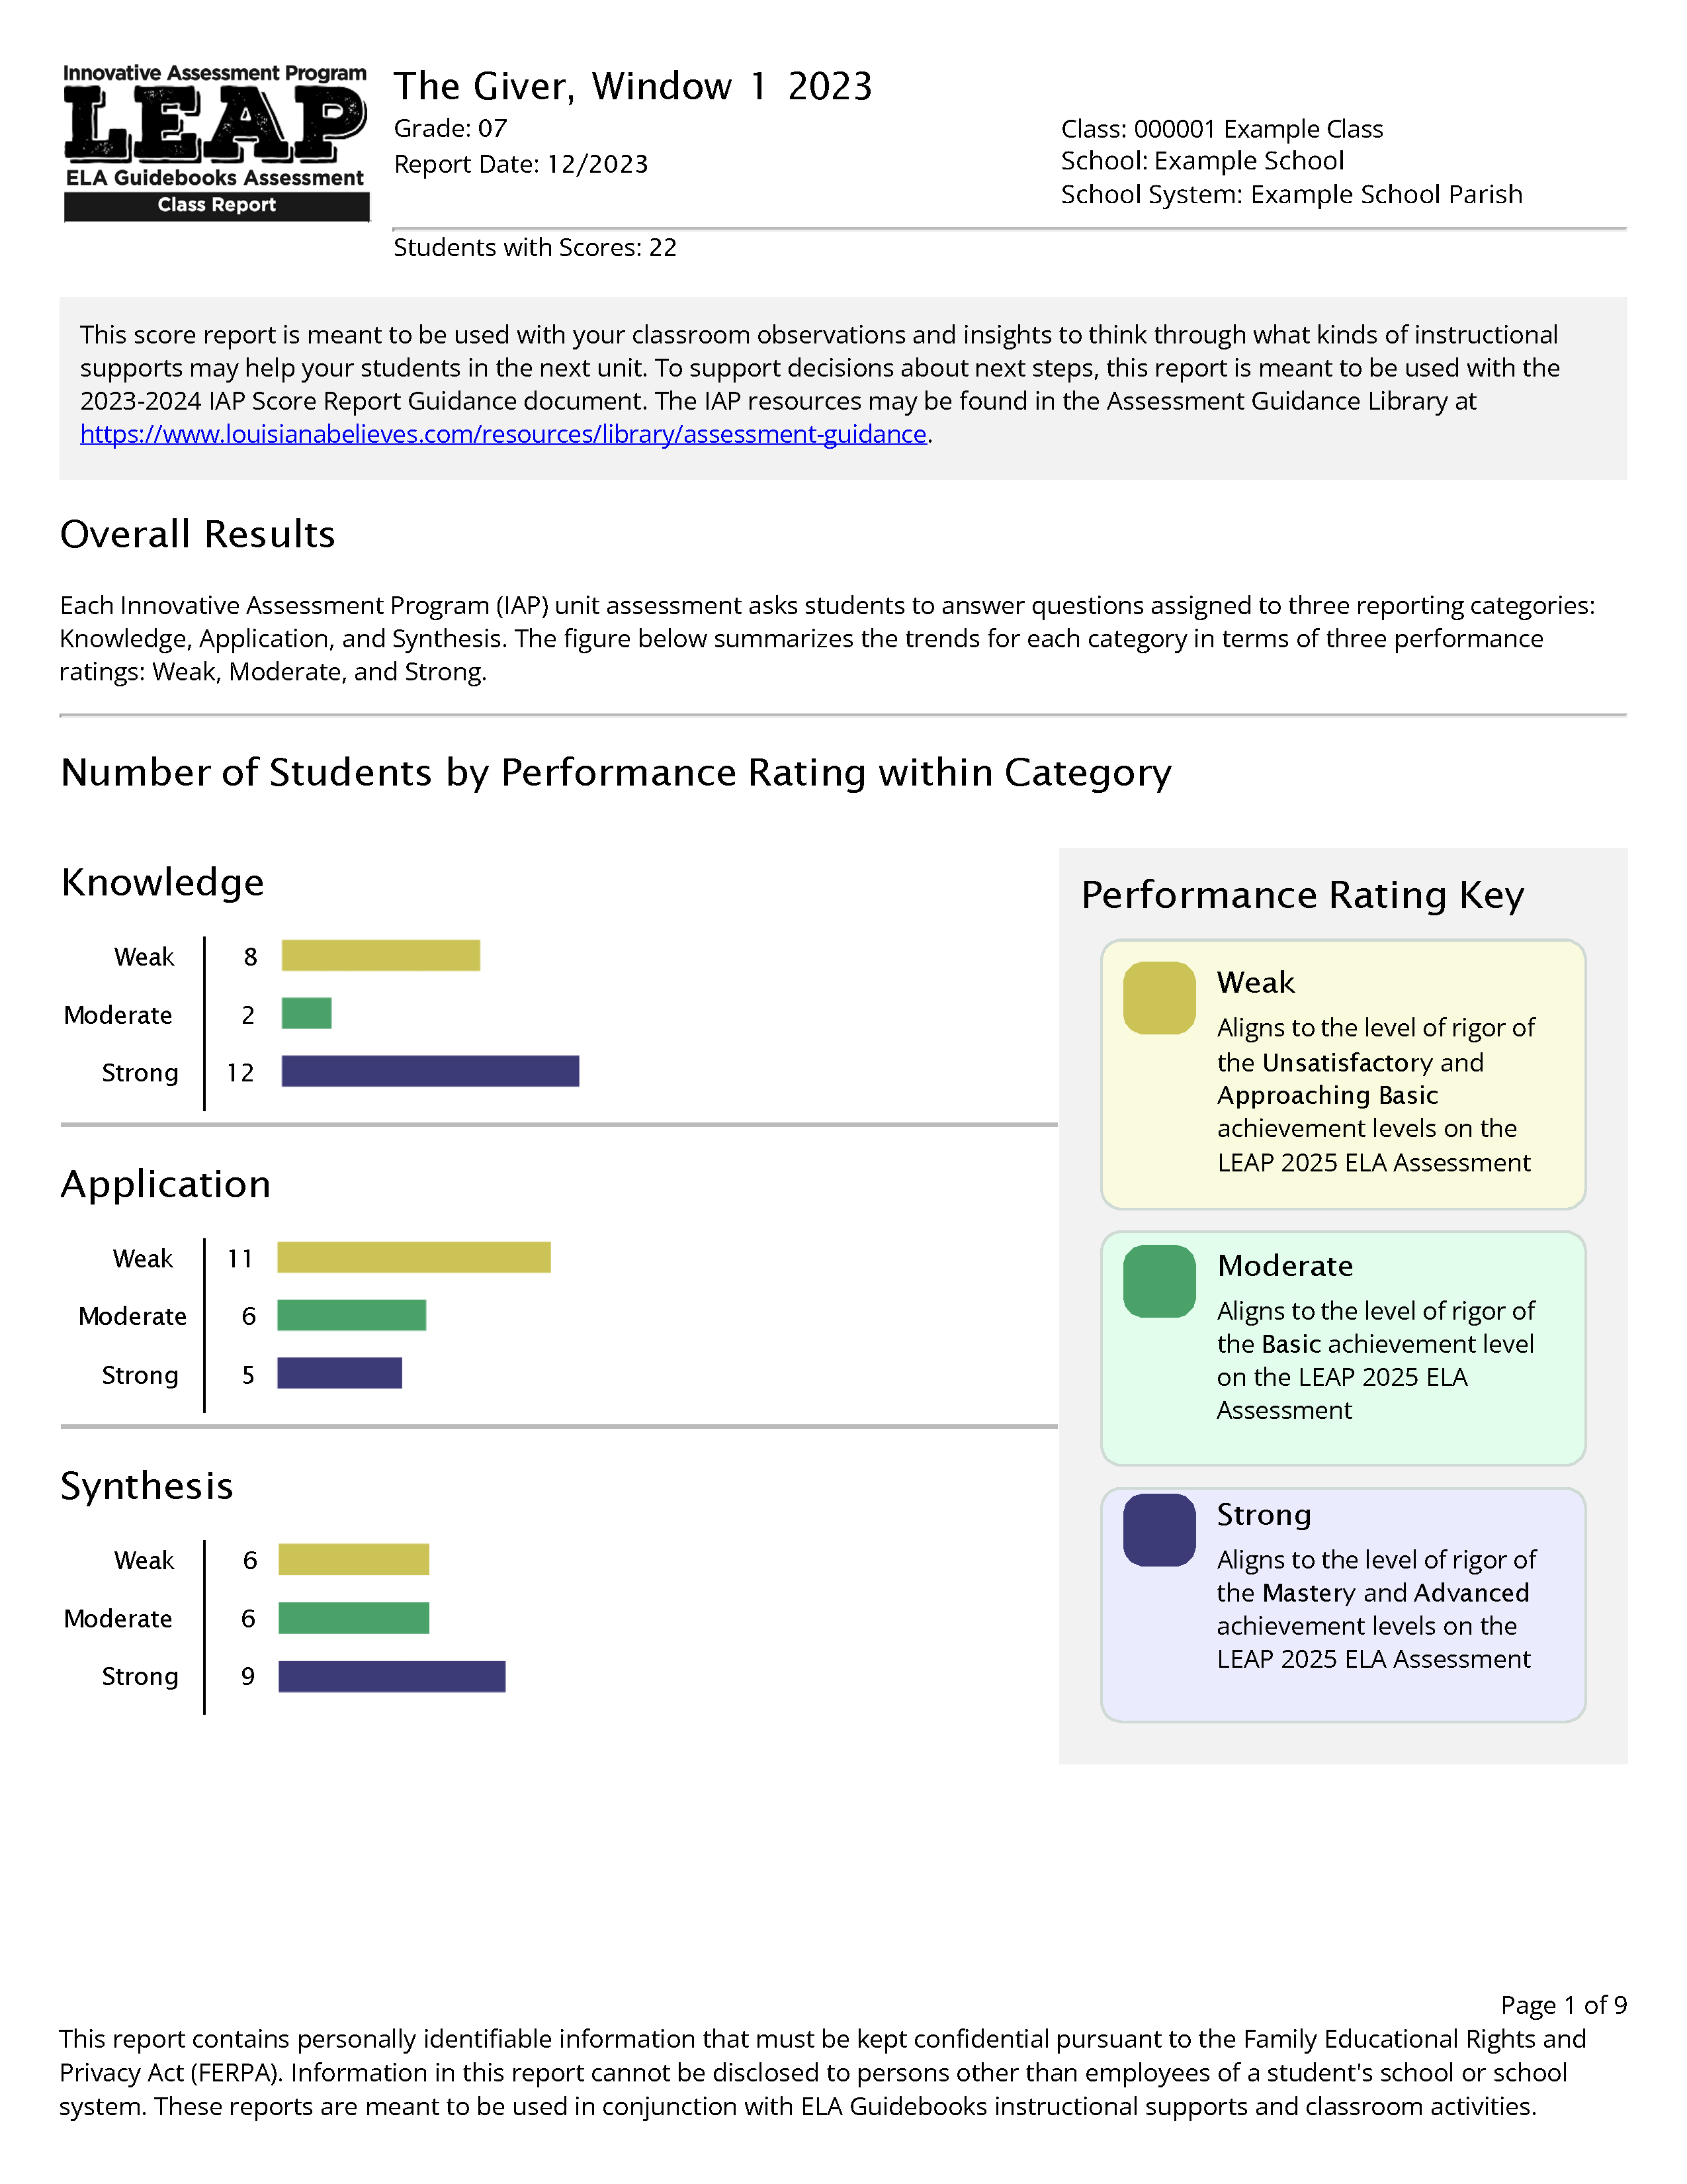
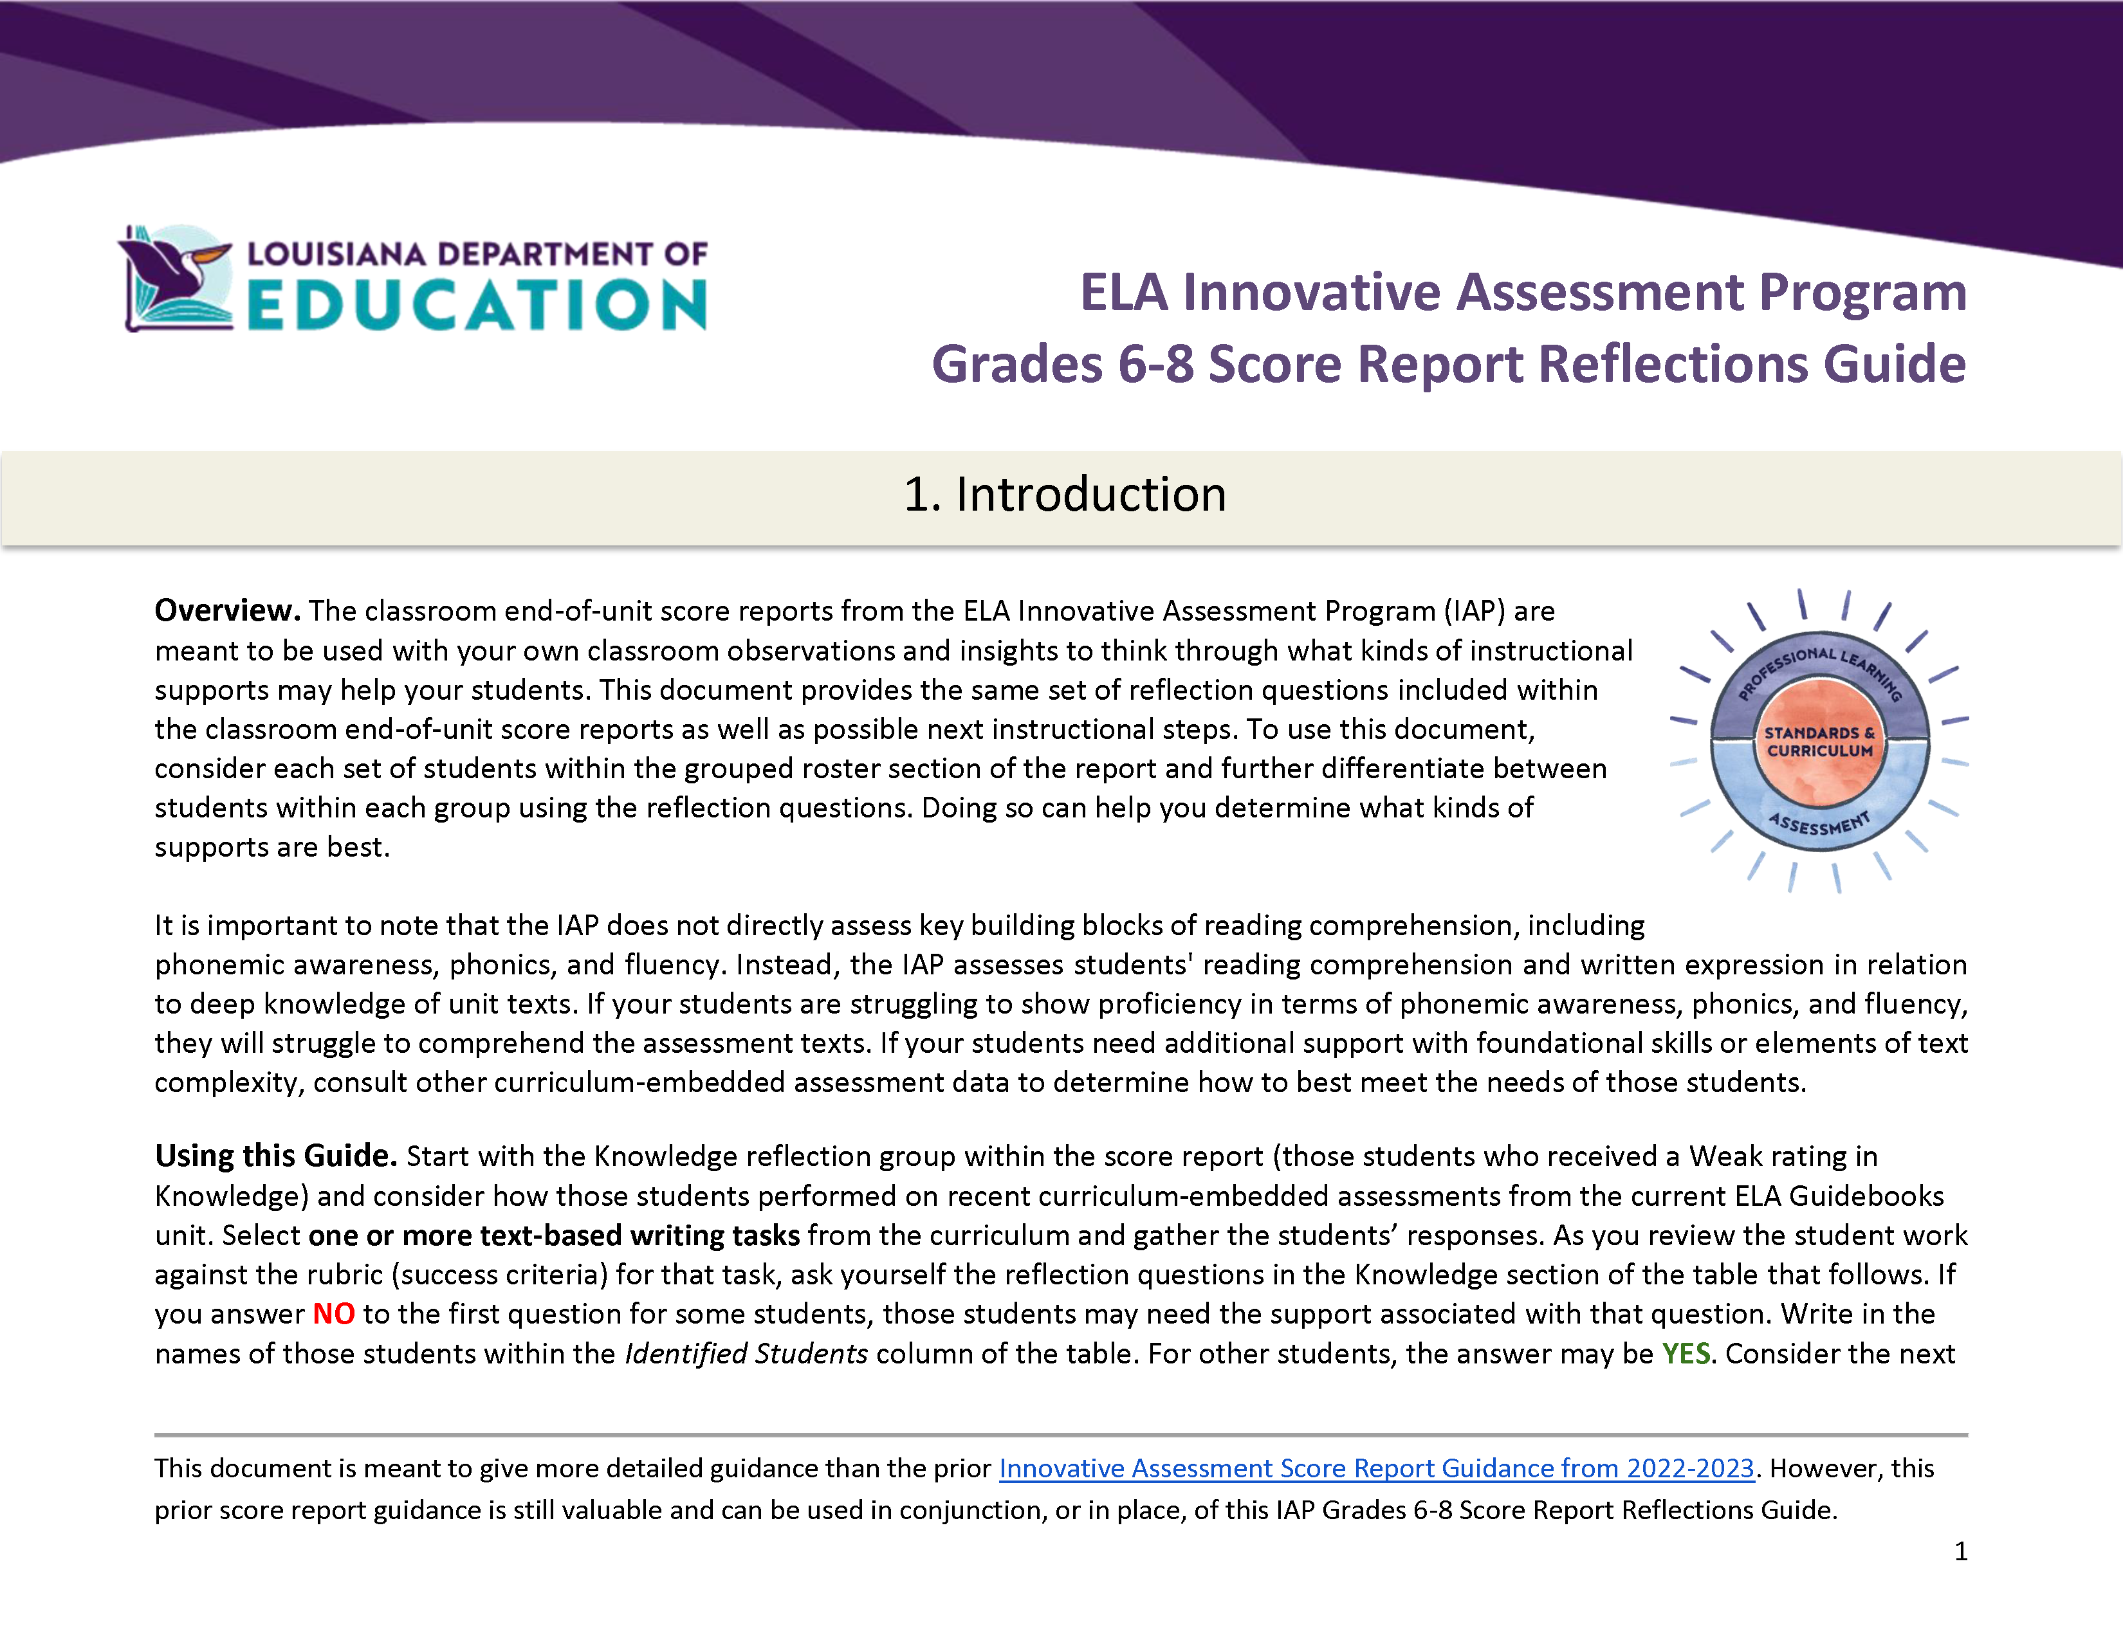

Updated Score Reporting for Grades 6-8 in 2023-24
Curriculum
Classroom Score Report
Score Report Reflections Guide
Notes:
Facilitator says: The Innovative Assessment Program, or the IAP, connects the state summative assessment to the ELA Guidebooks curriculum. This connection means that IAP reports can be used to inform instruction in your upcoming or current ELA guidebooks unit.
(click) For the 2023-24 school year, the student and classroom score reports have been updated, for grades 6, 7 and 8. In addition, (click) there is a new supporting document, the Score Report Reflections Guide for grades 6-8. This document is meant to help support decision making on instructional next steps.

Slide 3
Updated Score Reporting for Grades 6-8 in 2023-24
Curriculum
Classroom Score Report
Score Report Reflections Guide
Notes:
Facilitator says: First, we will look at the new classroom report, which is very different than the prior classroom report, which was a simple roster with student performance.

Slide 4
What’s New?
The classroom report is now made of multiple sections, each with one with a specific purpose.
The report better connects to the end-of-year reports by using the LEAP 2025 Performance Ratings of Strong, Moderate, Weak.
Recommended instructional groupings based on the Knowledge, Application and Synthesis Reporting Categories, with supporting reflection questions.
Notes:
Facilitator says: So what’s new in 2023-24 classroom score report for grades 6, 7 and 8?
(click) First, the classroom report is now made up of four sections, each of which has a specific purpose. (click) Second, instead of raw scores, student performance is characterized in terms of the LEAP 2025 Performance Ratings. Unlike raw scores, these ratings can be directly compared across unit assessments, meaning that, or example, the ratings from the Giver in Window 1 can be compared to ratings from the Christmas Carol in window 1.
And third and finally (click) the score report, within the grouped roster section, provides instructional groupings, specifically, three groupings. Coupled with these groupings are questions that are meant to help educators identify potential instructional next steps.

Slide 5
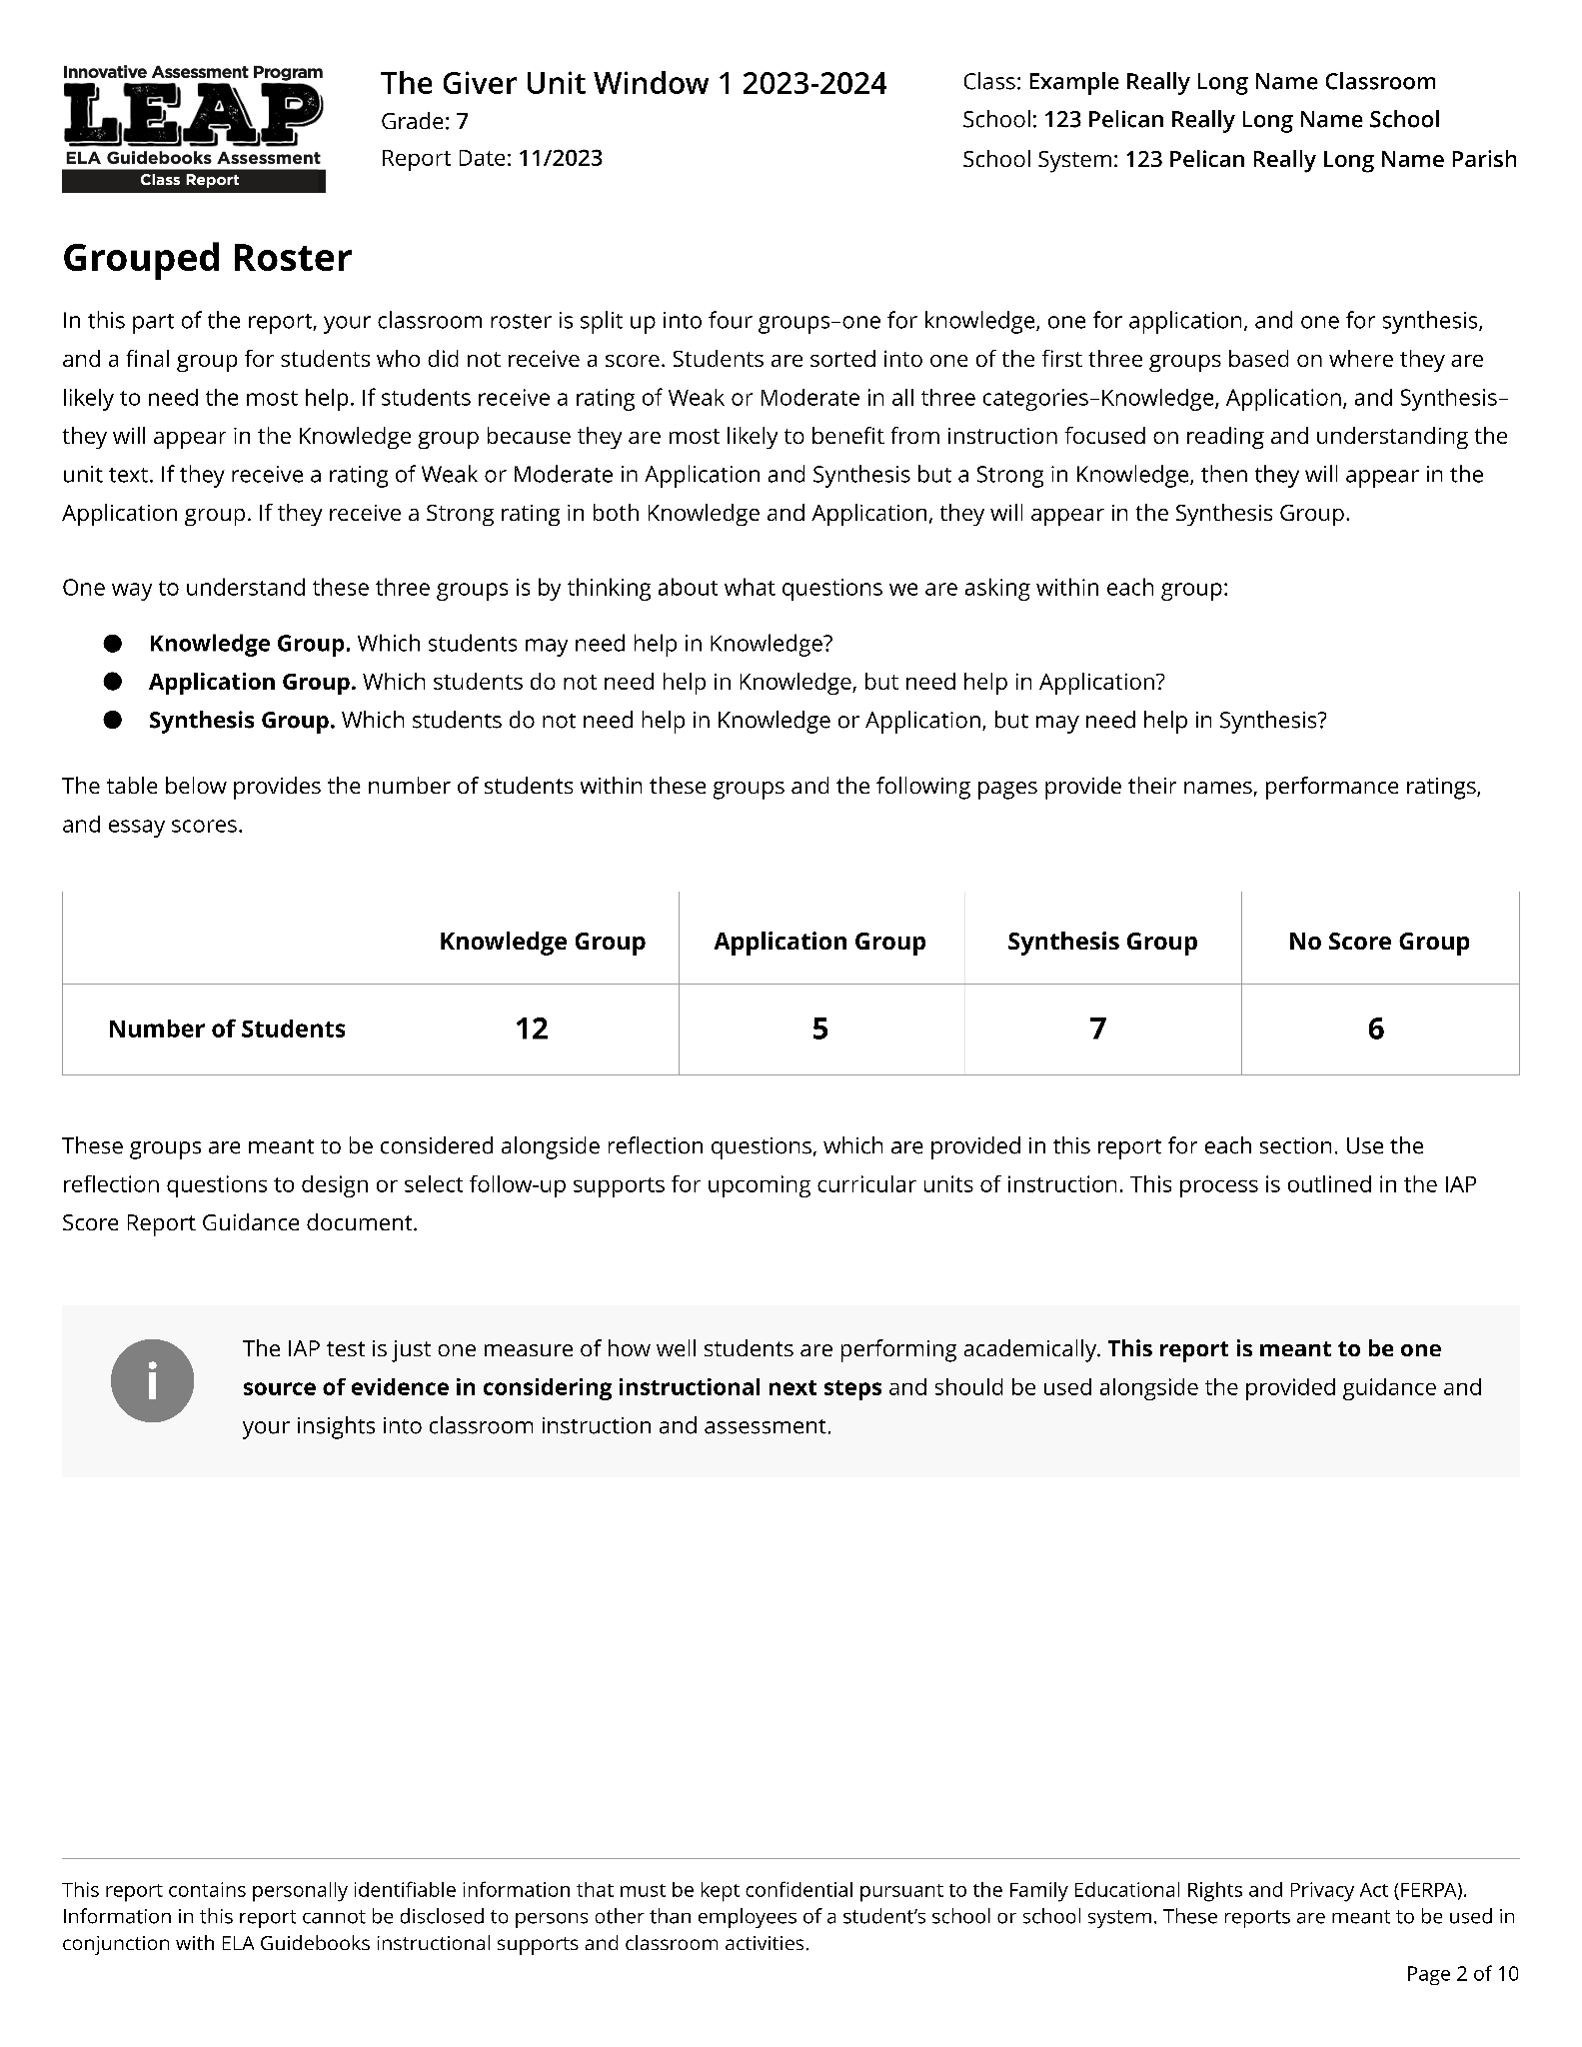
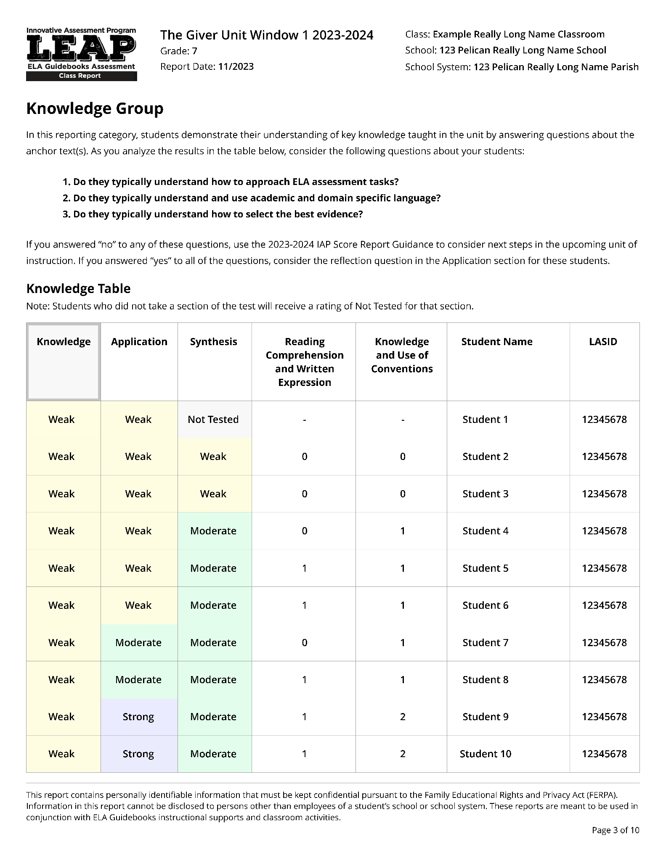
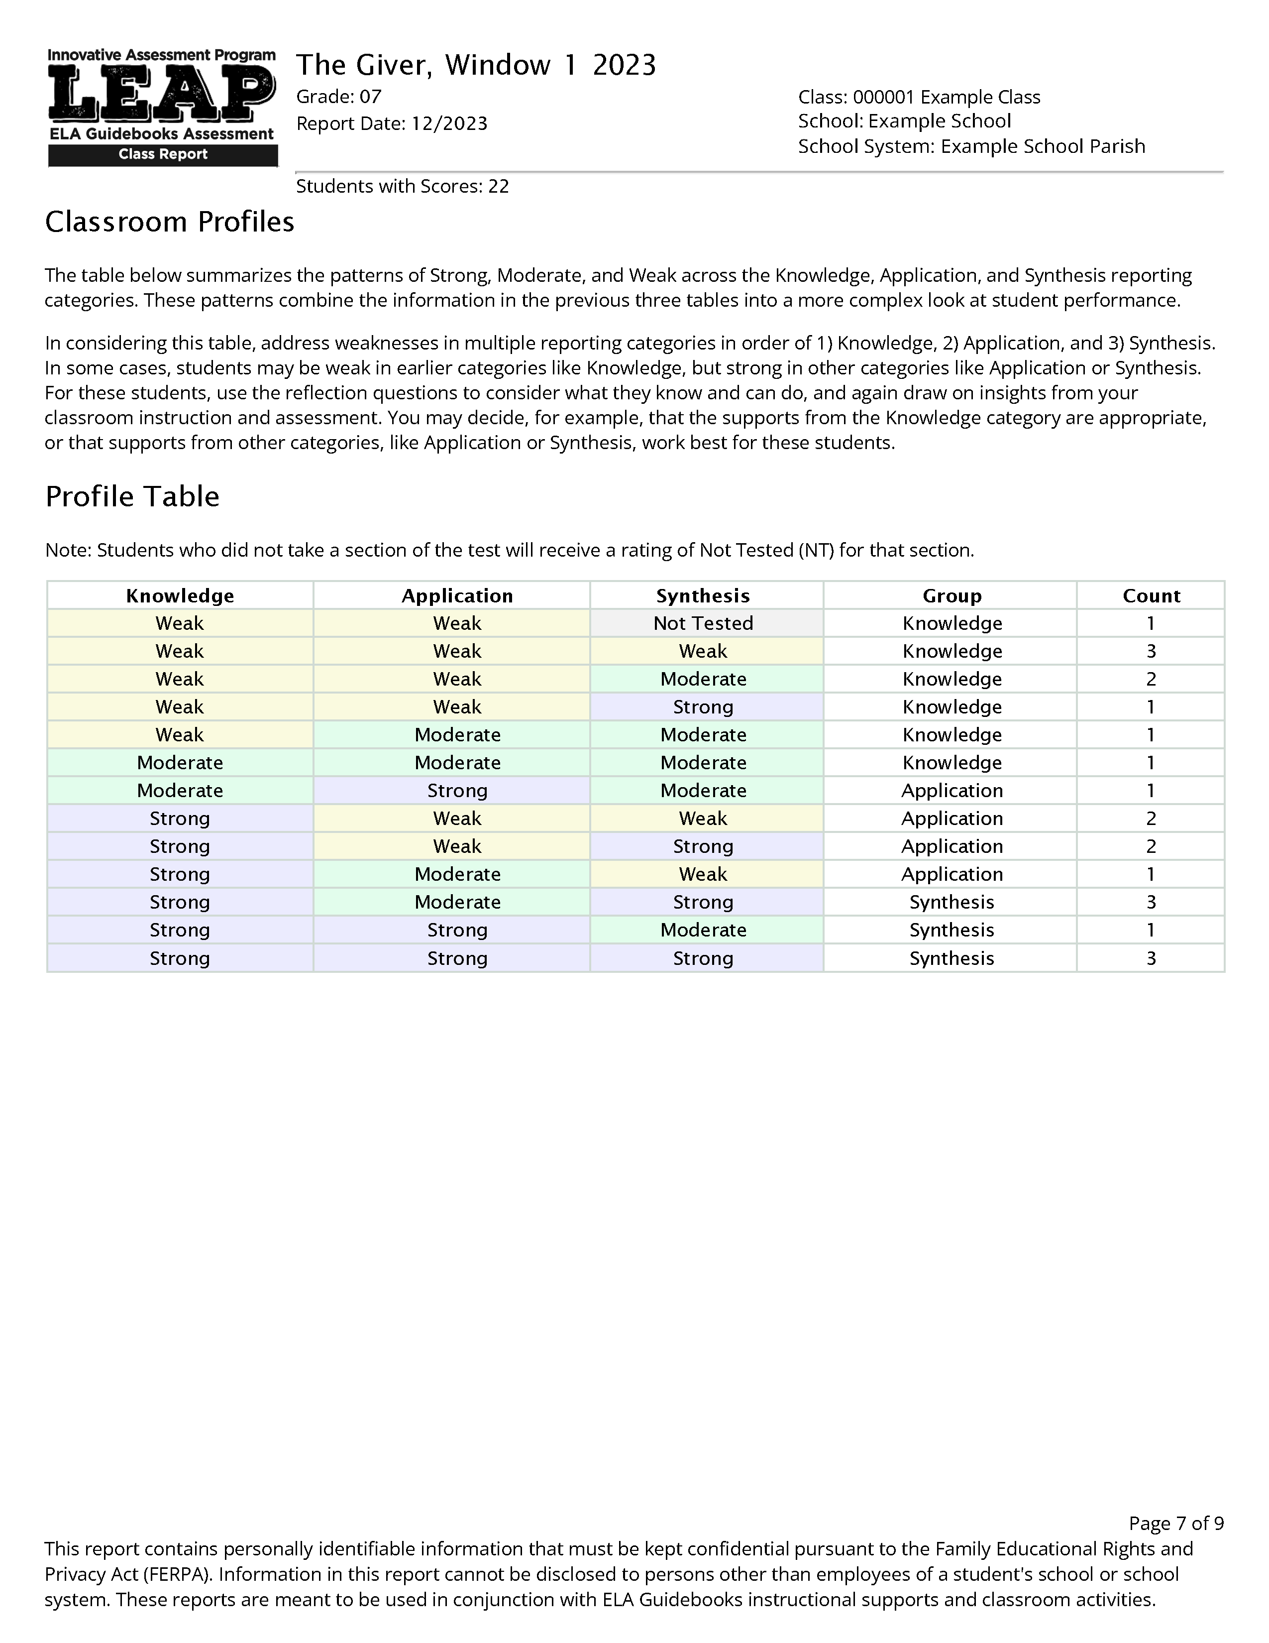
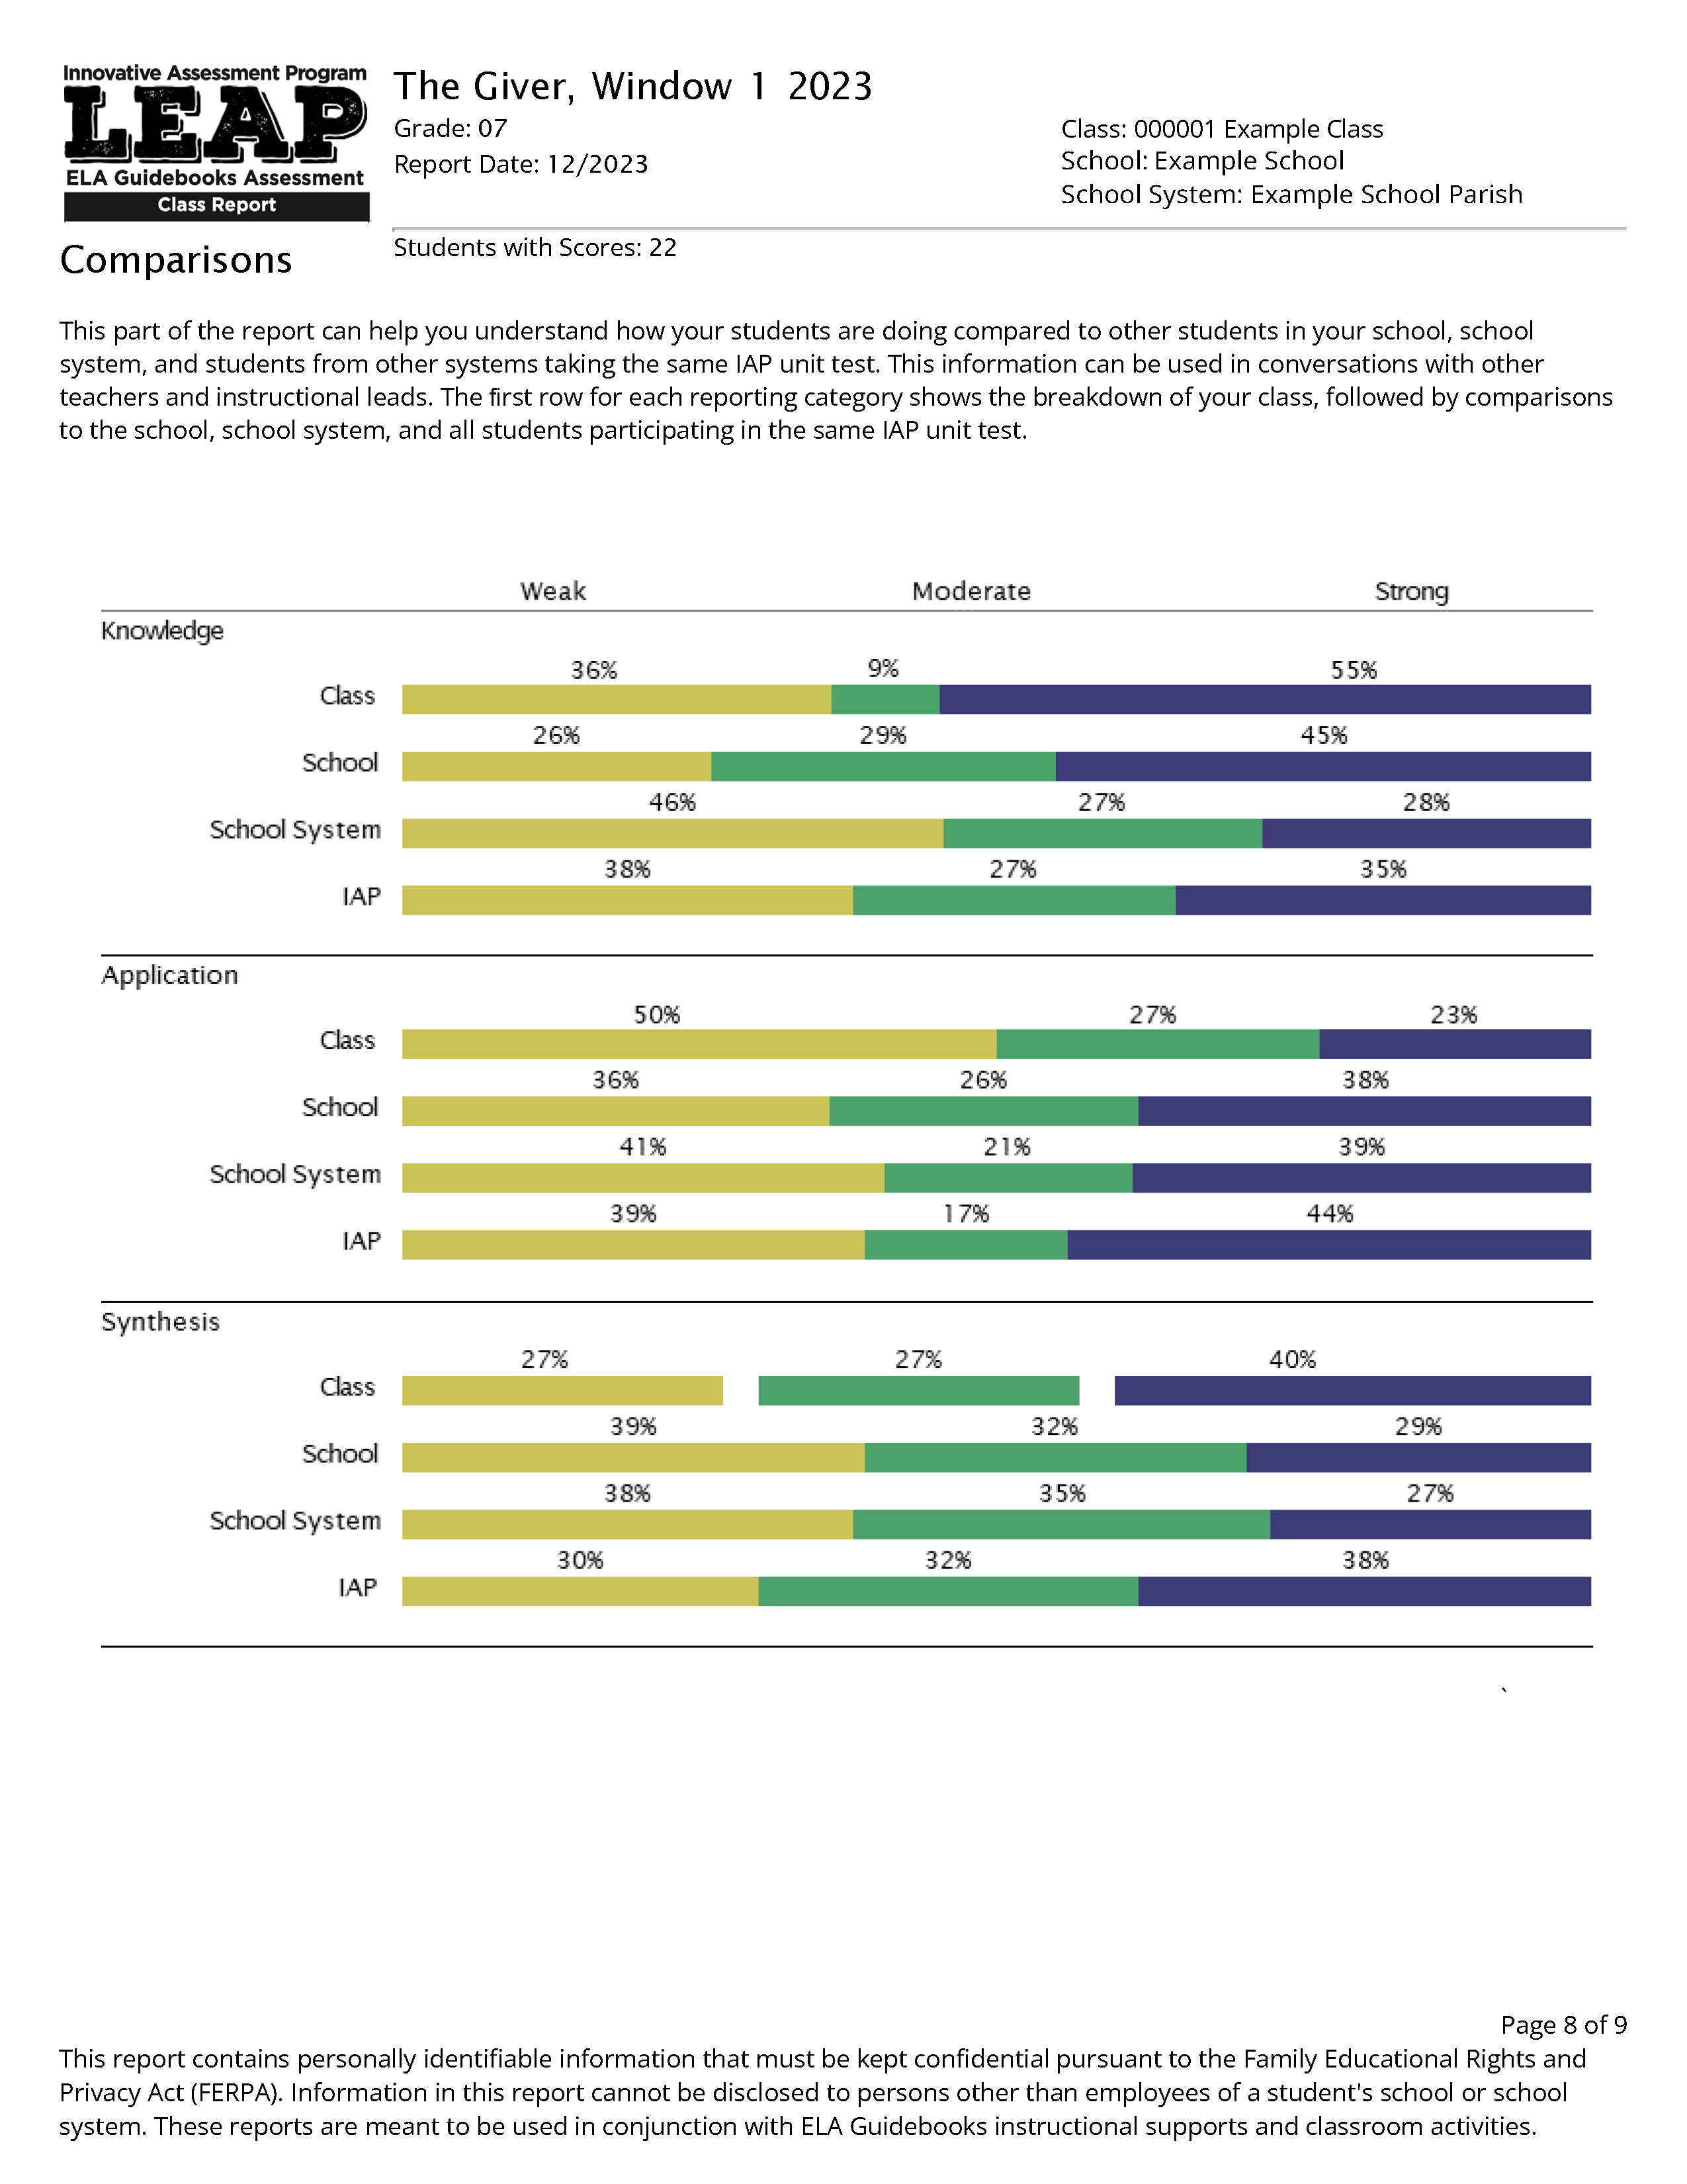
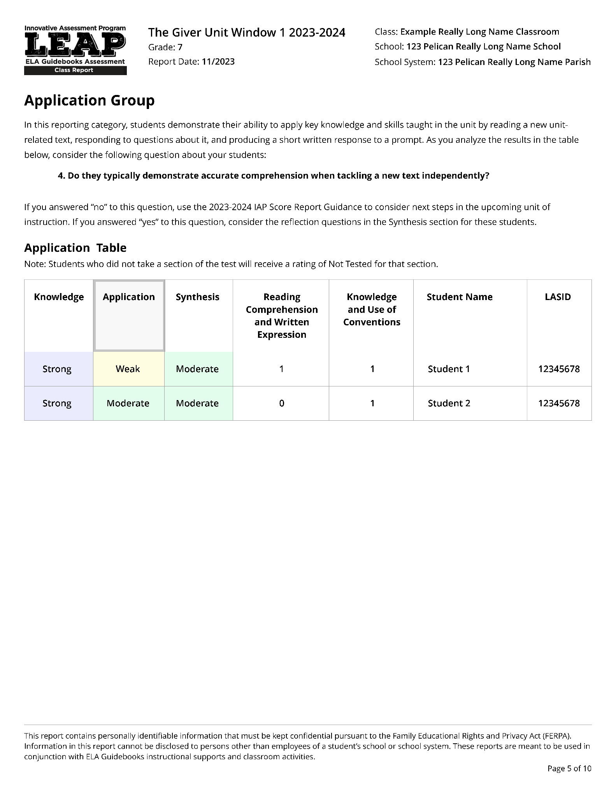
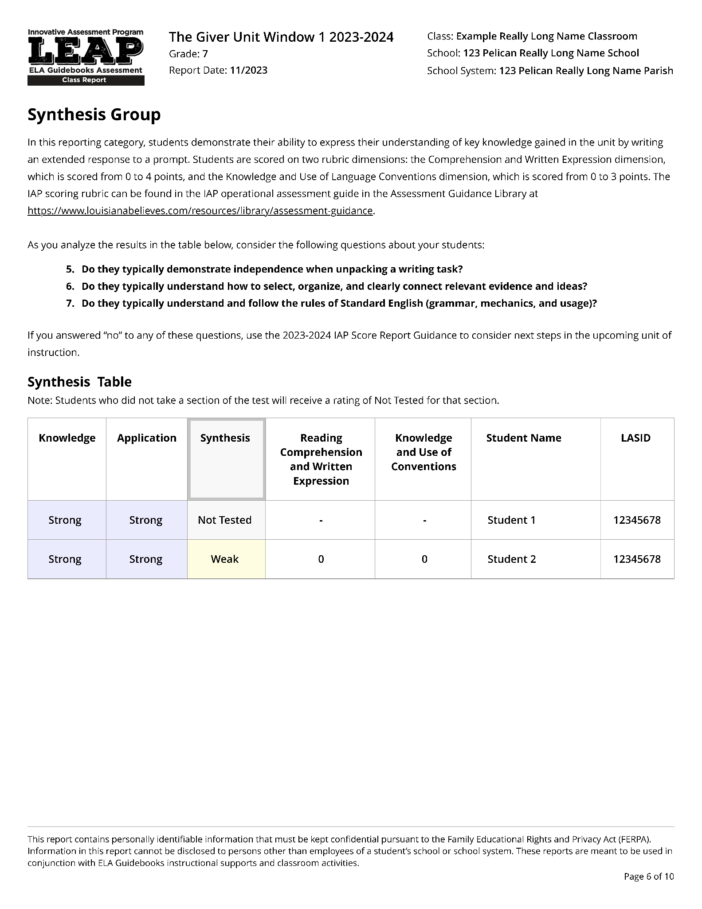
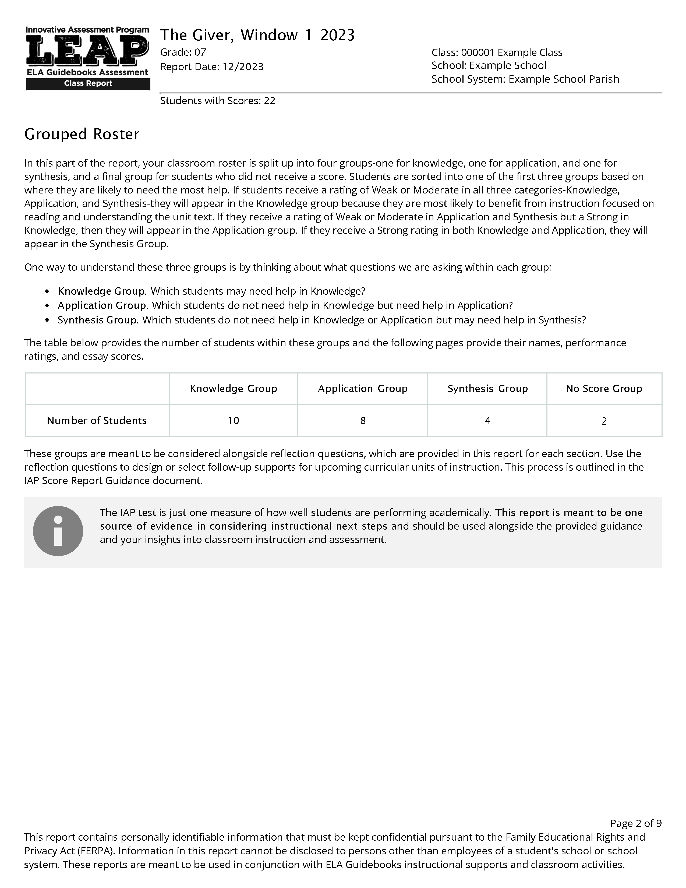
The Classroom Score Report
The new 2023-24 classroom score report is made up of four sections.
Overall Results
Grouped Roster
Classroom Profiles
Comparisons
Notes:
Duration: 35 seconds
Facilitator says: There are four sections, each one with a specific purpose. We have provided these multiple sections to make the report as useful as possible. These different sections provide different views of student performance, and you may find that a particular one is most useful to you. These multiple views are also meant to build on one another, by (click) starting with a holistic view of where the class is, within the overall results, and then (click) breaking that overall picture down into instructional groupings within the grouped roster section, before zooming back out and (click) providing a more complex view within the classroom profiles. Finally, to provide insight into how other students are, the (click) comparisons section shows student performance in your school, school system as well as the IAP as a whole.

Slide 6
The Classroom Score Report
The new 2023-24 classroom score report is made up of four sections.
Overall Results
Grouped Roster
Classroom Profiles
Comparisons
Notes:
Duration: 15 seconds
Facilitator says: We will start with the Overall Results.

Slide 7
Knowledge: how well your students understood the texts studied in class
Application: how well your students understood a new text or texts related to the ideas studied in class
Synthesis: how well your students write about the texts studied in class and the new text
Notes:
Duration: 35 seconds
Facilitator says: Student performance is reported in three categories:
(Click) Knowledge: is about how well your students understood the texts studied in class. This category is based on a section of the assessment in which your students answered questions about the text(s) read in class to show their understanding of key knowledge and skills taught in the unit.
(Click) Application: is about how well your students understood a new text related to the ideas studied in class …. In this section of the assessment your students read a new text or texts related to what they learned in class and then respond to questions and a writing prompt, to show how well he or she can apply the key knowledge and skills taught in the unit.
(Click) Synthesis: is about how well your students can write about the texts studied in class and the new text… in this section of the assessment your students wrote an essay showing his or her understanding of both what the read in class and the new text(s) provided on the test.

Slide 8
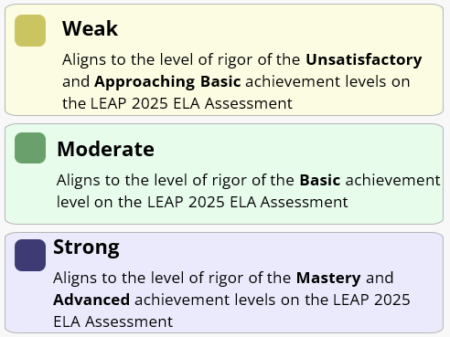
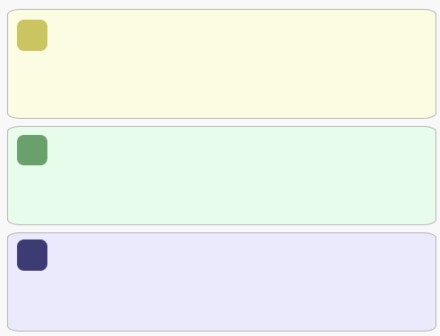
Overall Results
Each of these categories has three performance ratings that correspond to LEAP 2025:
Weak
Aligns to the level of rigor of the Unsatisfactory and Approaching Basic achievement levels on LEAP 2025
Moderate
Aligns to the level of rigor of the Basic achievement level on LEAP 2025
Strong
Aligns to the level of rigor of the Mastery and Advanced achievement levels on LEAP 2025
Notes:
Duration: 10 seconds
Facilitator says: Within each reporting category, students are classified as performing either at a weak, moderate or strong level, three performance ratings that correspond to LEAP 2025 performance levels.

Slide 9
Notes:
Duration: 10 seconds
Facilitator says: If we zoom into a section, say (click) Knowledege, we can see the peformance of the 22 students in this class that have scores.

Slide 10

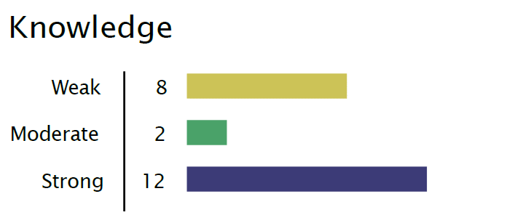
Of the 22 Students with scores in the class:
Notes:
Duration: 10 seconds
Facilitator says: If we zoom into a section, say (click) Knowledege, we can see the peformance of the 22 students in this class that have scores. This chart summarizes all of the students in the class,

Slide 11
The Classroom Score Report
The new 2023-24 classroom score report is made up of four sections.
Overall Results
Grouped Roster
Classroom Profiles
Comparisons
Notes:
Duration: 10 seconds
Facilitator says: Now that you have looked at the overall results section, we are going to look at the Grouped Roster

Slide 12
The Grouped Roster
Students are placed into groups.
Within each group, students needs are likely similar, which can help teachers plan future instruction.
Notes:
Duration: 30 seconds
Facilitator says: The Grouped Roster divides up the students within the class into four groups: one for knowledge, one for application, one for synthesis, and a final group for students who did not receive a score. These groups are meant to help teachers plan future instruction. For example, students in the Knowledge group most likely need help understanding the texts read in class and questions asked about them.

Slide 13
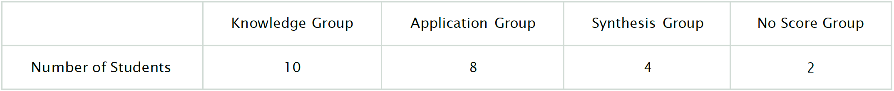
The Grouped Roster
Students are placed into groups.
Within each group, students needs are likely similar, which can help teachers plan future instruction.
Of the 22 Students with scores in the class:
Notes:
Duration: 30 seconds
Facilitator says: The Grouped Roster divides up the students within the class into four groups: one for knowledge, one for application, one for synthesis, and a final group for students who did not receive a score
The purpose of grouping students with similar performance ratings is to help teachers plan future instruction. For example, (click) the 10 students in the Knowledge group most likely need help understanding the texts read in class and questions asked about them. (click) The 8 students in the Application group most likley need help reading new texts independetly, and finally, the (click) 4 students in the syntheis group most likely
Students are sorted into the groups based on their performance ratings on each reporting category. Where did these numbers come from? Let’s walk through how students are grouped next.

Slide 14
Knowledge | Application | Synthesis | Reading Comp. and Written Expression | Knowledge and Use of Conventions | Student Name | LASID
Weak | Weak | Not Tested | - | - | STUDENT 1 | 1234567891
Weak | Weak | Weak | 0 | 1 | STUDENT 2 | 1234567891
Weak | Weak | Weak | 0 | 1 | STUDENT 3 | 1234567891
Weak | Weak | Weak | 0 | 1 | STUDENT 4 | 1234567891
Weak | Weak | Moderate | 2 | 2 | STUDENT 5 | 1234567891
Weak | Weak | Moderate | 2 | 3 | STUDENT 6 | 1234567891
Weak | Weak | Strong | 4 | 2 | STUDENT 7 | 1234567891
Weak | Moderate | Moderate | 2 | 1 | STUDENT 8 | 1234567891
Moderate | Moderate | Moderate | 2 | 3 | STUDENT 9 | 1234567891
Moderate | Strong | Moderate | 2 | 3 | STUDENT 10 | 1234567891
Strong | Weak | Weak | 0 | 1 | STUDENT 11 | 1234567891
Strong | Weak | Weak | 0 | 0 | STUDENT 12 | 1234567891
Strong | Weak | Strong | 4 | 3 | STUDENT 13 | 1234567891
Strong | Weak | Strong | 2 | 3 | STUDENT 14 | 1234567891
Strong | Moderate | Weak | 0 | 1 | STUDENT 15 | 1234567891
Strong | Moderate | Strong | 4 | 2 | STUDENT 16 | 1234567891
Strong | Moderate | Strong | 4 | 2 | STUDENT 17 | 1234567891
Strong | Moderate | Strong | 4 | 2 | STUDENT 18 | 1234567891
Strong | Strong | Moderate | 4 | 1 | STUDENT 19 | 1234567891
Strong | Strong | Strong | 4 | 2 | STUDENT 20 | 1234567891
Strong | Strong | Strong | 4 | 2 | STUDENT 21 | 1234567891
Strong | Strong | Strong | 6 | 2 | STUDENT 22 | 1234567891
-- | -- | -- | -- | -- | STUDENT 23 | 1234567891
-- | -- | -- | -- | -- | STUDENT 24 | 1234567891
10 Students Are Placed Into the Knowledge Group
8 Students Are Placed Into the Application Group
4 Students Are Placed Into the Synthesis Group
2 students in the No Score Group
Notes:
These groups were created by first sorting the class roster based on performance on each of the three categories. Then students who have a rating of Weak or Moderate on knowledge are placed into the knowledge group. After that, students who have a rating of Weak or Moderate on Application are placed into the application group. The remaining students with scores are placed into the Synthesis group. Finally, any students without scores are placed into the no score group.

Slide 15
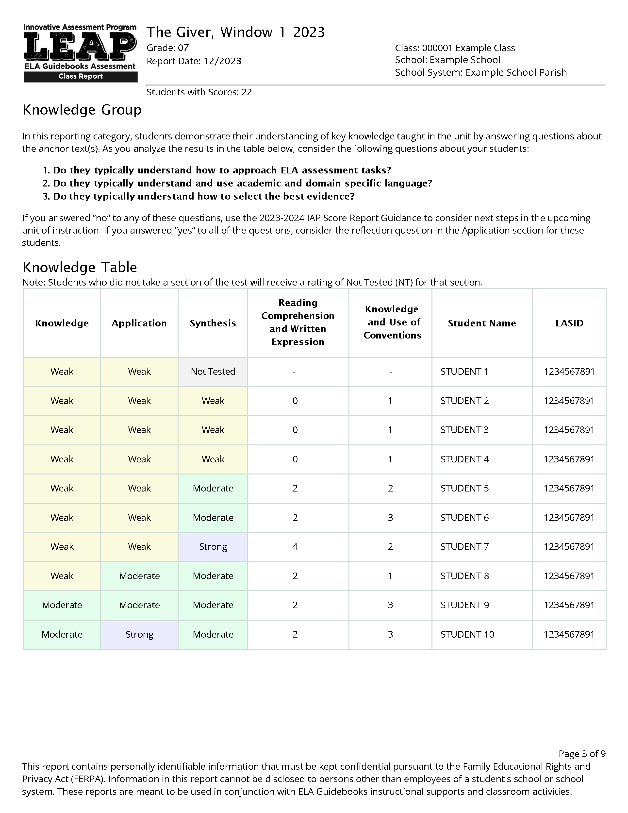
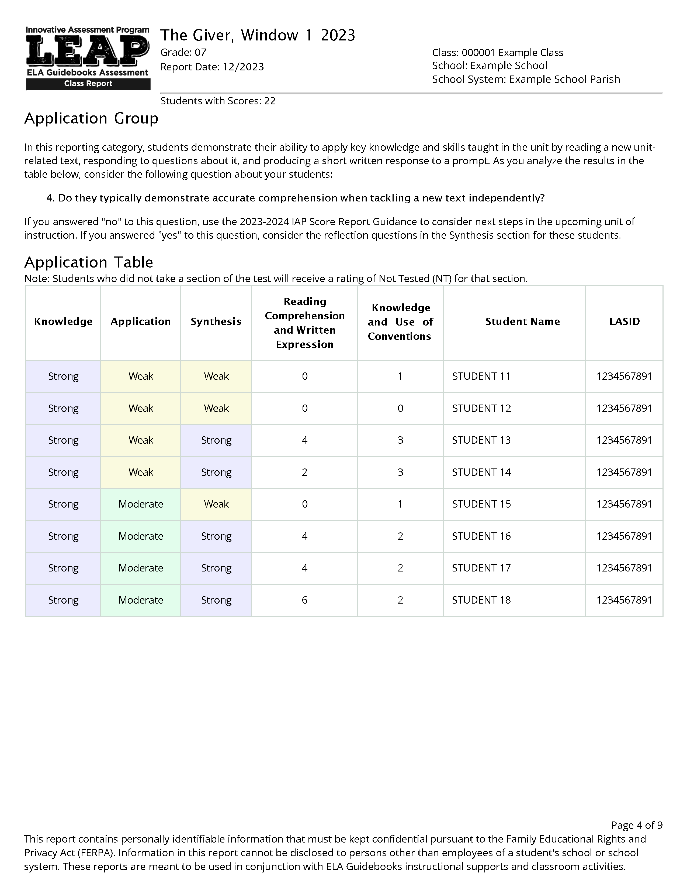
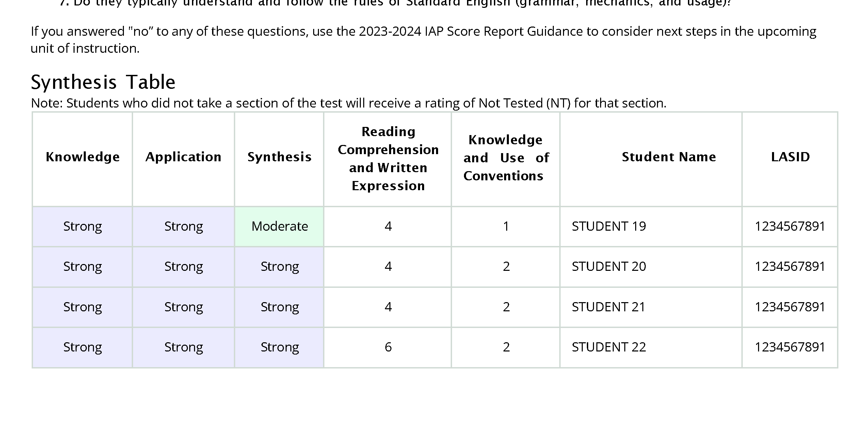
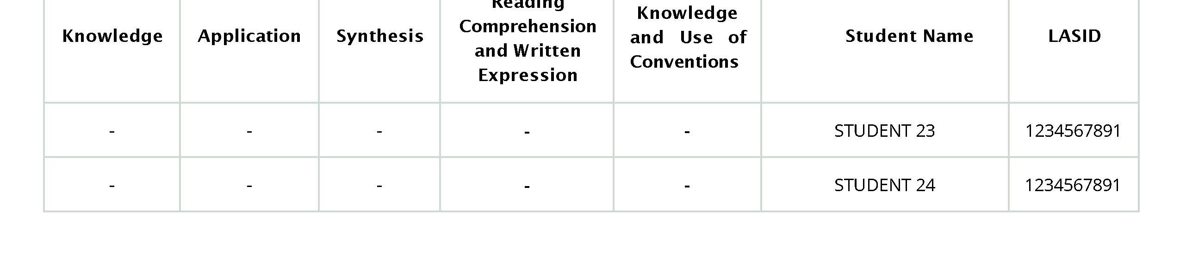
Knowledge | Application | Synthesis | Reading Comp. and Written Expression | Knowledge and Use of Conventions | Student Name | LASID
Weak | Weak | Not Tested | - | - | STUDENT 1 | 1234567891
Weak | Weak | Weak | 0 | 1 | STUDENT 2 | 1234567891
Weak | Weak | Weak | 0 | 1 | STUDENT 3 | 1234567891
Weak | Weak | Weak | 1 | 1 | STUDENT 4 | 1234567891
Weak | Weak | Moderate | 2 | 2 | STUDENT 5 | 1234567891
Weak | Weak | Moderate | 2 | 3 | STUDENT 6 | 1234567891
Weak | Weak | Strong | 4 | 2 | STUDENT 7 | 1234567891
Weak | Moderate | Moderate | 2 | 1 | STUDENT 8 | 1234567891
Moderate | Moderate | Moderate | 2 | 3 | STUDENT 9 | 1234567891
Moderate | Strong | Moderate | 2 | 3 | STUDENT 10 | 1234567891
Strong | Weak | Weak | 0 | 1 | STUDENT 11 | 1234567891
Strong | Weak | Weak | 0 | 0 | STUDENT 12 | 1234567891
Strong | Weak | Strong | 4 | 3 | STUDENT 13 | 1234567891
Strong | Weak | Strong | 2 | 3 | STUDENT 14 | 1234567891
Strong | Moderate | Weak | 0 | 1 | STUDENT 15 | 1234567891
Strong | Moderate | Strong | 3 | 2 | STUDENT 16 | 1234567891
Strong | Moderate | Strong | 4 | 2 | STUDENT 17 | 1234567891
Strong | Moderate | Strong | 4 | 2 | STUDENT 18 | 1234567891
Strong | Strong | Moderate | 4 | 1 | STUDENT 19 | 1234567891
Strong | Strong | Strong | 4 | 2 | STUDENT 20 | 1234567891
Strong | Strong | Strong | 4 | 2 | STUDENT 21 | 1234567891
Strong | Strong | Strong | 6 | 2 | STUDENT 22 | 1234567891
-- | -- | -- | -- | -- | STUDENT 23 | 1234567891
-- | -- | -- | -- | -- | STUDENT 24 | 1234567891
10 Students Are Placed Into the Knowledge Group
8 Students Are Placed Into the Application Group
4 Students Are Placed Into the Synthesis Group
2 students in the No Score Group
Notes:
These groups were created by first sorting the class roster based on performance on each of the three categories. Then students who have a rating of Weak or Moderate on knowledge are placed into the knowledge group. After that, students who have a rating of Weak or Moderate on Application are placed into the application group. The remaining students with scores are placed into the Synthesis group. Finally, any students without scores are placed into the no score group.

Slide 16
Do these students typically understand how to approach ELA assignments (i.e., success criteria)?
Do these students typically understand and use academic and domain-specific language?
Do these students typically understand how to select the best evidence?
Notes:
Duration: 40 seconds
Facilitator says: Each of the individual tables for each group is accompanied by a set of (click) reflection questions that are meant to help guide considerations of what kinds of instructional next steps, or levers, are likely to be most helpful to students. For example, (click) here we can see the three reflection questions for the knowledge group.
These questions are also in the Score Report Reflections Guide.

Slide 17
IAP Reports & Supports
Curriculum
&
&
Classroom Score Report
Score Report Reflections Guide
Notes:
Facilitator says: This brings us back to the support resource, (click) the IAP Grades 6-8 Score Report Reflections Guide. This document is meant to be (click) paired with the classroom report, and specifically the grouped roster section, as well as (click) assessments from the curriculum. Drawing on information from the report and classroom assessments should help provide additional insight into instructional next steps.

Slide 18
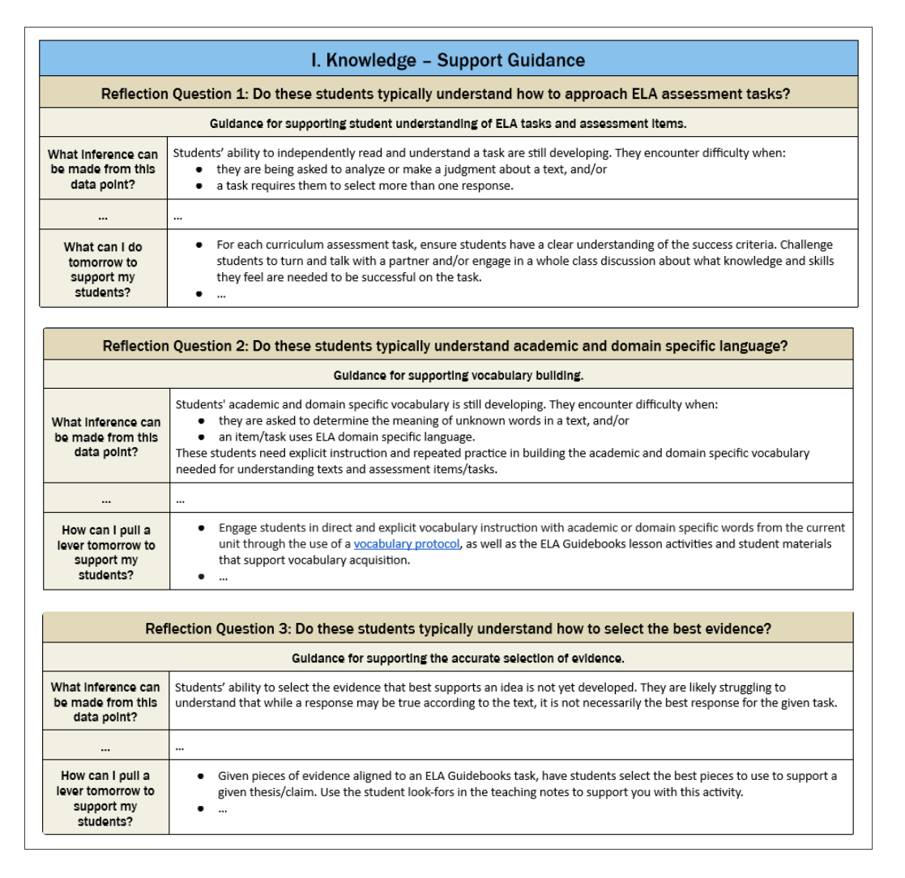
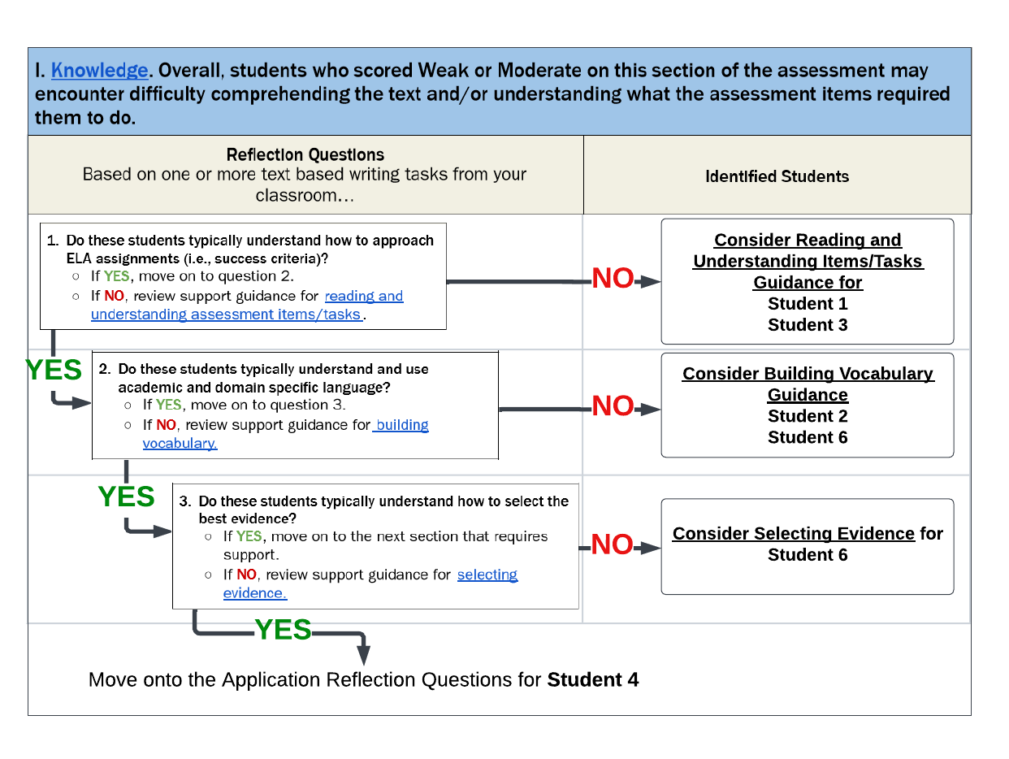
Using the Score Report Reflections Guide
1. Start with the Knowledge, Application and Synthesis Tables in the Classroom Report.
2. Think through the reflection questions in the Reflections Guide.
3. Identify “levers” that are most useful and then implement.
Notes:
Duration: 60 seconds
Facilitator says: This flow chart illustrates the process of using the Score Report Reflections Guide for the Knowledge group. For each group withing the Grouped Roster section, (click) the reflection guide there has a number of corresponding questions. Looking at the students in the score report, the reflection guide asks to you draw on a recent classroom writing task and think through a set of reflection questions. Doing so lets you, potently, (click) better match students to the instructional next steps or ‘levers” provided in the second half of the reflections guide.

Slide 19
The Classroom Score Report
The new 2023-24 classroom score report is made up of four sections.
Overall Results
Grouped Roster
Classroom Profiles
Comparisons
Notes:
Duration: 10 seconds
Facilitator says: Now we will move on to the Classroom Profiles Report.

Slide 20
Classroom Profiles
This section is meant to provide a more detailed summary of your classroom, while also connecting to the prior sections of the report.
Notes:
Duration: 30 seconds
Facilitator says: The Grouped Roster section put students into three groups based on where they were most likely to need help. The profile section, instead, shows the number of students for each unique combination of ratings for the three categories. This collapses the roster table into the unique patterns of ratings on the Knowledge, Application and Synthesis.

Slide 21
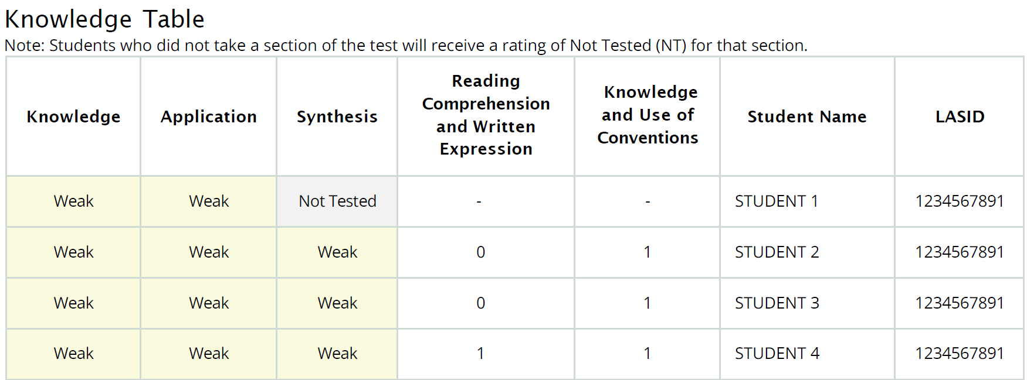

Classroom Profiles
Notes:
Duration: 15 seconds
Facilitator says: The top of this slide shows the three studetns who scored weak in all three reporting categeories. What the profiles do is collapse this into a count, and show the nubmer of sutdnets for each unique patern.

Slide 22
The Classroom Score Report
The new 2023-24 classroom score report is made up of four sections.
Overall Results
Grouped Roster
Classroom Profiles
Comparisons
Notes:
Duration: 5 seconds
Facilitator says: Finally we will look at the Comparisons Report.

Slide 23
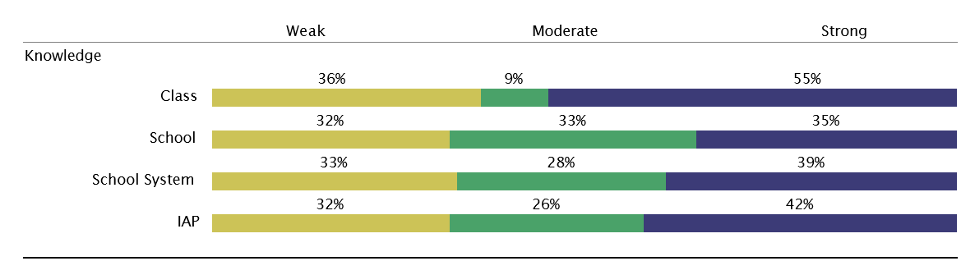
Comparisons
This part of the report compares the percentages of students in each rating for each category for your classroom to other groups of students participating in the IAP.
Notes:
Duration: 20 seconds
Facilitator says: The final section, comparsions, compares the class to the school, school system and all the students taking the IAP. Each row in this figure provides the percent of students in each performance level (strong, moderate and weak) for a group of students for a reporting category.
If we zoom in on knowledge, and look just at the class we can see that 36% of the students had a weak rating for Knowledge section, and (click) 9% had moderate rating, and, finally (click) that 55% of the students had a strong rating. This class appears to have higher levels of students in the strong category for knowledge when compared to the school, school system or all students taking the IAP

Slide 24
For questions about the IAP, please contact
Ruth Caillouet, the Innovative Assessment Program Coordinator
Ruth.caillouet@la.gov
Send general assessment questions to
assessment@la.gov
Notes:
Thank you for your partnership with us in building this assessment and its reports and supports. The next session of the series will focus on the Score Report Reflections Guide.

