Slide 1
Innovative Assessment Program
Professional Learning Series
Short Videos
For Parents: Understanding the 2023-24 Student Score Report
December 2023
Notes:
Facilitator says: In this short video, we will review the new, 2023-24 student score report for the Innovative Assessment Program. This video is meant to help parents and caregivers better understand the report.

Slide 2
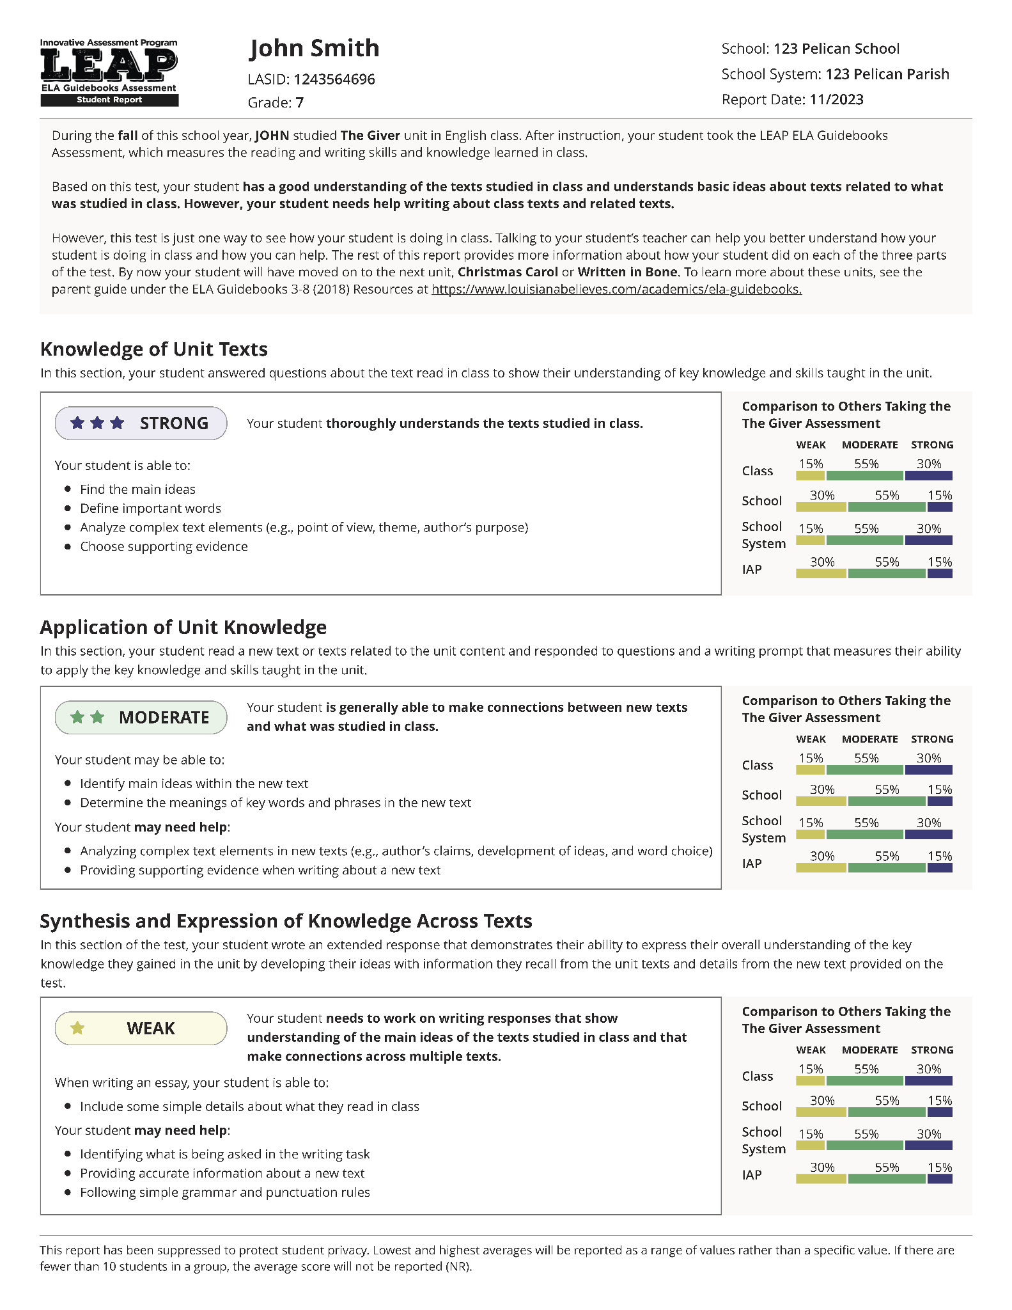
New Student Report
Reports out on the reading and writing skills and knowledge learned in class.
Is meant to better connect to the end-of-year reports by using the LEAP 2025 Performance Ratings
Notes:
Facilitator says: The new student report, introduced for this first time this year tells you about how your student did, based on a test that looks at the reading and writing skills, and knowledge, learned in class. This new report is meant to better connect to the end of year reports, by using the LEAP 2025 Performance ratings, which we will turn to next.

Slide 3
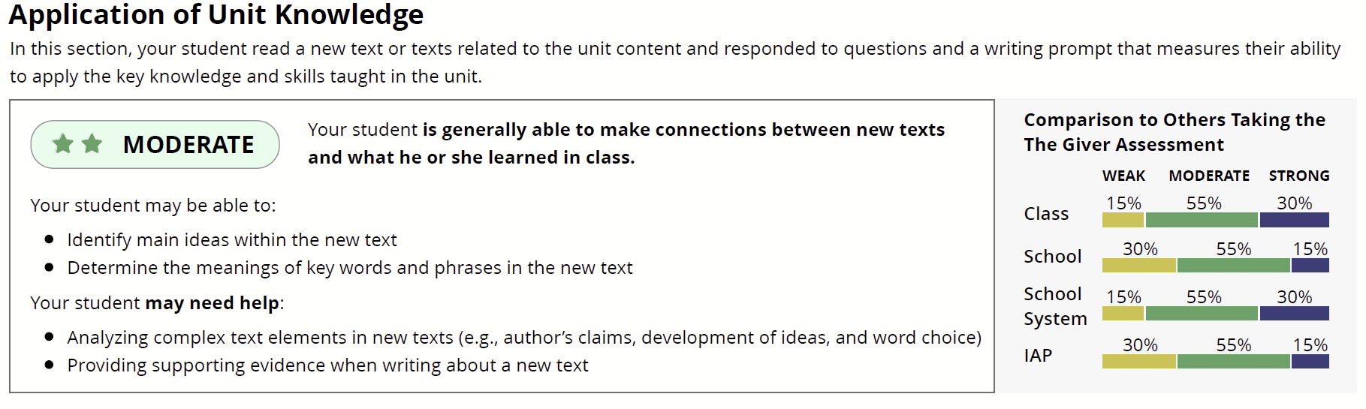
Knowledge: how well your student understood the texts studied in class
Application: how well your student understood a new text related to the ideas studied in class
Synthesis: how well your student can write about the texts studied in class and the new text
Notes:
Facilitator says: Your student’s performance is reported in three categories:
(Click) Knowledge: is about how well your student understood the texts studied in class. This category is based on a section of the assessment in which your student answered questions about the text(s) read in class to show their understanding of key knowledge and skills taught in the unit.
(Click) Application: is about how well your student understood a new text related to the ideas studied in class …. In this section of the assessment your student read a new text or texts related to what they learned in class and then respond to questions and a writing prompt, to show how well he or she can apply the key knowledge and skills taught in the unit.
(Click) Synthesis: is about how well your student can write about the texts studied in class and the new text… in this section of the assessment your student wrote an essay showing his or her understanding of both what the read in class and the new text(s) provided on the test.

Slide 4

Notes:
Facilitator says: Now let’s zoom into one of the categories to better understand what’s provided for each category.

Slide 5
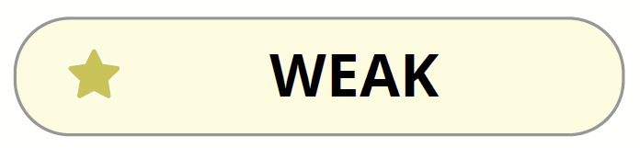
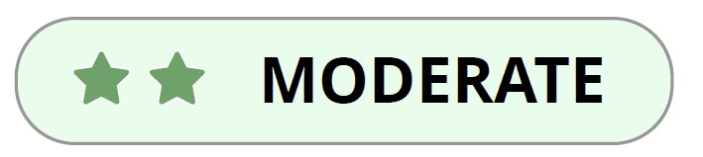
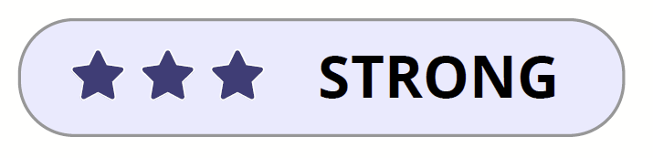
Needs support for further study
Comparable to Approaching Basic or Unsatisfactory
May need support for further study
Comparable to Basic
Ready for further study
Comparable to as Mastery or Advanced
Notes:
Facilitator says: (Click) For this category, application, this example student scored “Moderate”, which means that he or she can connect a new reading – read during the test - to what he or she learned in class. (click) This moderate rating also means that the student may need help as they learn in the upcoming unit. This moderate rating is also comparable, in terms of difficulty, to the LEAP 2025 achievement level rating of Basic.
There are two other ratings that students can receive. The first of which is (click) weak, which means that a student needs help as they learn in the upcoming unit and this moderate rating is also comparable, in terms of difficulty, to the LEAP 2025 achievement level rating of Approaching Basic or Unsatisfactory.
Finally, (click) the last possible rating is strong, which means that the student is ready to learn in the upcoming unit, and is comparable to the LEAP 2025 Mastery or Advanced achievement levels.

Slide 6
Notes:
Facilitator says: In addition to ratings for each category, the report also provides information on what a student at that level is able to do, and what they still may need help doing. In the example shown on the screen, you can see that a student who scored moderate on Application is likely able to identify main ideas in a new text and determine meanings of key words and phrases, but may need help analyzing complex text elements and providing supporting evidence when writing about a new text. This feedback was created through careful analysis of student data on the IAP. However, it may not fit every student. Some students who score moderate on Application may be able to analyze complex text elements, or may even struggle to identify main ideas within the new text. So this feedback is meant to be a starting point in considering what a student can do.

Slide 7
Notes:
Facilitator says: Finally, the far right part of this section compares your student to his or her class, as well as to the school, school system and all students taking the IAP. Each row in this figure provides the percent of students in each performance level (strong, moderate and weak) for a group of students.
Looking at just the top row, for all of the students in your student’s class, we see that 15% of the students had a weak rating for the Application section, and (click) 55% had moderate rating, and, finally (click) that 30% of the students had a strong rating.

Slide 8
Notes:
Facilitator says: Simairly, we can also look at the performance of students in your student’s (click) school, (click) school system, or, finally, (click) the performance of all of the students who took this IAP assessment

Slide 9
If you have questions about your student’s report or how your student is doing, please reach out to your student’s English language arts teacher.
Send general assessment questions to
assessment@la.gov
Notes:
Thank you for taking the time to learn more about the Innovative Assessment Program Student Score Report. If you have questions or would like to know more, please reach out to your student’s English language arts teacher.

