Slide 1
Innovative Assessment Program
Professional Learning Series
Session 5: Understanding the Score Reports
December 2023
Notes:
Time needed for the session:
15-30 minutes
Needed materials for session:
Copies of a complete score report
Duration: 20 seconds
Facilitator says: Welcome to the Innovative Assessment Program’s Professional Learning series, session 5 which is focusing on understanding the new classroom score report for grades 6-8.
My name is XXX and I am partnering with the Lousianna Department of Education to present this information.

Slide 2
Professional Learning Series
Understanding the IAP Module | Understanding the IAP Item Types Module | Using IAP Data Module
Introduction to the Innovative Assessment Understanding Grade-Level Standards | Selected-Response and Constructed Response Synthesis Essay | Understanding the Score Reports Using the Score Report Reflections Guide Using CSV Files for In Depth Analysis
Please contact Ruth.Caillouet@la.gov
Kathleen.Judy@la.gov
Notes:
Duration: 30 seconds
Facilitator says: This session builds on earlier learning sessions about the Innovative Assessment. This session and session 6 go hand in hand. If you are a classroom teacher, we recommended that you spend 15-30 minutes familiarizing yourself with the various score reports, both as part of this session and outside of if, and then spend more time on session 6 which will walk you through using the Score Report Reflections Guide in conjunction with your score report.

Slide 3
Objectives
Participants will understand the following:
Classroom Score Report and the data presented within its four sections
Student Score Report
Notes:
Duration: 10 seconds
Facilitator says: For session 5 the learning objectives are straightforward - to understand the four sections of the classroom score report, as well as the student score report.

Slide 4

Agenda Items
1. Context
2. The 2023-24 Classroom Score Report
3. The 2023-24 Student Score Report
4. Wrap Up
Notes:
Duration: 30 seconds
NOTE THERE IS AN ANIMATION ON THIS SLIDE.
Facilitator says: Let’s take a look at our agenda for this session. First, we will briefly review the context of the Innovative Assessment Program, or IAP, and then move to the four sections of the Classroom Score Report. The classroom score report is intended for teachers and meant to help them plan instructional next steps.
We will then review the Student Score Report, which is intended for students and parents/caregivers and meant to help them better understand their student’s achievement. Note that periodically a “Pause” image [ADVANCE SLIDE SO THE IMAGE IS VISIBLE] will appear on a slide as an indication that you might want to stop the video and review some materials in more depth.

Slide 5
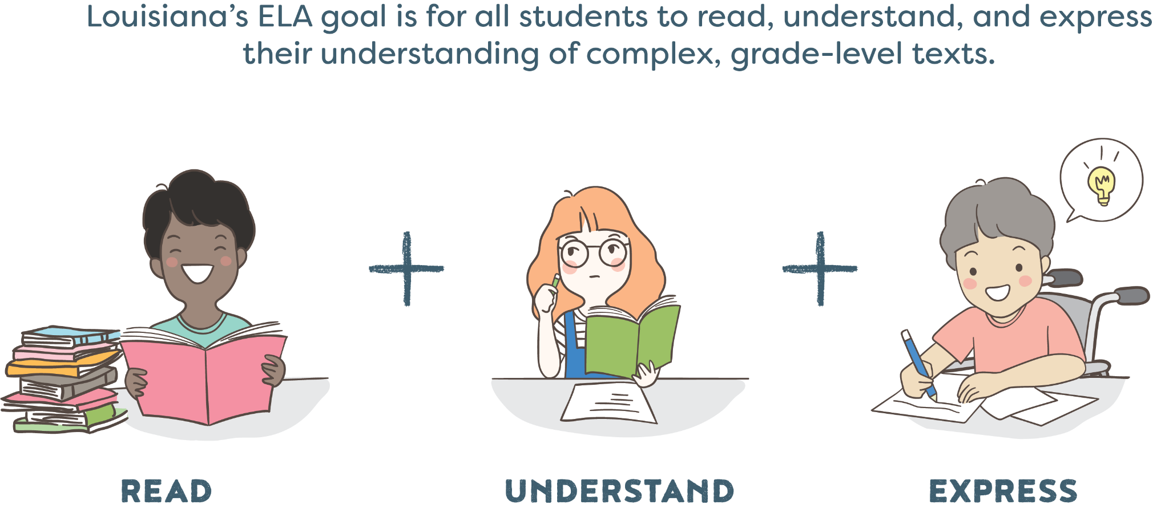
Louisiana’s ELA Goal
Notes:
Duration: 30 seconds
Facilitator says: We always begin with our ELA goal for all students to read, understand, and express their understanding of complex, grade-level texts.

Slide 6
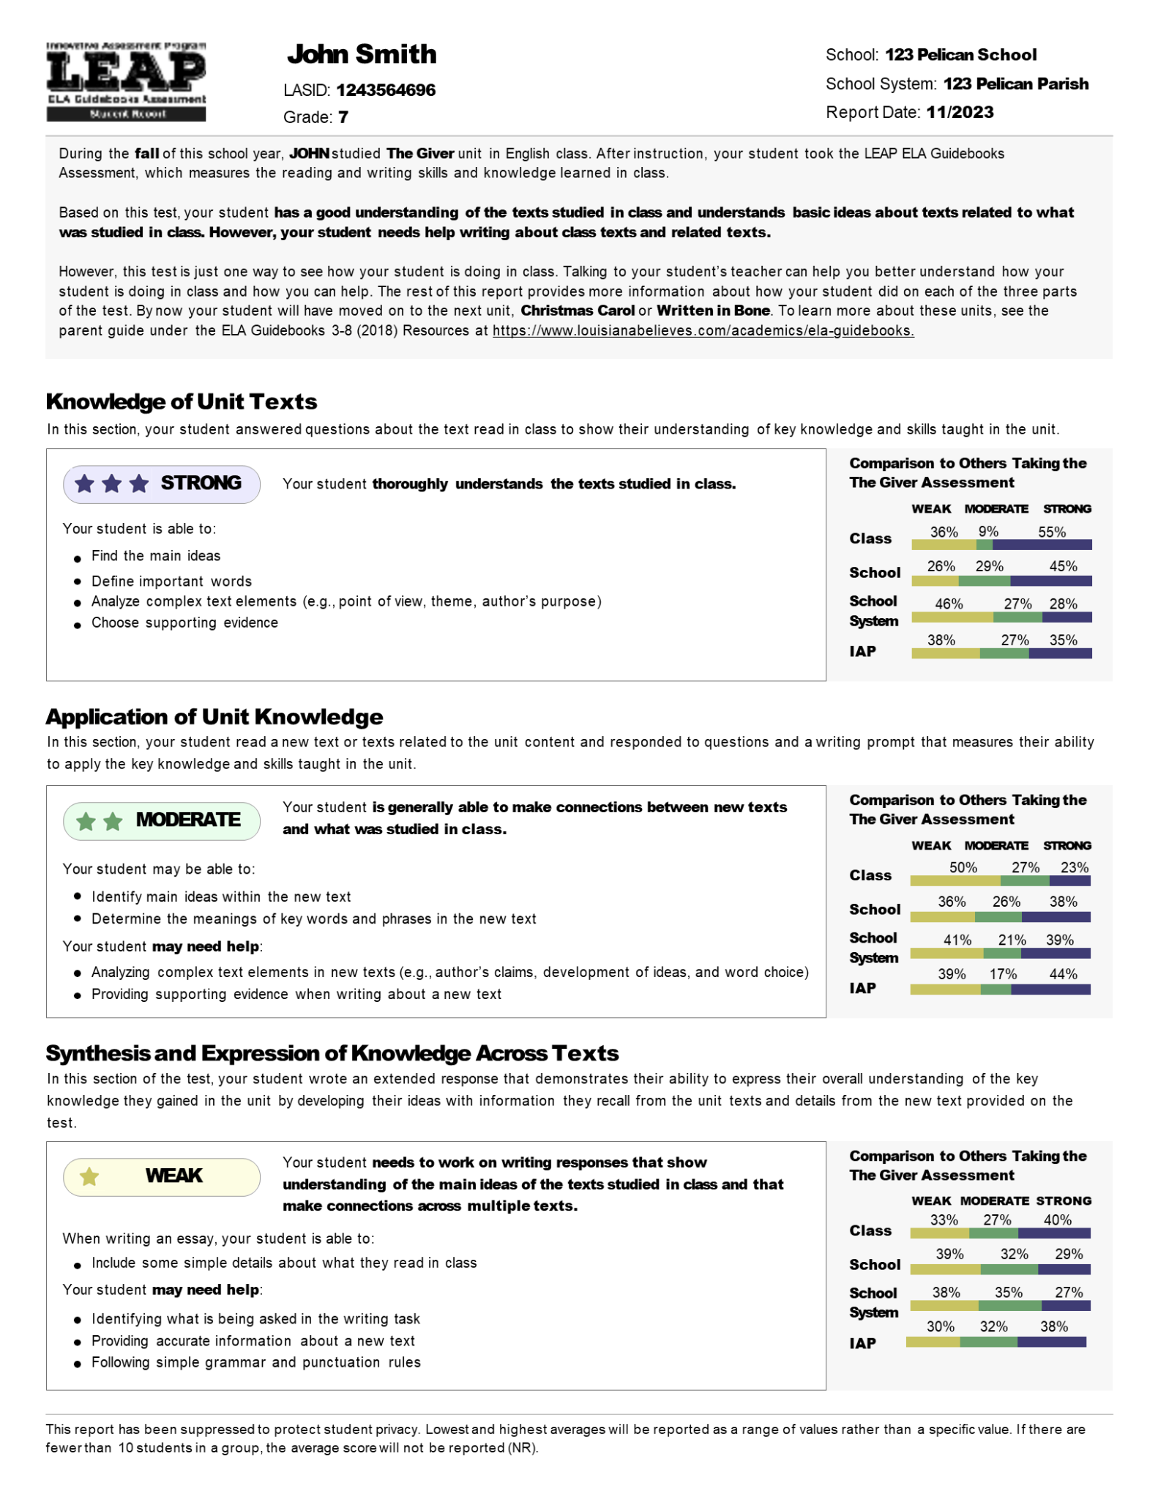
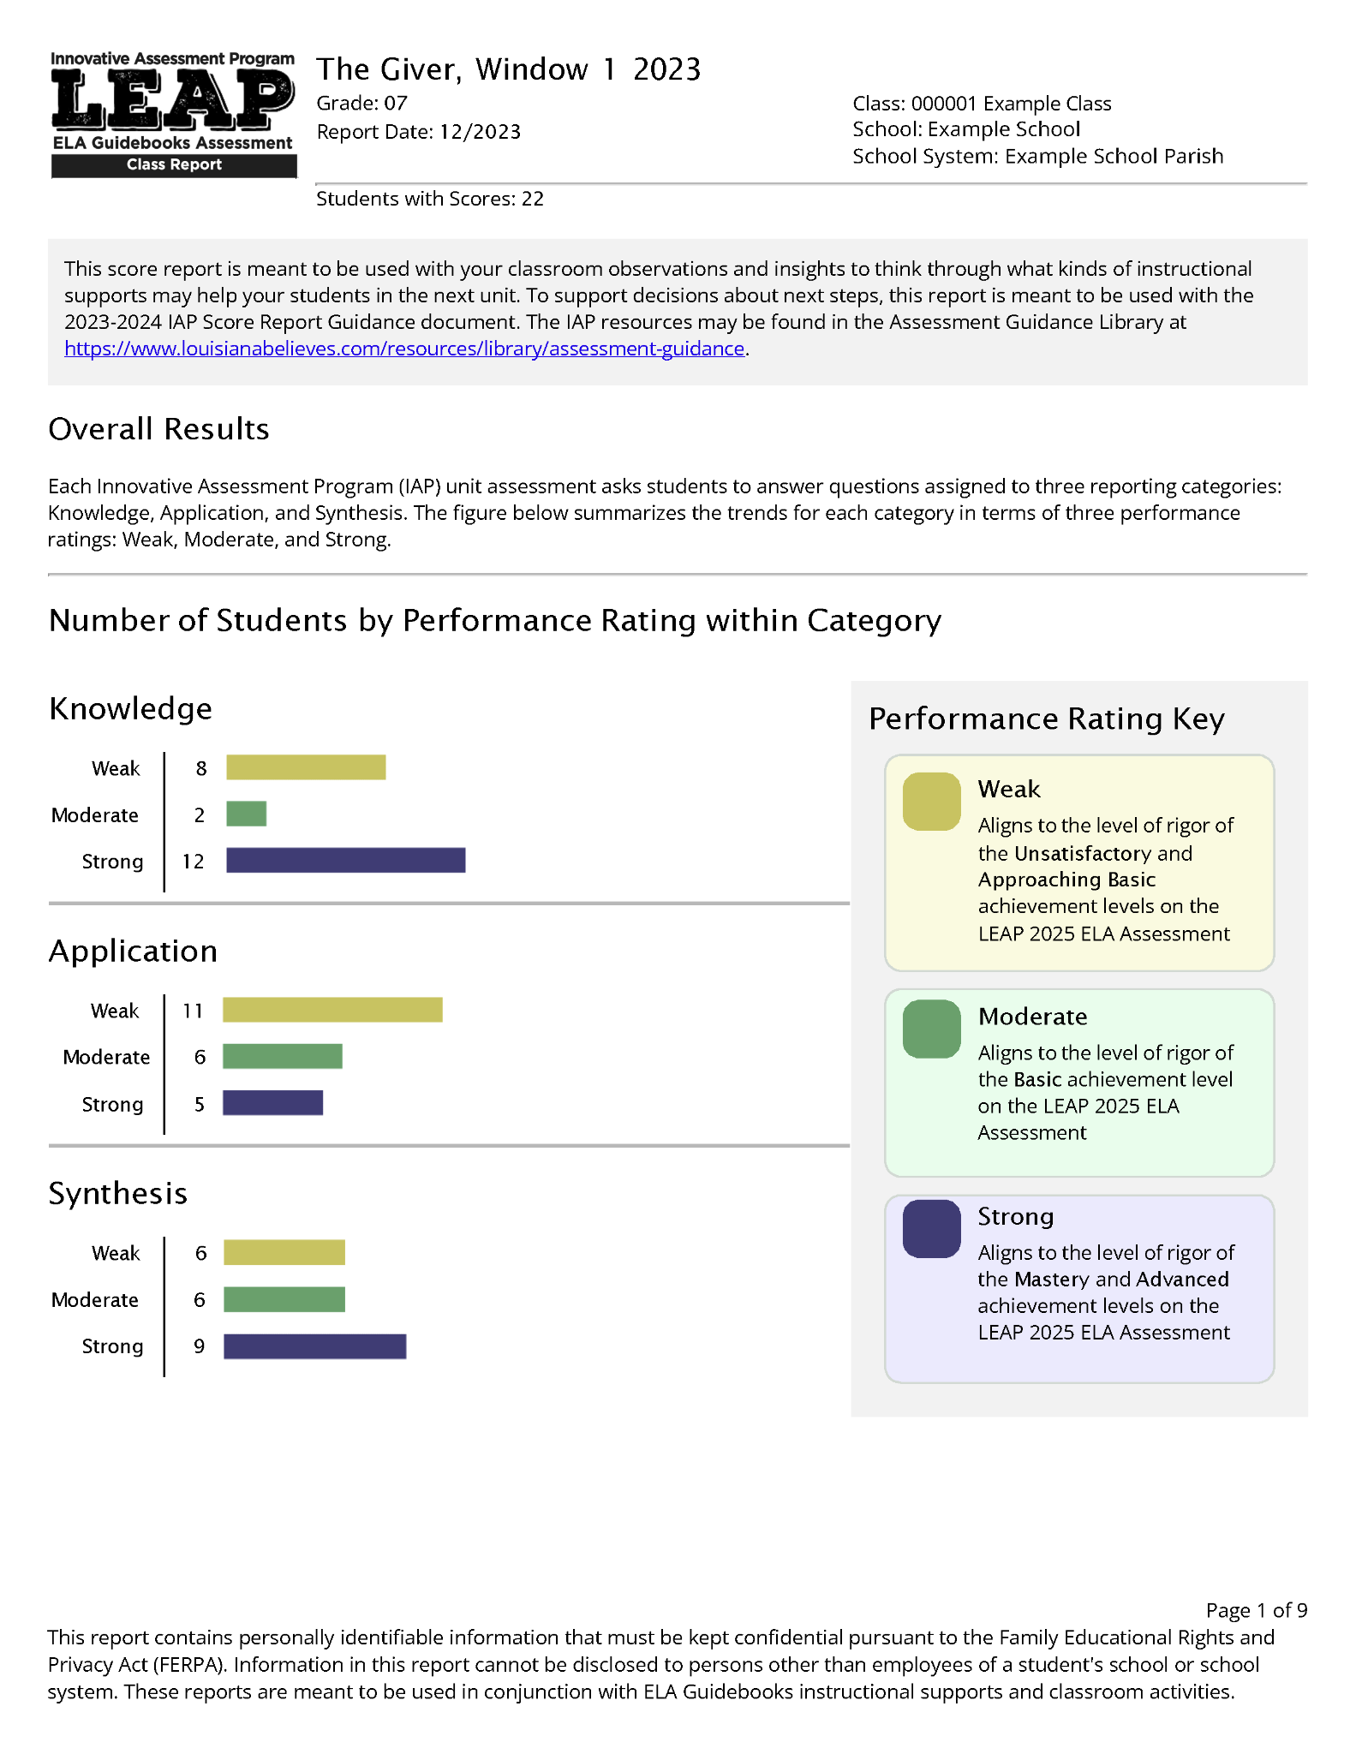

Updated Score Reporting for Grades 6-8 in 2023-24
Student Report
Classroom Score Report
Score Report Reflections Guide
Notes:
Duration: 30 seconds
Facilitator says: The Innovative Assessment Program, or the IAP, connects the state summative assessment to the ELA Guidebooks curriculum. This connection means that IAP reports can be used to inform instruction in your upcoming or current ELA guidebooks unit.
For the 2023-24 school year, the student and classroom score reports have been updated, for grades 6, 7 and 8. In addition, there is a new supporting document, the Score Report Reflections Guide for grades 6-8. This document is meant to help support decision making on instructional next steps.

Slide 7

Materials for Today’s Session
Materials for today’s session, including this slide deck and an example score report, are available online at: https://ldoe.zendesk.com/hc/en-us/sections/19671802015127-Professional-Learning
Notes:
Duration: 10 seconds
Facilitator says: Materials for today, including an example classroom score report, are available online on the ZenDesk Website. You might want to pause the video and make sure that you have downloaded the example classroom score report, or your own classroom score report, since a lot of this session walks through that report.

Slide 8
Agenda Items
1. Context
2. The 2023-24 Classroom Score Report
3. The 2023-24 Student Score Report
4. Wrap Up
Notes:
Duration: 10 seconds
Facilitator says: Now we are going to dig into the 4 sections of the classroom score report.

Slide 9
What’s New?
Classroom and student reports better connect to the end-of-year reports by using the LEAP 2025 Performance Ratings of Strong, Moderate, Weak.
The classroom report is now has multiple sections, each with a specific purpose.
The classroom report also provides recommended instructional groupings, with supporting reflection questions.
Notes:
Duration: 30 seconds
NOTE THERE IS AN ANIMATION ON THIS SLIDE.
Facilitator says: So what’s new in 2023-24 classroom score report for grades 6, 7 and 8?
(click) First, instead of raw scores, student performance is characterized in terms of the LEAP 2025 Performance Ratings. Unlike raw scores, these ratings can be directly compared across unit assessments, meaning that, for example, the ratings from the Giver in Window 1 can be compared to ratings from the Christmas Carol or Written in Bone in Window 2.
(click) Second, the classroom report is now made up of four sections, each of which has a specific purpose.
And third and finally (click) the score report, within the grouped roster section, provides instructional groupings, specifically, three groupings. Coupled with these groupings are questions that are meant to help educators identify potential instructional next steps.

Slide 10
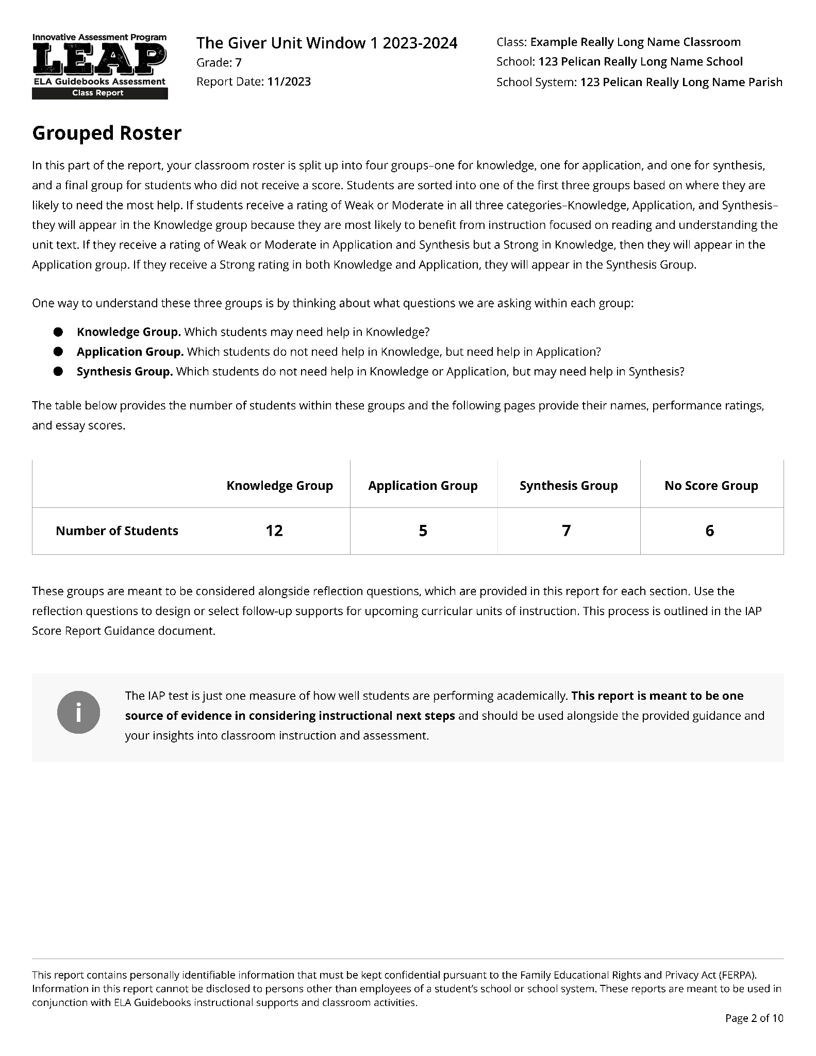
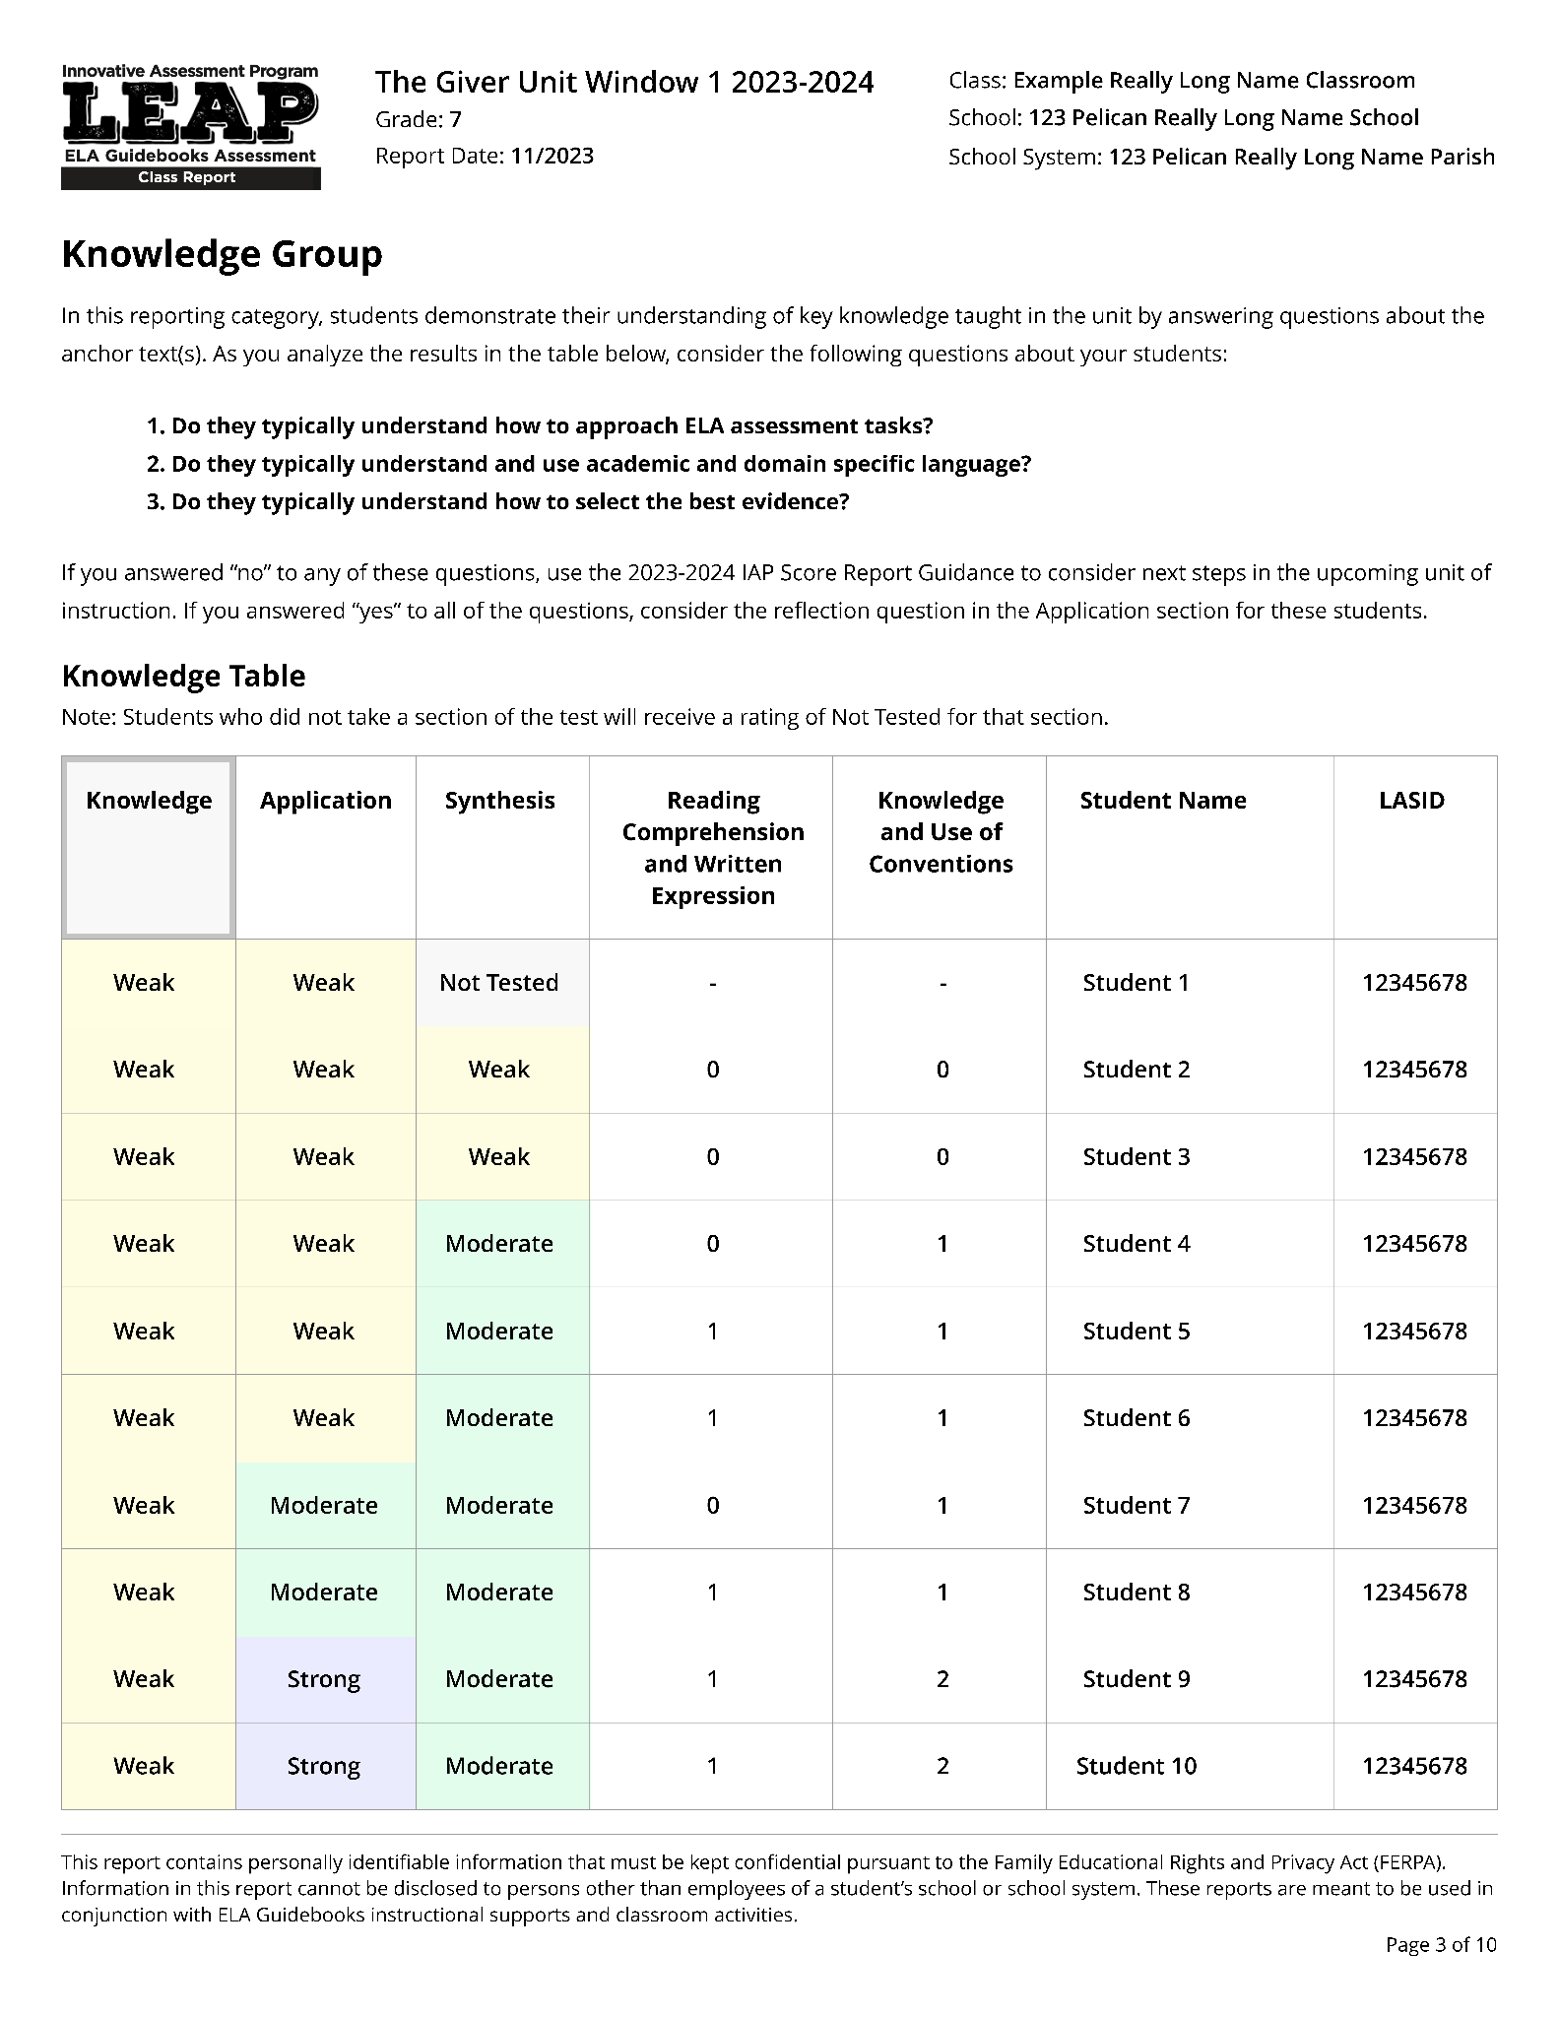
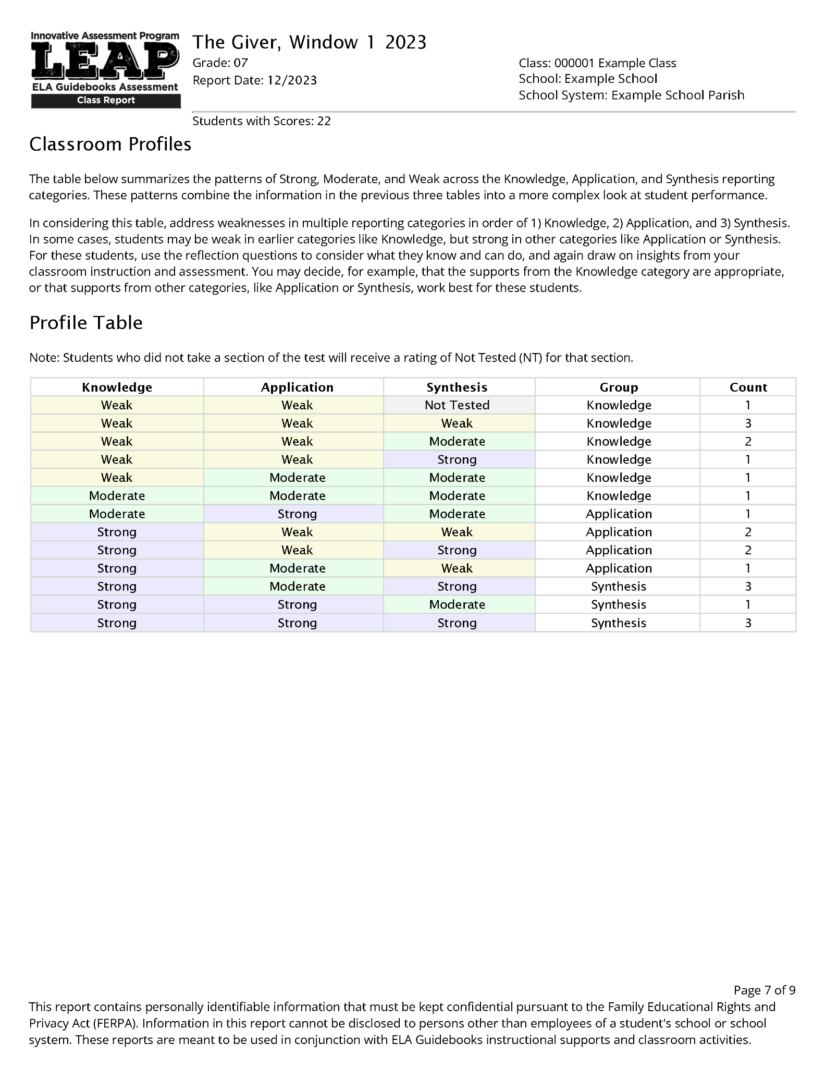
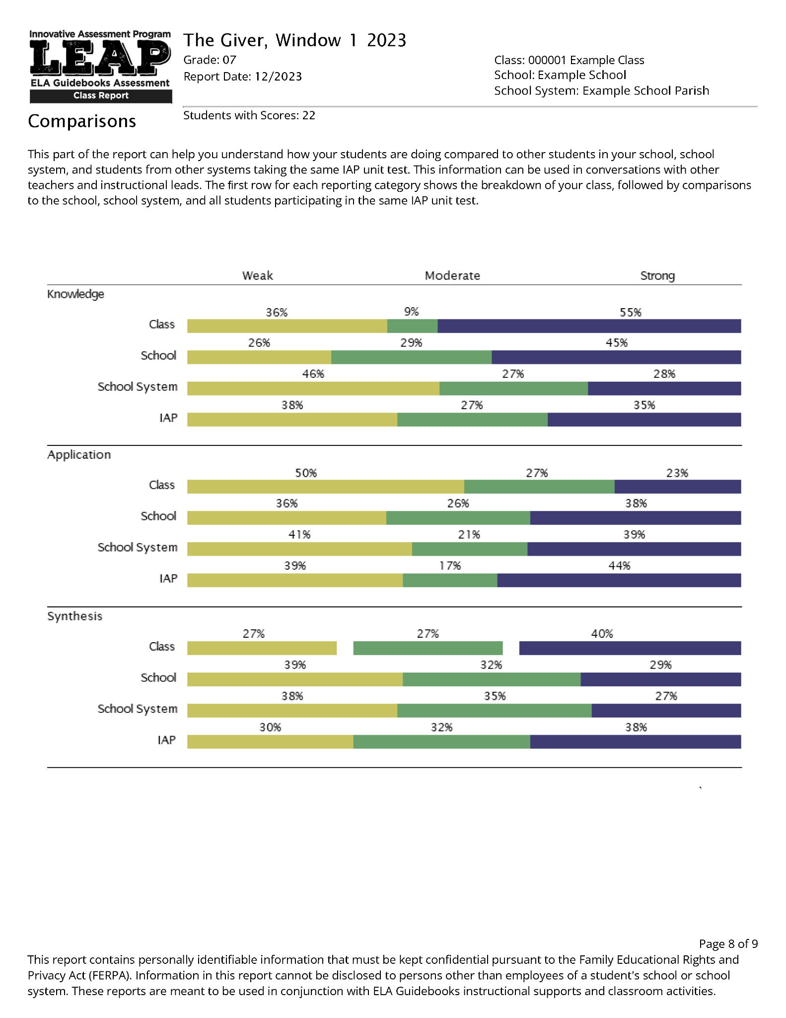
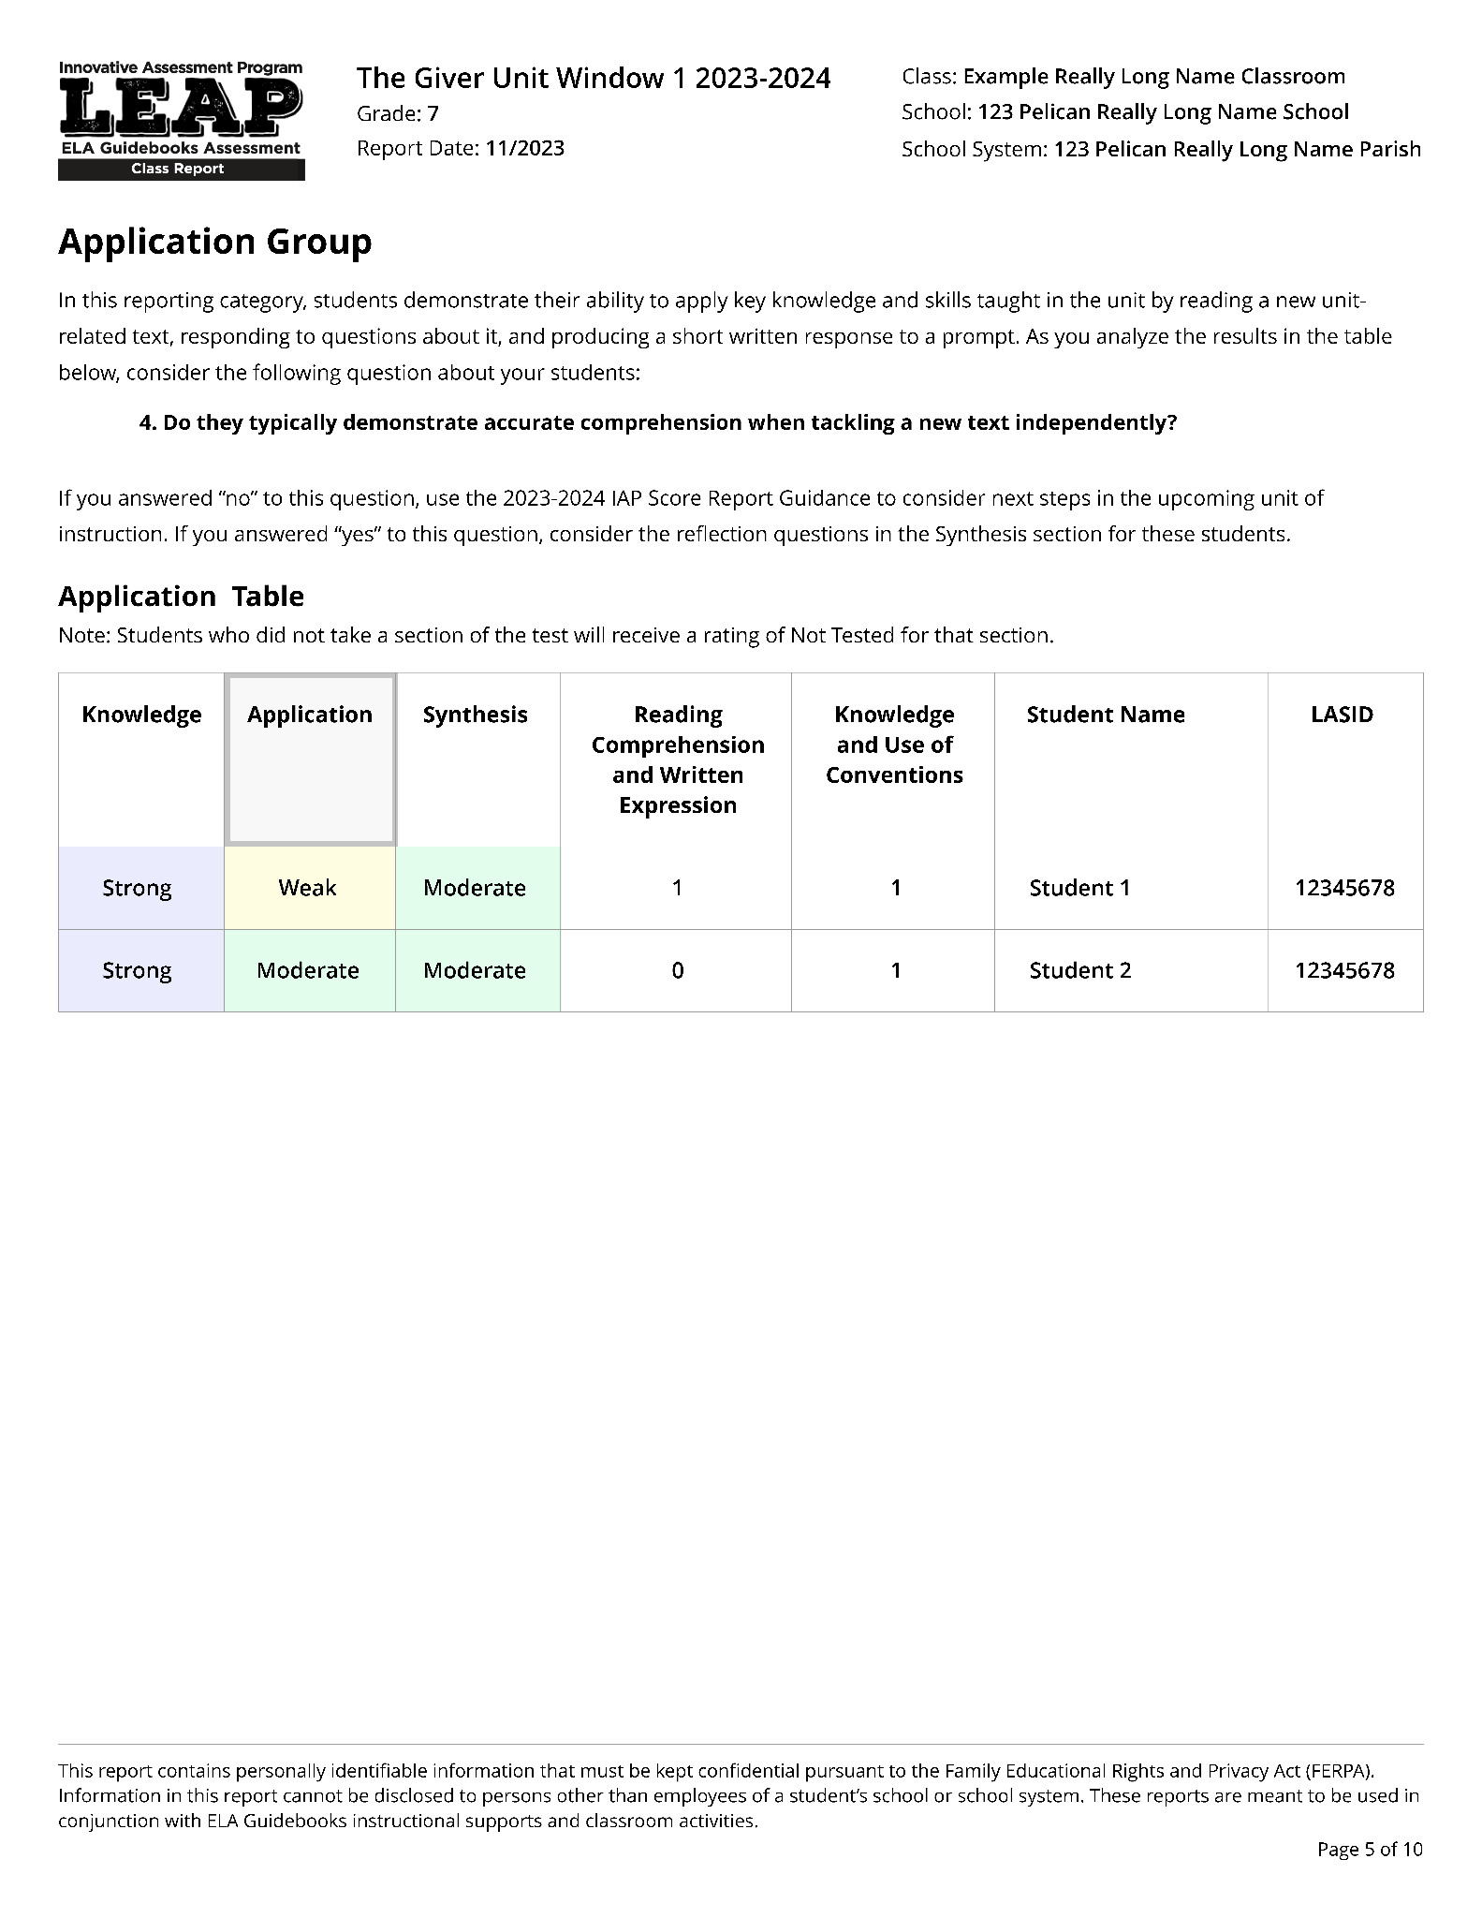
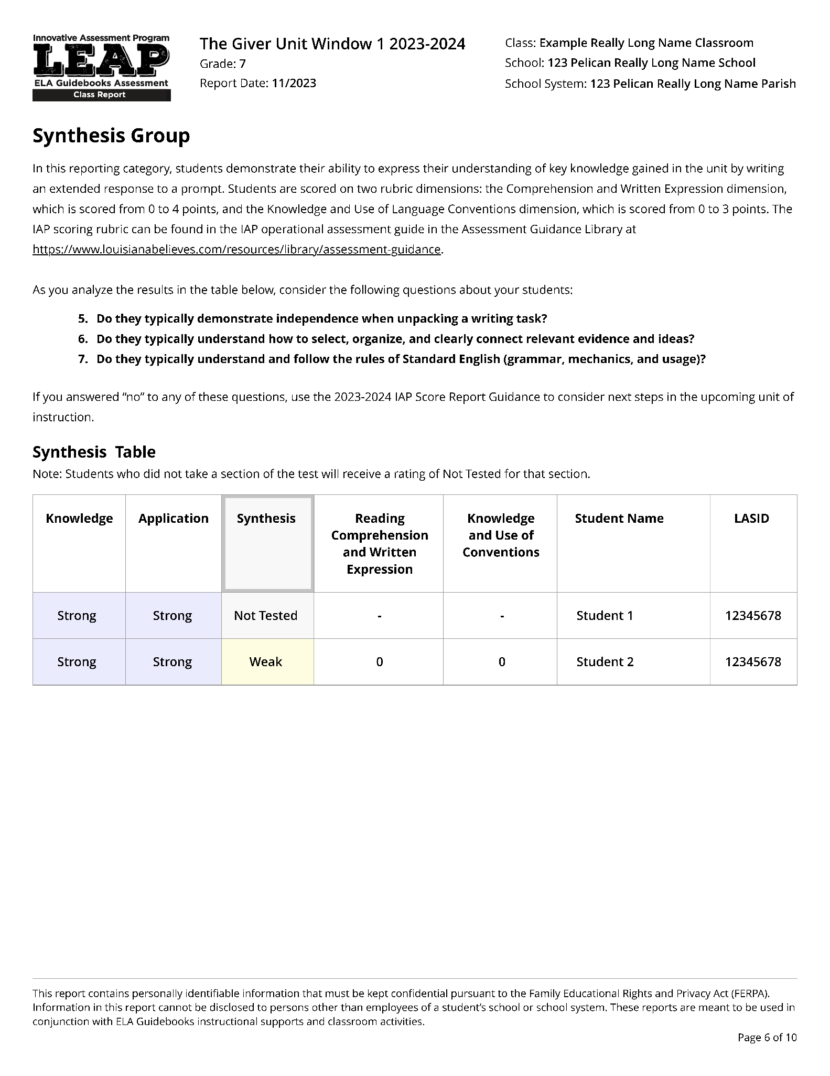
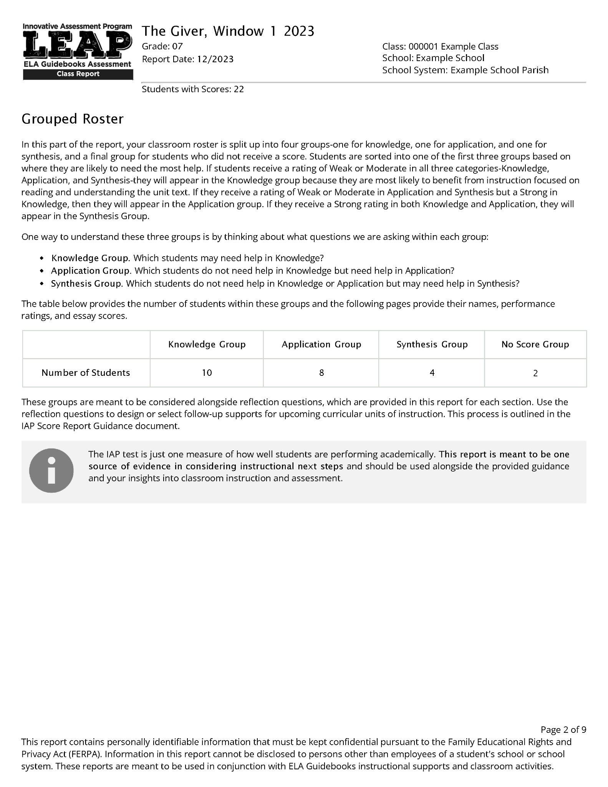
The Classroom Score Report
The new 2023-24 classroom score report is made up of four sections.
Overall Results
Grouped Roster
Classroom Profiles
Comparisons
Notes:
Duration: 10 seconds
Facilitator says: There are four sections, each one with a specific purpose.

Slide 11
The Classroom Score Report
The new 2023-24 classroom score report is made up of four sections.
Overall Results
Grouped Roster
Classroom Profiles
Comparisons
Notes:
Duration: 15 seconds
Facilitator says: We will start with the Overall Results. You might want to pause the video and make sure that you have your own copy - or a sample copy of a classroom score report to refer to. Feel free to pause the video at any time to look at your copy. And note that there are several opportunities throughout this video where we will offer you a chance to pause and respond to a question.

Slide 12
Overall Results
This report shows the number of students in each reporting category, at each of three performance ratings.
Notes:
Duration: 10 seconds
Facilitator says: The overall results section provides a summary picture of the number of students in each reporting category at each of three performance ratings.

Slide 13
Knowledge: how well your students understand the texts studied in class
Application: how well your students understand a new text or texts related to the ideas studied in class
Synthesis: how well your students write about the texts studied in class and the new text
Notes:
Duration: 1 minute
NOTE THERE IS AN ANIMATION ON THIS SLIDE.
Facilitator says: Student performance is reported in three categories:
(Click) Knowledge: is about how well your students understood the texts studied in class. This category is based on a section of the assessment in which your students answered questions about the text(s) read in class to show their understanding of key knowledge and skills taught in the unit.
(Click) Application: is about how well your students understood a new text related to the ideas studied in class. In this section of the assessment your students read a new text or texts related to what they learned in class and then responded to questions and a writing prompt, to show how well they can apply the key knowledge and skills taught in the unit.
(Click) Synthesis: is about how well your students can write about the texts studied in class and the new text. In this section of the assessment your students wrote an extended response that demonstrates their ability to express their overall understanding of the key knowledge they gained in the unit by developing their ideas with information they recall from the unit texts and details from the new text(s) provided on the test.

Slide 14
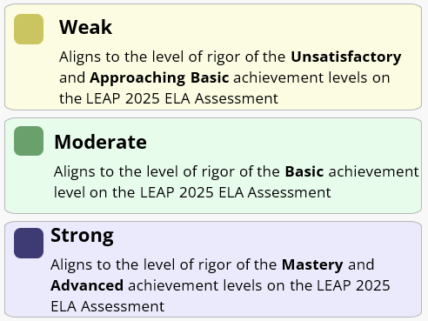
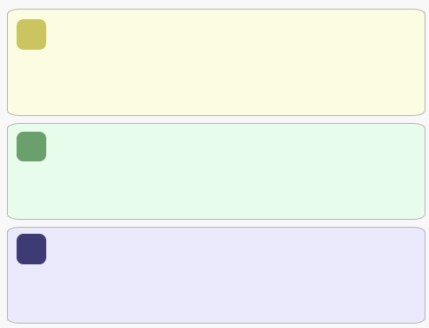
Overall Results
Each of these categories has three performance ratings that correspond to LEAP 2025:
Weak
Aligns to the level of rigor of the Unsatisfactory/Approaching Basic achievement levels on LEAP 2025
Moderate
Aligns to the level of rigor of the Basic achievement level on LEAP 2025
Strong
Aligns to the level of rigor of the Mastery/ Advanced achievement levels on LEAP 2025
Notes:
Duration: 10 seconds
Facilitator says: Within each reporting category, students are classified as performing either at a weak, moderate or strong level, which correspond to the LEAP 2025 achievement levels.

Slide 15
Overall Results
22 Students with scores in this class
Notes:
Duration: 5 seconds
Facilitator says: Notice that there are 22 students with scores in this class, and later we will learn that there are two additional students who did not test, but were included with this class code.

Slide 16
Overall Results
Pause the video: Describe how the 22 students performed on each section of the assessment.
Notes:
Duration: 10 seconds
Facilitator says: Pause the video here and look at how the 22 students performed on the three assessment sections. Take some time and describe what you see.

Slide 17
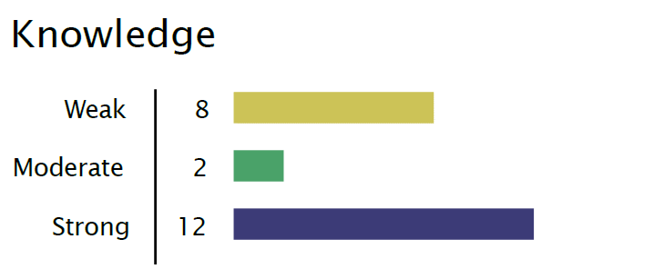
Overall Results
You might have noticed:
  8 students scored Weak in Knowledge
  2 students scored Moderate in Knowledge, and
  12 students scored Strong in Knowledge
Notes:
Duration: 30 seconds
Facilitator says: You might have noticed that 8 students scored weak in knowledge, 2 students scored moderate in knowledge and 12 students scored strong in knowledge. Each of these sections summarizes the performance of all of the 22 students in the class with scores.

Slide 18
The Classroom Score Report
The new 2023-24 classroom score report is made up of four sections.
Overall Results
Grouped Roster
Classroom Profiles
Comparisons
Notes:
Duration: 10 seconds
Facilitator says: Now that we have looked at the overall results section, we are going to look at the Grouped Roster.

Slide 19
The Grouped Roster
Students are placed into groups.
Within each group, students needs are likely similar, which can help teachers plan future instruction.
Notes:
Duration: 30 seconds
Facilitator says: The Grouped Roster divides up the students within the class into four groups: one for knowledge, one for application, one for synthesis, and a final group for students who did not receive a score. These groups are meant to help teachers plan future instruction. For example, students in the Knowledge group most likely need help understanding the texts read in class and questions asked about them.

Slide 20
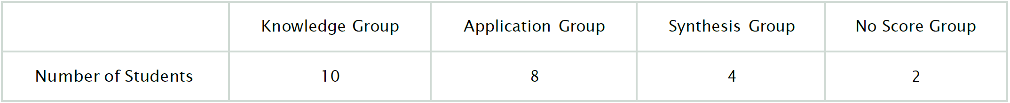
The Grouped Roster
Students are placed into groups.
Within each group, students needs are likely similar, which can help teachers plan future instruction.
Of the 22 Students with scores in the class:
10
8
4
2
Notes:
Duration: 30 seconds
NOTE THERE IS AN ANIMATION ON THIS SLIDE.
Facilitator says: If we zoom in, we can see that there are 10 students in the knowledge group. These students most likely need help understanding the texts read in class and questions asked about them. Moving on, we can also see that there are 8 students in the Application group, and these students most likely need help reading new texts independently, as well as relating the ideas in new texts to what they’ve learned in class. Next to last, we can see 4 students in the synthesis group, who most likely need help writing, and in particular, by drawing on their knowledge to write about the texts.
Students are sorted into the groups based on their performance ratings on each reporting category. Where did these numbers come from? Let’s walk through how students are grouped next.

Slide 21
Knowledge | Application | Synthesis | Reading Comp. and Written Expression | Knowledge and Use of Conventions | Student Name | LASID
Weak | Weak | Not Tested | - | - | STUDENT 1 | 1234567891
Weak | Weak | Weak | 0 | 1 | STUDENT 2 | 1234567891
Weak | Weak | Weak | 0 | 1 | STUDENT 3 | 1234567891
Weak | Weak | Weak | 0 | 1 | STUDENT 4 | 1234567891
Weak | Weak | Moderate | 2 | 2 | STUDENT 5 | 1234567891
Weak | Weak | Moderate | 2 | 3 | STUDENT 6 | 1234567891
Weak | Weak | Strong | 4 | 2 | STUDENT 7 | 1234567891
Weak | Moderate | Moderate | 2 | 1 | STUDENT 8 | 1234567891
Moderate | Moderate | Moderate | 2 | 3 | STUDENT 9 | 1234567891
Moderate | Strong | Moderate | 2 | 3 | STUDENT 10 | 1234567891
Strong | Weak | Weak | 0 | 1 | STUDENT 11 | 1234567891
Strong | Weak | Weak | 0 | 0 | STUDENT 12 | 1234567891
Strong | Weak | Strong | 4 | 3 | STUDENT 13 | 1234567891
Strong | Weak | Strong | 2 | 3 | STUDENT 14 | 1234567891
Strong | Moderate | Weak | 0 | 1 | STUDENT 15 | 1234567891
Strong | Moderate | Strong | 4 | 2 | STUDENT 16 | 1234567891
Strong | Moderate | Strong | 4 | 2 | STUDENT 17 | 1234567891
Strong | Moderate | Strong | 8 | 2 | STUDENT 18 | 1234567891
Strong | Strong | Moderate | 4 | 1 | STUDENT 19 | 1234567891
Strong | Strong | Strong | 4 | 2 | STUDENT 20 | 1234567891
Strong | Strong | Strong | 4 | 2 | STUDENT 21 | 1234567891
Strong | Strong | Strong | 6 | 2 | STUDENT 22 | 1234567891
-- | -- | -- | -- | -- | STUDENT 23 | 1234567891
-- | -- | -- | -- | -- | STUDENT 24 | 1234567891
10 Students Are Placed Into the Knowledge Group
8 Students Are Placed Into the Application Group
4 Students Are Placed Into the Synthesis Group
2 students in the No Score Group
Notes:
Duration: 30 seconds
NOTE THERE IS AN ANIMATION ON THIS SLIDE.
Facilitator says: These groups were created by first sorting the class roster based on performance on each of the three categories, starting with Knowledge and sorting from weak to strong, then repeating that sorting with Application and finally Synthesis.
(click) Then the 10 students who have a rating of Weak or Moderate on Knowledge are placed into the knowledge group. After that, (click) the 8 students who have a rating of Weak or Moderate on Application are placed into the Application group. (click) The remaining 4 students with scores are placed into the Synthesis group. Finally, (click) the 2 students without scores are placed into the no score group.

Slide 22
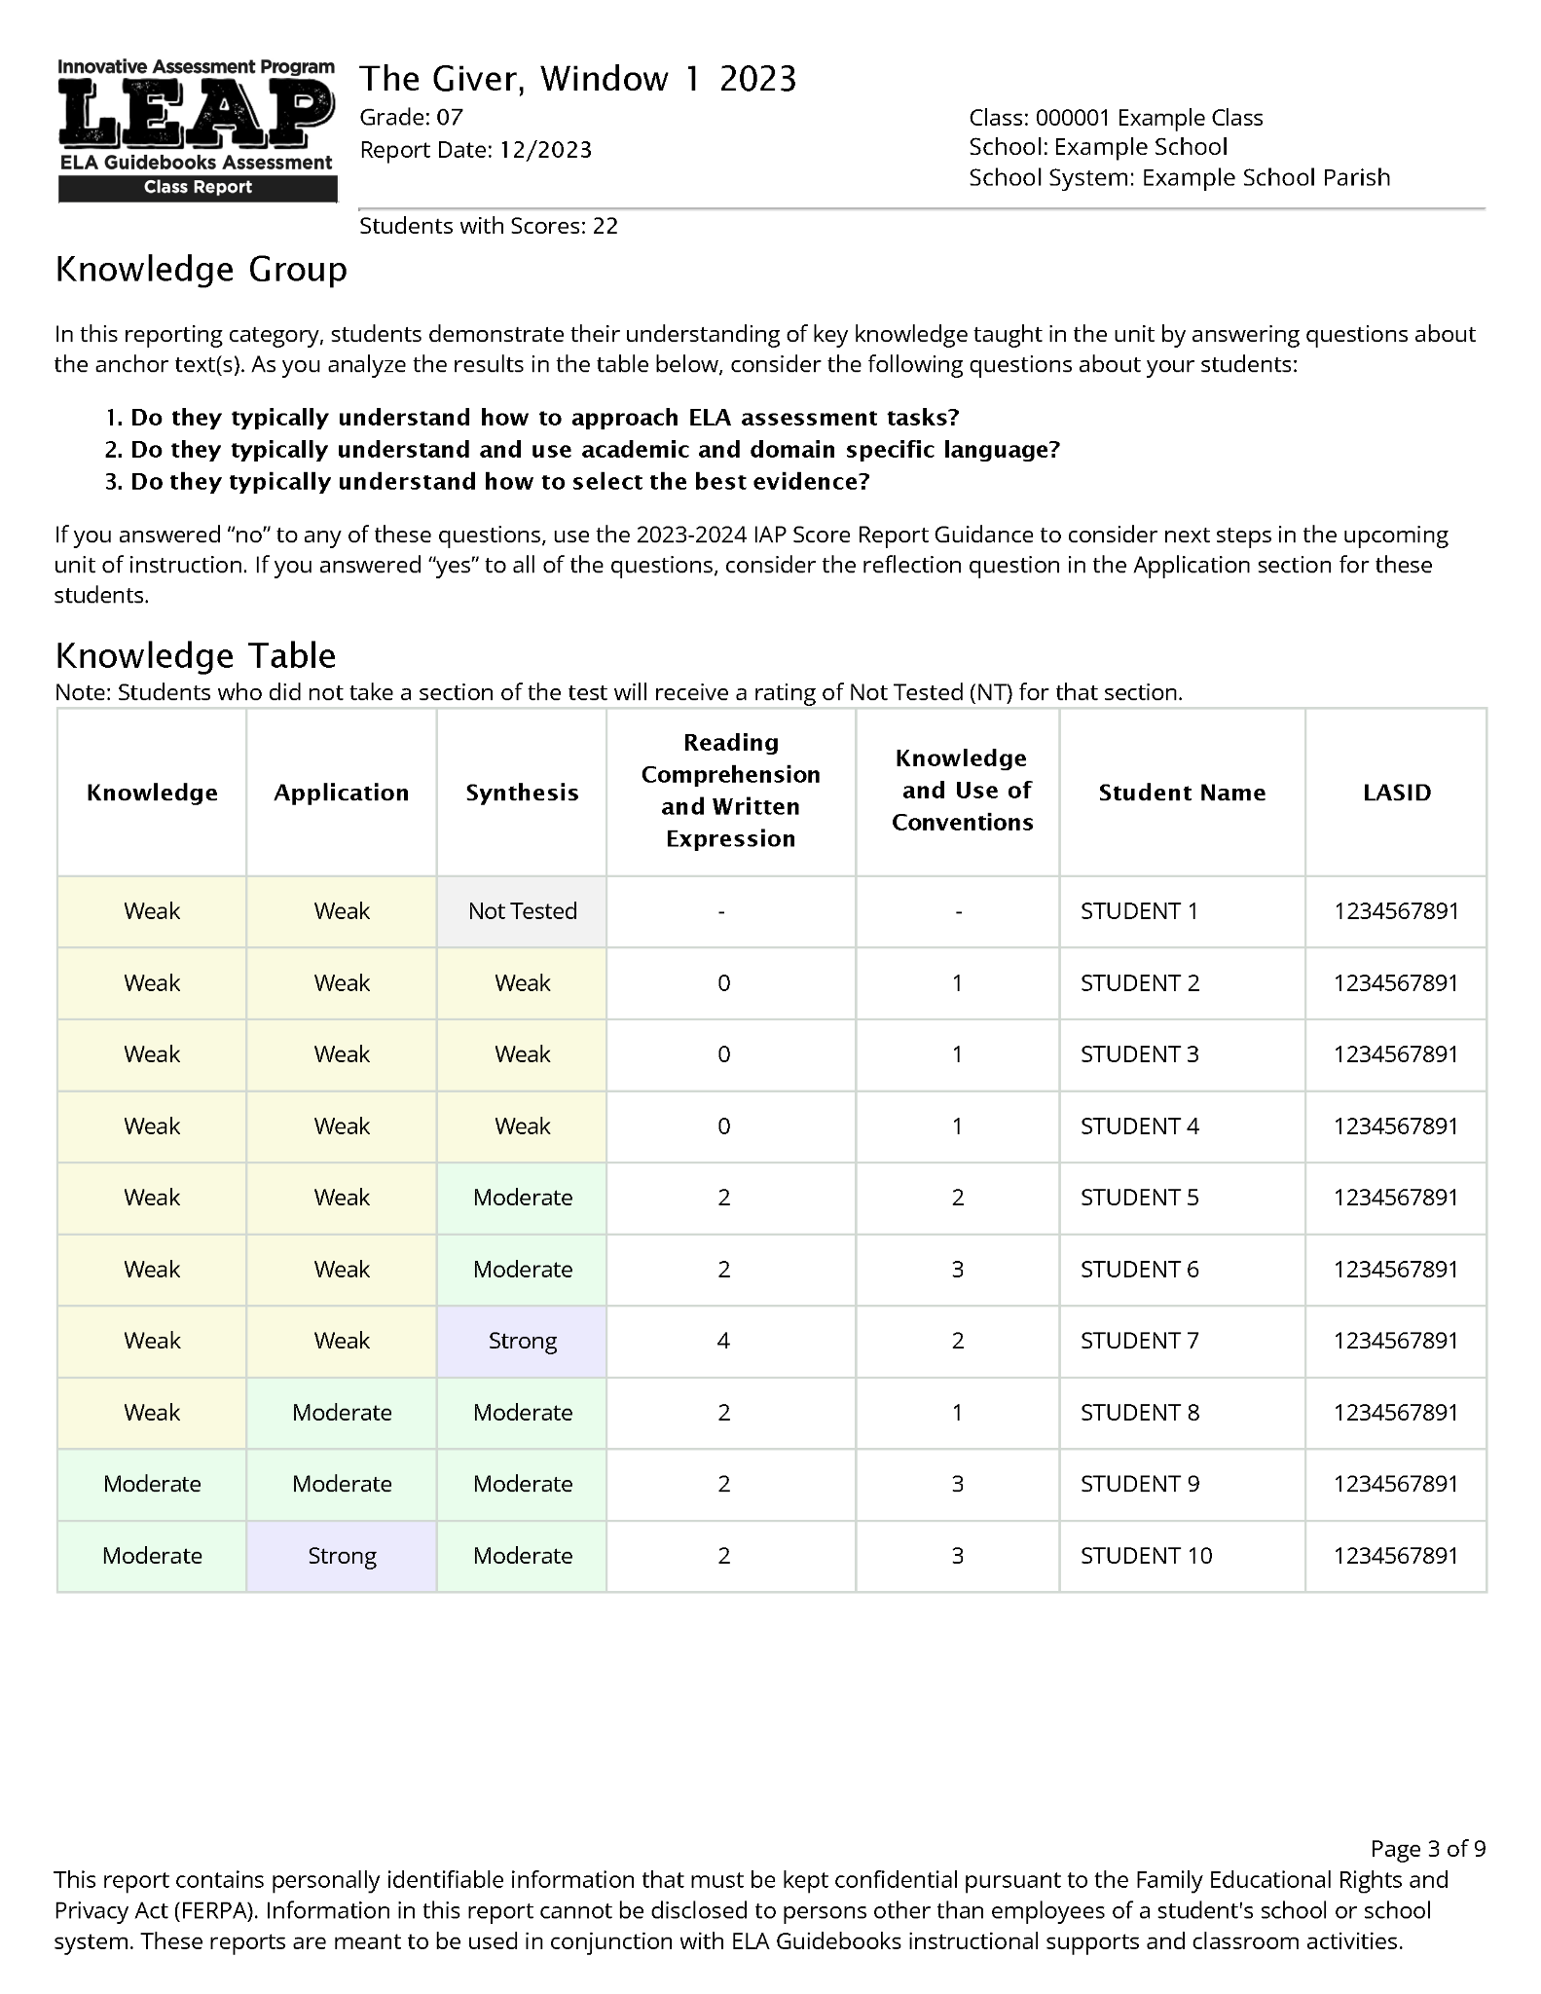
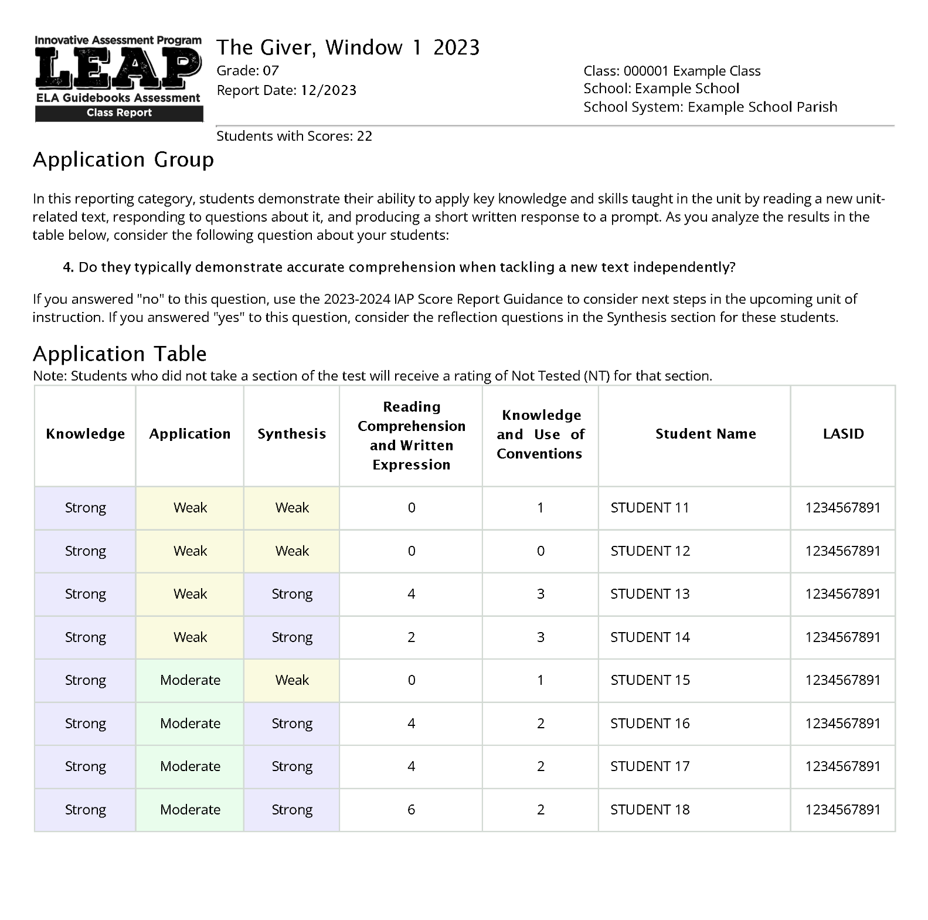
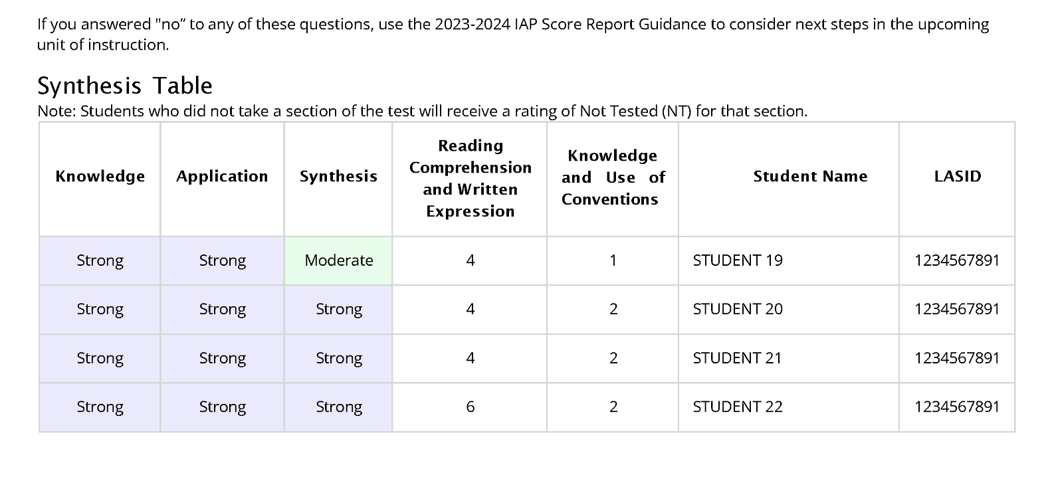
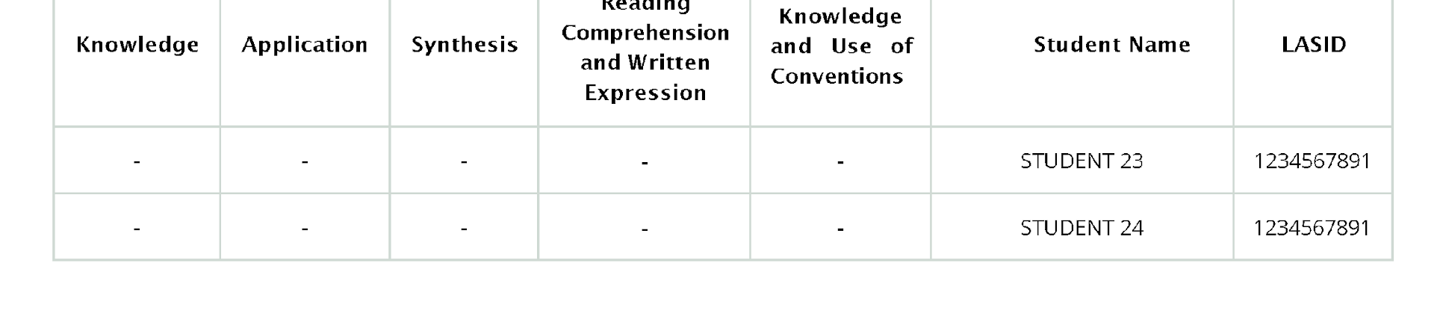
Knowledge | Application | Synthesis | Reading Comp. and Written Expression | Knowledge and Use of Conventions | Student Name | LASID
Weak | Weak | Not Tested | - | - | STUDENT 1 | 1234567891
Weak | Weak | Weak | 0 | 1 | STUDENT 2 | 1234567891
Weak | Weak | Weak | 0 | 1 | STUDENT 3 | 1234567891
Weak | Weak | Weak | 1 | 1 | STUDENT 4 | 1234567891
Weak | Weak | Moderate | 2 | 2 | STUDENT 5 | 1234567891
Weak | Weak | Moderate | 2 | 3 | STUDENT 6 | 1234567891
Weak | Weak | Strong | 4 | 2 | STUDENT 7 | 1234567891
Weak | Moderate | Moderate | 2 | 1 | STUDENT 8 | 1234567891
Moderate | Moderate | Moderate | 2 | 3 | STUDENT 9 | 1234567891
Moderate | Strong | Moderate | 2 | 3 | STUDENT 10 | 1234567891
Strong | Weak | Weak | 0 | 1 | STUDENT 11 | 1234567891
Strong | Weak | Weak | 0 | 0 | STUDENT 12 | 1234567891
Strong | Weak | Strong | 4 | 3 | STUDENT 13 | 1234567891
Strong | Weak | Strong | 2 | 3 | STUDENT 14 | 1234567891
Strong | Moderate | Weak | 0 | 1 | STUDENT 15 | 1234567891
Strong | Moderate | Strong | 3 | 2 | STUDENT 16 | 1234567891
Strong | Moderate | Strong | 4 | 2 | STUDENT 17 | 1234567891
Strong | Moderate | Strong | 4 | 2 | STUDENT 18 | 1234567891
Strong | Strong | Moderate | 4 | 1 | STUDENT 19 | 1234567891
Strong | Strong | Strong | 4 | 2 | STUDENT 20 | 1234567891
Strong | Strong | Strong | 4 | 2 | STUDENT 21 | 1234567891
Strong | Strong | Strong | 6 | 2 | STUDENT 22 | 1234567891
-- | -- | -- | -- | -- | STUDENT 23 | 1234567891
-- | -- | -- | -- | -- | STUDENT 24 | 1234567891
10 Students Are Placed Into the Knowledge Group
8 Students Are Placed Into the Application Group
4 Students Are Placed Into the Synthesis Group
2 students in the No Score Group
Notes:
Duration: 5 seconds
Facilitator says: Each of these groups of students are shown in their own table within the Grouped Roster section.

Slide 23
Knowledge | Application | Synthesis | Reading Comp. and Written Expression | Knowledge and Use of Conventions | Student Name | LASID
Weak | Weak | Not Tested | - | - | STUDENT 1 | 1234567891
Weak | Weak | Weak | 0 | 1 | STUDENT 2 | 1234567891
Weak | Weak | Weak | 0 | 1 | STUDENT 3 | 1234567891
Weak | Weak | Weak | 1 | 1 | STUDENT 4 | 1234567891
Weak | Weak | Moderate | 2 | 2 | STUDENT 5 | 1234567891
Weak | Weak | Moderate | 2 | 3 | STUDENT 6 | 1234567891
Weak | Weak | Strong | 4 | 2 | STUDENT 7 | 1234567891
Weak | Moderate | Moderate | 2 | 1 | STUDENT 8 | 1234567891
Moderate | Moderate | Moderate | 2 | 3 | STUDENT 9 | 1234567891
Moderate | Strong | Moderate | 2 | 3 | STUDENT 10 | 1234567891
Strong | Weak | Weak | 0 | 1 | STUDENT 11 | 1234567891
Strong | Weak | Weak | 0 | 0 | STUDENT 12 | 1234567891
Strong | Weak | Strong | 4 | 3 | STUDENT 13 | 1234567891
Strong | Weak | Strong | 2 | 3 | STUDENT 14 | 1234567891
Strong | Moderate | Weak | 0 | 1 | STUDENT 15 | 1234567891
Strong | Moderate | Strong | 3 | 2 | STUDENT 16 | 1234567891
Strong | Moderate | Strong | 4 | 2 | STUDENT 17 | 1234567891
Strong | Moderate | Strong | 4 | 2 | STUDENT 18 | 1234567891
Strong | Strong | Moderate | 4 | 1 | STUDENT 19 | 1234567891
Strong | Strong | Strong | 4 | 2 | STUDENT 20 | 1234567891
Strong | Strong | Strong | 4 | 2 | STUDENT 21 | 1234567891
Strong | Strong | Strong | 6 | 2 | STUDENT 22 | 1234567891
-- | -- | -- | -- | -- | STUDENT 23 | 1234567891
-- | -- | -- | -- | -- | STUDENT 24 | 1234567891
10 Students Are Placed Into the Knowledge Group
8 Students Are Placed Into the Application Group
4 Students Are Placed Into the Synthesis Group
2 students in the No Score Group
Notes:
Duration: 15 seconds
Facilitator says: After the summary of the groups on the first page of the grouped roster, there are individual tables for groups of students that show the score profiles for those students. The table for the Knowledge Group is shown here on the left.
Remember, the 10 students in the Knowledge group scored weak or moderate in the Knowledge section, and so this table shows how they scoredon both Knowledge as well as on the other sections.
Before each of the tables, there are a few reflection questions which are meant to help guide considerations of what supports are likely to be most helpful to students. Session 6 will talk about these questions that also appear in the Score Report Reflections Guide and how they might be used to inform teaching in the current unit.

Slide 24
The Grouped Roster - Group Tables
10 Students Are Placed Into the Knowledge Group
These 10 students may have different ratings, on Application and Synthesis, as well as the rubric scores, but are all Weak or Moderate on Knowledge.
Notes:
Duration: 15 seconds
NOTE THERE IS AN ANIMATION ON THIS SLIDE.
Facilitator says: Remember, the 10 students in the Knowledge group scored weak or moderate in the Knowledge section, and this table shows their results in knowledge, as well as for Application, Synthesis and the rubric dimensions of the essay used to produce the synthesis rating.
(click) Let’s zoom in on student 5 to make sure we are all on the same page about what the report is telling us.

Slide 25
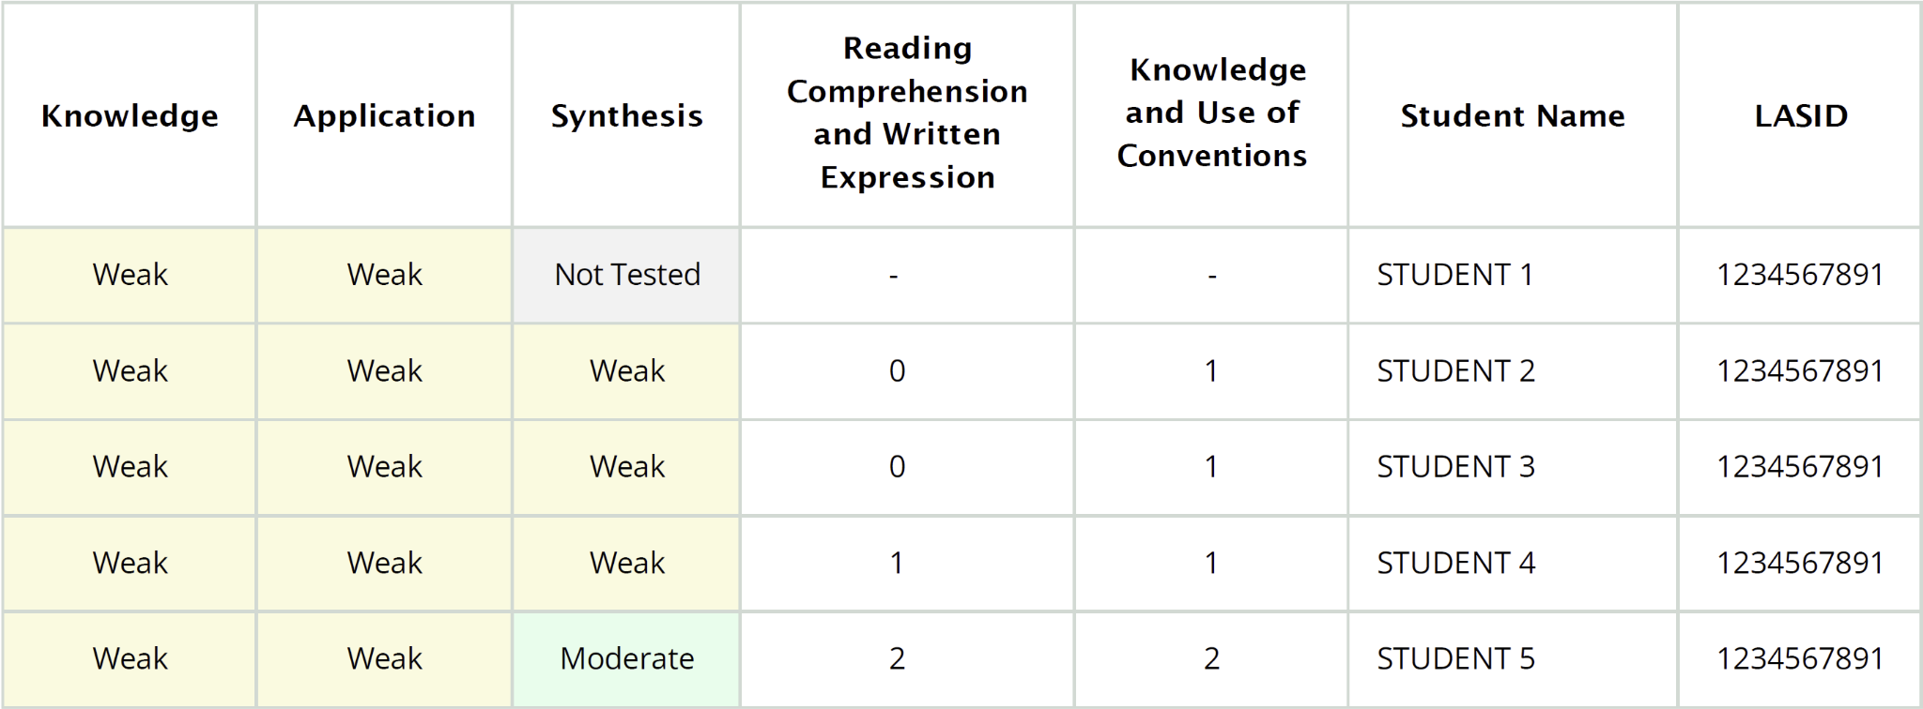
The Grouped Roster - Student Data
Reporting Category Ratings
Reading Comprehension and Written Expression (RCWE) Rubric Score x 2
Knowledge and Use of Language Conventions Rubric Score
Notes:
Duration: 45 seconds
NOTE THERE IS AN ANIMATION ON THIS SLIDE.
Facilitator says: On this slide we can see the results for student 5. (click) The first three columns contain the performance ratings - strong, moderate and weak - on the three reporting categories - knowledge, application and synthesis. Next we can see the scores on the essay that makes up the synthesis reporting category. (click) The score provided within the Reading Comprehension and Written Expression column is the rubric score, which is scored from 0 to 4 points, times by 2. So this student who has a score of 2 received a 1 on the rubric. Finally, (click) the Knowledge and Use of Language Conventions column provides the rubric score for the dimension without any adjustments.

Slide 26
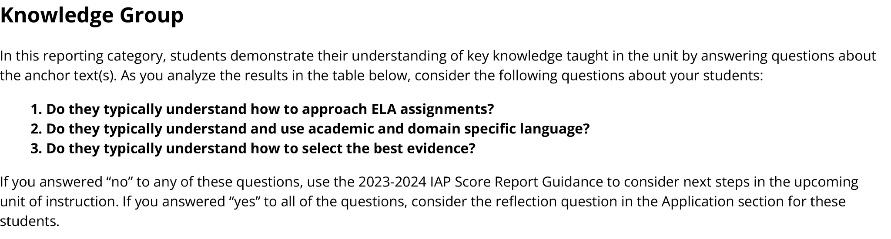
The Grouped Roster - Reflection Questions
These reflection questions are connected to the Score Report Reflections Guide, which is addressed in the next module.
Notes:
Duration: 15 seconds
Facilitator says: Before each of the tables, there are reflection questions which are meant to help guide considerations of what supports are likely to be most helpful to this group of students. These questions are also in the Score Report Reflections Guide and connect to instructional next steps, or “levers” for instruction.

Slide 27
The Classroom Score Report
The new 2023-24 classroom score report is made up of four sections.
Overall Results
Grouped Roster
Classroom Profiles
Comparisons
Notes:
Duration: 10 seconds
Facilitator says: Now we will move on to the Classroom Profiles section of the report.

Slide 28
Classroom Profiles
This section is meant to provide a more detailed summary of your classroom, while also connecting to the prior sections of the report.
Notes:
Duration: 30 seconds
NOTE THERE IS AN ANIMATION ON THIS SLIDE.
Facilitator says: The Grouped Roster section that we just reviewed put students into three groups based on where they were most likely to need help. The profile section, instead, shows the number of students for each unique combination of ratings for the three categories. This collapses the roster table into the unique patterns of ratings on the Knowledge, Application and Synthesis.
(click) So we can see that there are three students who have Weak in all three reporting categories, and we’ll walk through how we got that count on the next slide.

Slide 29
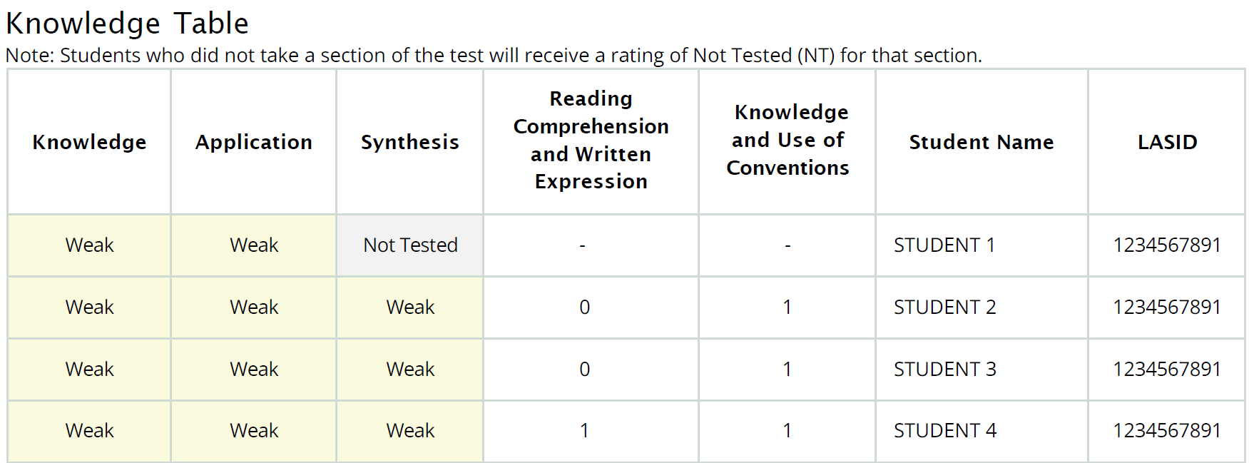
Classroom Profiles
Notes:
Duration: 15 seconds
Facilitator says: The top of this slide shows the data for all three students who scored weak in all three reporting categories. The profile table collapses this data into a count, and shows the number of students for each unique pattern. This is a finer-grained grouping of students than was shown in the Grouped Rosters.

Slide 30
The Classroom Score Report
The new 2023-24 classroom score report is made up of four sections.
Overall Results
Grouped Roster
Classroom Profiles
Comparisons
Notes:
Duration: 5 seconds
Facilitator says: Finally we will look at the Comparisons section of the report.

Slide 31
Comparisons
This part of the report compares the percentages of students in each rating for each category for your classroom to other groups of students participating in the IAP.
Pause the video: Describe how the class in this report compared to other groups of students in one or more sections.
Notes:
Duration: 20 seconds
Facilitator says: This is an opportunity to see how your class of students compared to the school, school system and IAP. Pause the video and take a few moments to describe how the class in this report compared to other groups of students in one or more sections. After you restart the video I’ll note what I noticed.

Slide 32
Comparisons
You might have noticed things like more students in the class were rated “strong” compared to the school or IAP in the knowledge category.
What do you notice in the report?
Notes:
Duration: 30 seconds
Facilitator says: This comparison report might help you ask more questions. For example, why did this class perform better than the school as a whole in knowledge?

Slide 33
Agenda Items
1. Context
2. The 2023-24 Classroom Score Report
3. The 2023-24 Student Score Report
4. Wrap Up
Notes:
Duration: 10 seconds
Facilitator says: Now that we’ve reviewed the classroom score report, we will take a little bit of time to review the student score report.

Slide 34
Student Report
Provides student level information in terms of:
the three reporting categories,
the performance ratings,
with additional information on:
  what the students are able to do, and what they may need help doing
  comparisons to other groups
Notes:
Duration: 45 seconds
Facilitator says: The student report provides the same information as the classroom report, specifically performance on each of the three reporting categories - Knowledge, Application and Synthesis - and their performance ratings - Strong, Moderate or Weak. This report is meant to be sent home with students to provide parents and caregivers with an update about how their student is doing. Ideally, this information can foster productive conversations between students and their parents or caregivers, and also support engagement between teachers, students, parents and caregivers.

Slide 35
Student Report
Notes:
Duration: 60 seconds
Facilitator says: In addition to ratings for each category, the report also provides information on what a student at that level is able to do, and what they still may need help doing. In the example shown on the screen, you can see that a student who scored moderate on Application is likely able to identify main ideas in a new text and determine meanings of key words and phrases, but may need help analyzing complex text elements and providing supporting evidence when writing about a new text. This feedback was created through careful analysis of student data on the IAP. However, it may not fit every student. Some students who score moderate on Application may be able to analyze complex text elements, or may even struggle to identify main ideas within the new text. So this feedback is meant to be a starting point in considering what a student can do.
Finally, the student report also provides a comparison of student performance at the class, school, school system and overall IAP level.

Slide 36
Agenda Items
1. Context
2. The 2023-24 Classroom Score Report
3. The 2023-24 Student Score Report
4. Wrap Up
The IAP classroom score report provides data in ways that match what you are used to seeing--your classroom roster--but with reflection questions which are also included within the Score Report Reflections Guide (see session 6).
The student score report is designed to promote conversations that support student learning.
Notes:
Duration: 15 seconds
Facilitator says: This brings us to our final section of the session, which is a simple call out note that summarizes what we’ve learned.
AFTER ANIMATION: The IAP classroom score report was designed to provide data in ways that are meant to match what you are used to seeing - your classroom roster - but reorded in ways that hopefully support instructional next steps.An important part of the classroom score report, the reflection questions, are also within the Score Report Reflections Guide, which is the subject of the next learning module.
Finally, the student score report is designed to promote conversations between students, parents or caregivers, and teachers, in ways that support student learning.

Slide 37
For questions about the IAP, please contact
Ruth Caillouet, the Innovative Assessment Program Coordinator
Ruth.caillouet@la.gov
Send general assessment questions to
assessment@la.gov
Notes:
Thank you for your participation and partnership in the Innovative Assessment Program. The next session of the series will focus on the Score Report Reflections Guide.

